Slide 1
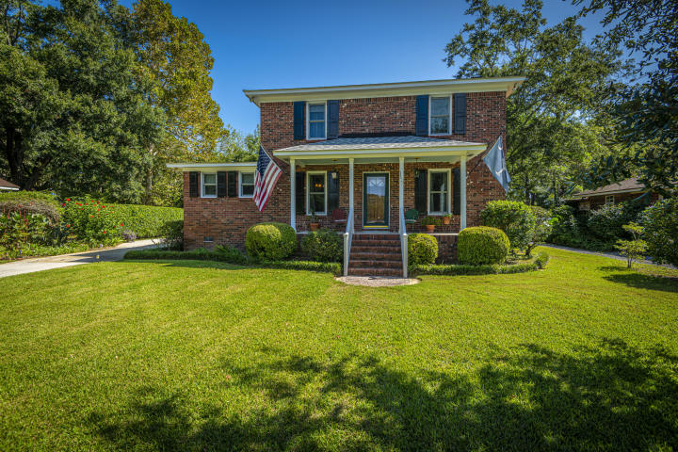
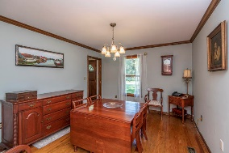
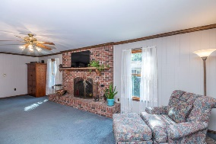
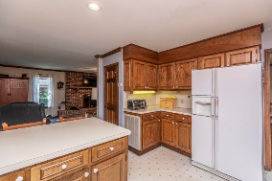
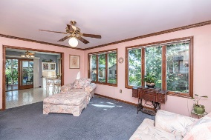
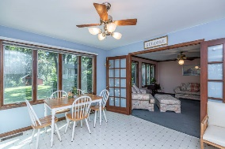
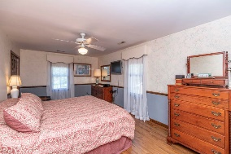
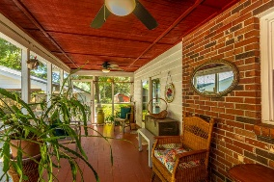
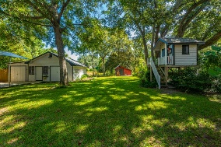
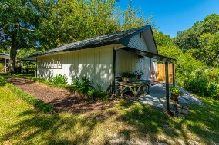
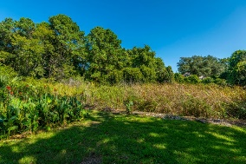
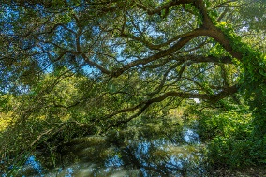
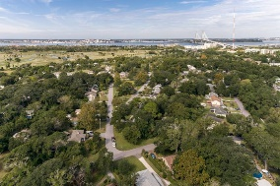


NEW LISTING – CONVENIENT LOCATION - INQUIRE NOW!
1127 Harborgate Drive
Bay View Acres
Mount Pleasant, SC 29464
MLS# 20026590
$880,000
4 Bedrooms | 2½ Baths | 2,970 sf
Bay View Acres. Great family -or young professional's- home in Charleston's most desired neighborhood. Mount Pleasant is the most sought after location in South Carolina. Walking distance to school, numerous restaurants and bars, including but not limited to Patriots Point activities and the Mount Pleasant Memorial Park, a private neighborhood access to our beloved Shem Creek Recreation area, and grocery stores, to name a few. The best view in Charleston is within steps of the front yard: The Ravenel Bridge. Straight shot to the beach, and downtown Charleston, think 7 miles. Skip the traffic commute and be home for Happy Hour! All brick with two stories and functional hurricane shutters, just under 3000 sq. ft.
This four bedroom, two and a half bath-home has plenty of room to spread out or be cozy. The kitchen has an ample pantry and an airy dining area plus, room at the counter so you can keep up with all that is going on around you, including enjoyment of the large fireplace on one wall of the living room. There is a separate dining room, and a sweet den with a wide open view of the private backyard with it's compound of three outbuildings and marsh front. Mature Oaks, azaleas, and camellias with an already installed well and sprinkler system will give you many hours of enjoyment in your yard. You will also enjoy an oversized laundry room, large screened side porch, and there is accessible attic storage space. Ample parking for multiple vehicles and/or a boat.
Three out buildings include an elevated child's playhouse, a small barn-like structure which has power and a 1200 sq. ft "shed" also wired and water supplied, with attic space for extra storage.
The neighborhood has a private park with updated playground equipment, a basketball court, tennis court and baseball/soccer field. There is also a private boat launch. There is no HOA. The Civic Club collects annual dues to host a few events each year and to maintain the neighborhood community properties, which include three entrances into (but not for cut through to anywhere else!) Bayview Acres from Coleman Boulevard.
They say the third time is the charm, but we dare you -as this home's third owners- to enjoy it more than the first two home lovers have. Shop and compare then check in, to see this great place to live in and love what you will be able to do to call it HOME!
Russ Whited
ABR, CRS, EPRO, GRI
O 843-725-6117 | M 843-200-9606
russ@ask4russ.com | www.ask4russ.com
AgentOwned Premiere Group | 100 Crowfield Blvd | Goose Creek, SC 29445-5337

