Slide 1
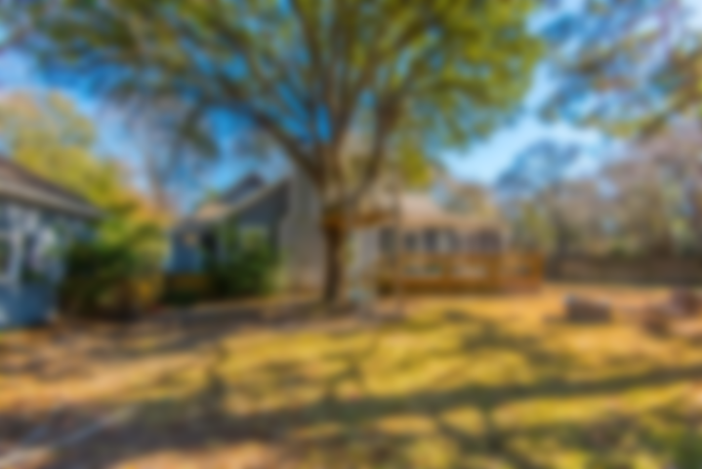
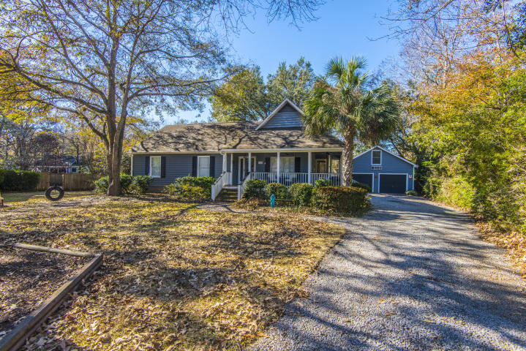
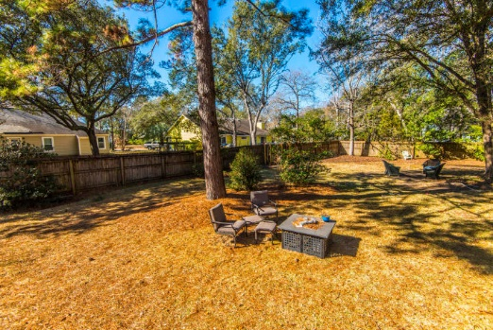
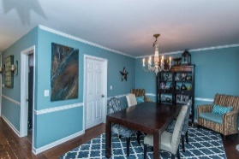
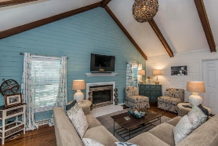
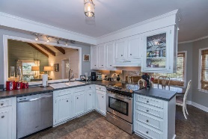
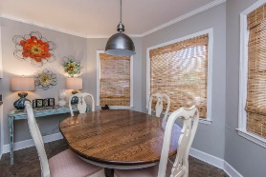
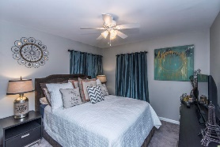
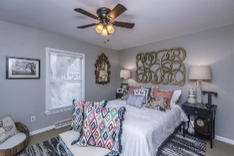
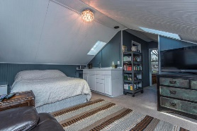
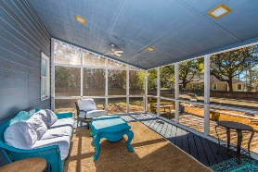
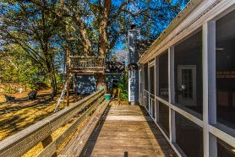
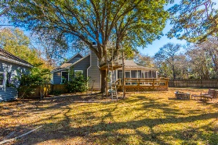


Ready to Sell in Snee Farm
1128 Clapper Court
Mount Pleasant, SC 29464 | MLS# 18001490 | $439,900
Open House
Saturday 3/24 & Sunday 3/25 2-4pm
Look at this 3 bedroom 2 bath home in Snee Farm just minutes from anything! This home features a formal dining room right off main entry. A beautiful eat in kitchen with breakfast nook and large sunken living room with vaulted ceiling and exposed beams. There is a master suite with large closet and master bath attached with stand up shower. Hall bathroom has a tub shower combination for soaking needs! There are also two nice sized guest rooms across from master. The garage offers 2 car parking and lots of storage space with an additional 318 square feet of living space with separate bathroom and entrance. The backyard is completely fenced in for privacy. A large screened in porch and deck completes this backyard oasis. This house is a must see!
Lauren Courcoux
Mobile - (843) 224-8613
lauren.courcoux@carolinaone.com
www.laurendelucacourcoux.com
Carolina One Real Estate | 2713 Highway 17 North | Mt Pleasant, SC 29466

