Slide 1
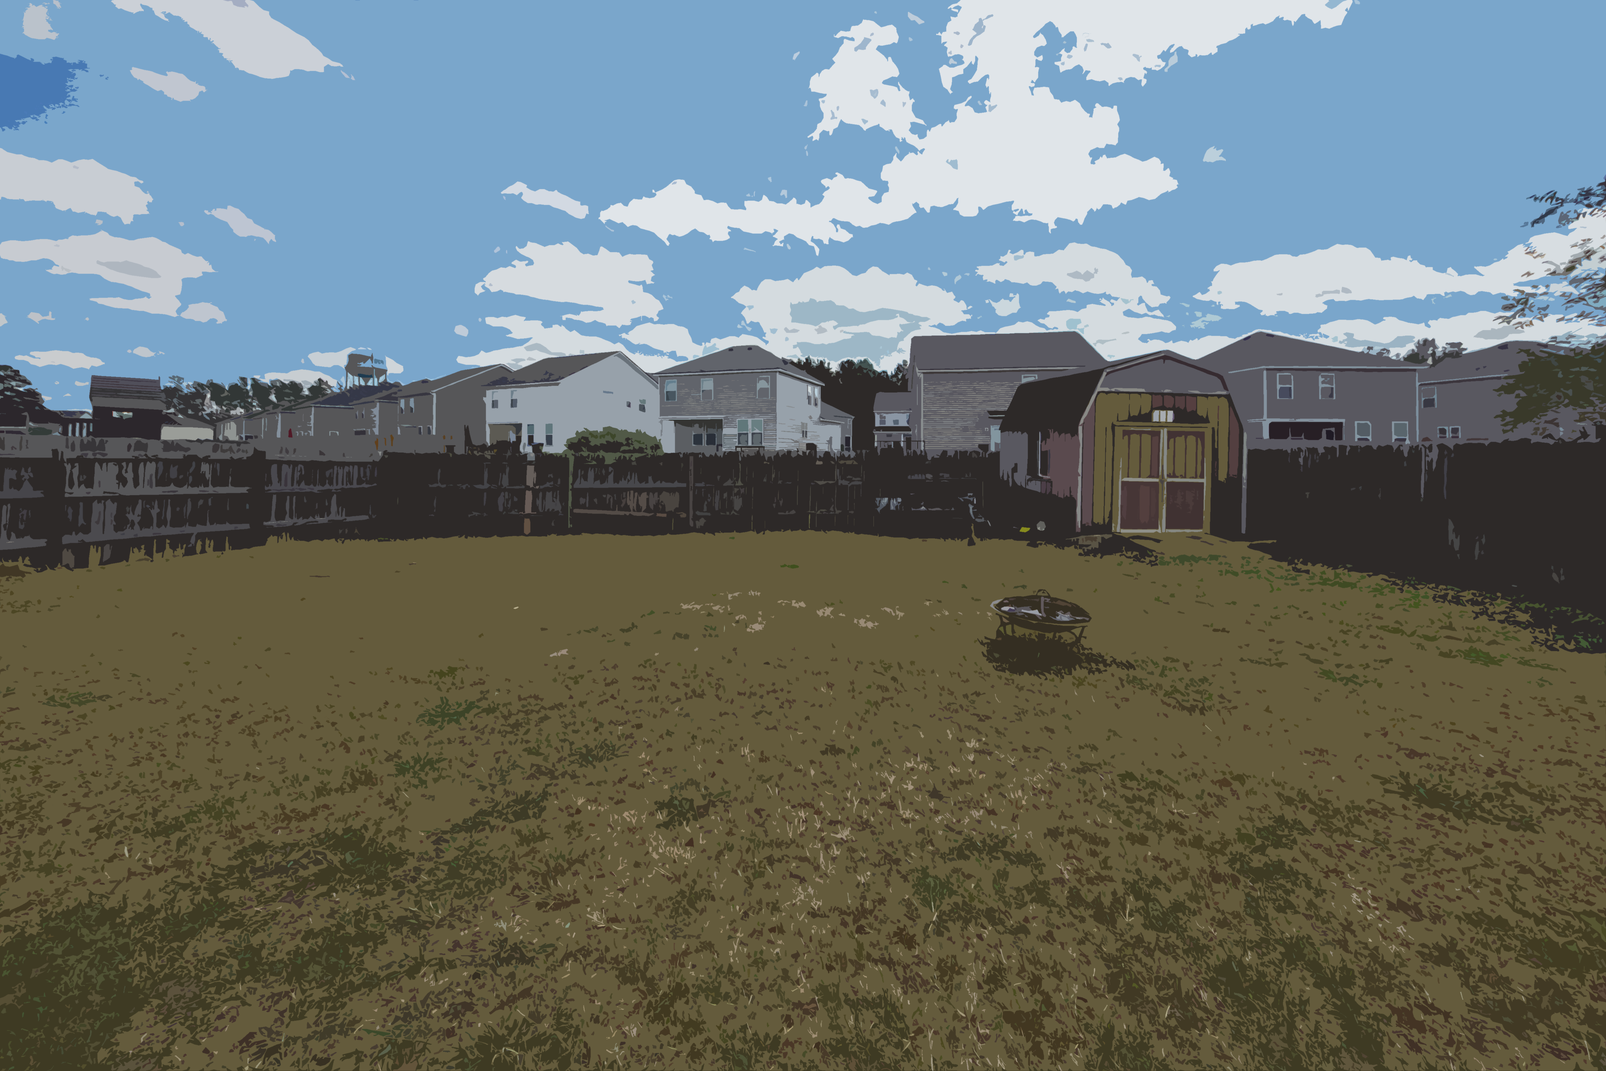
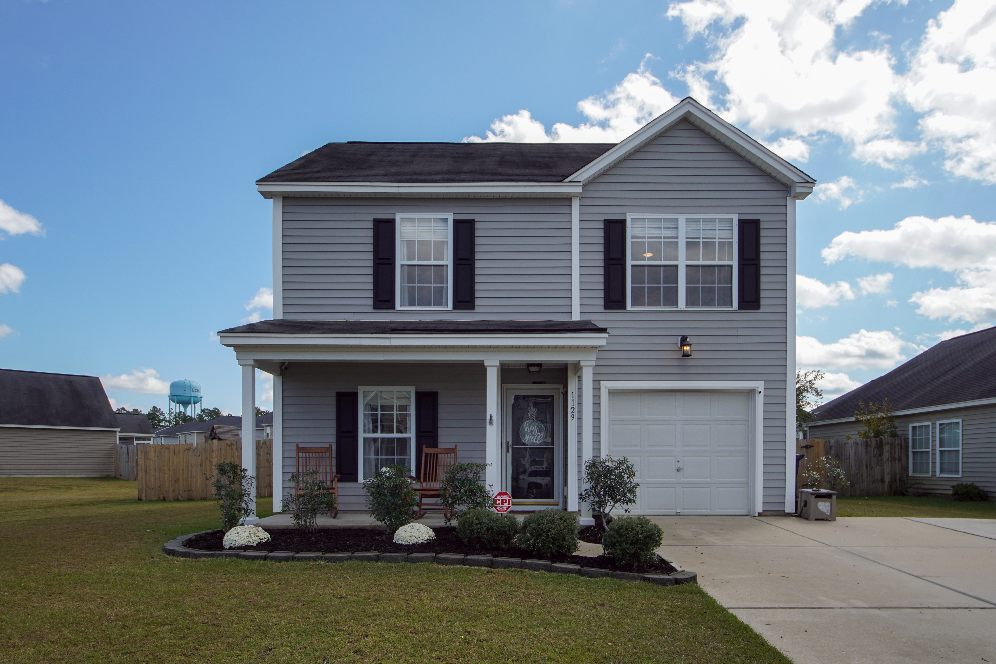
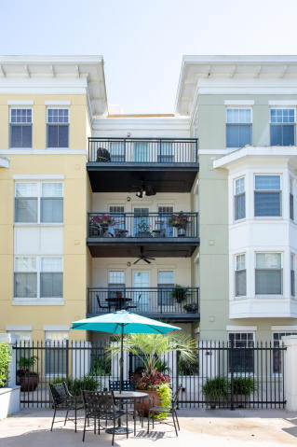
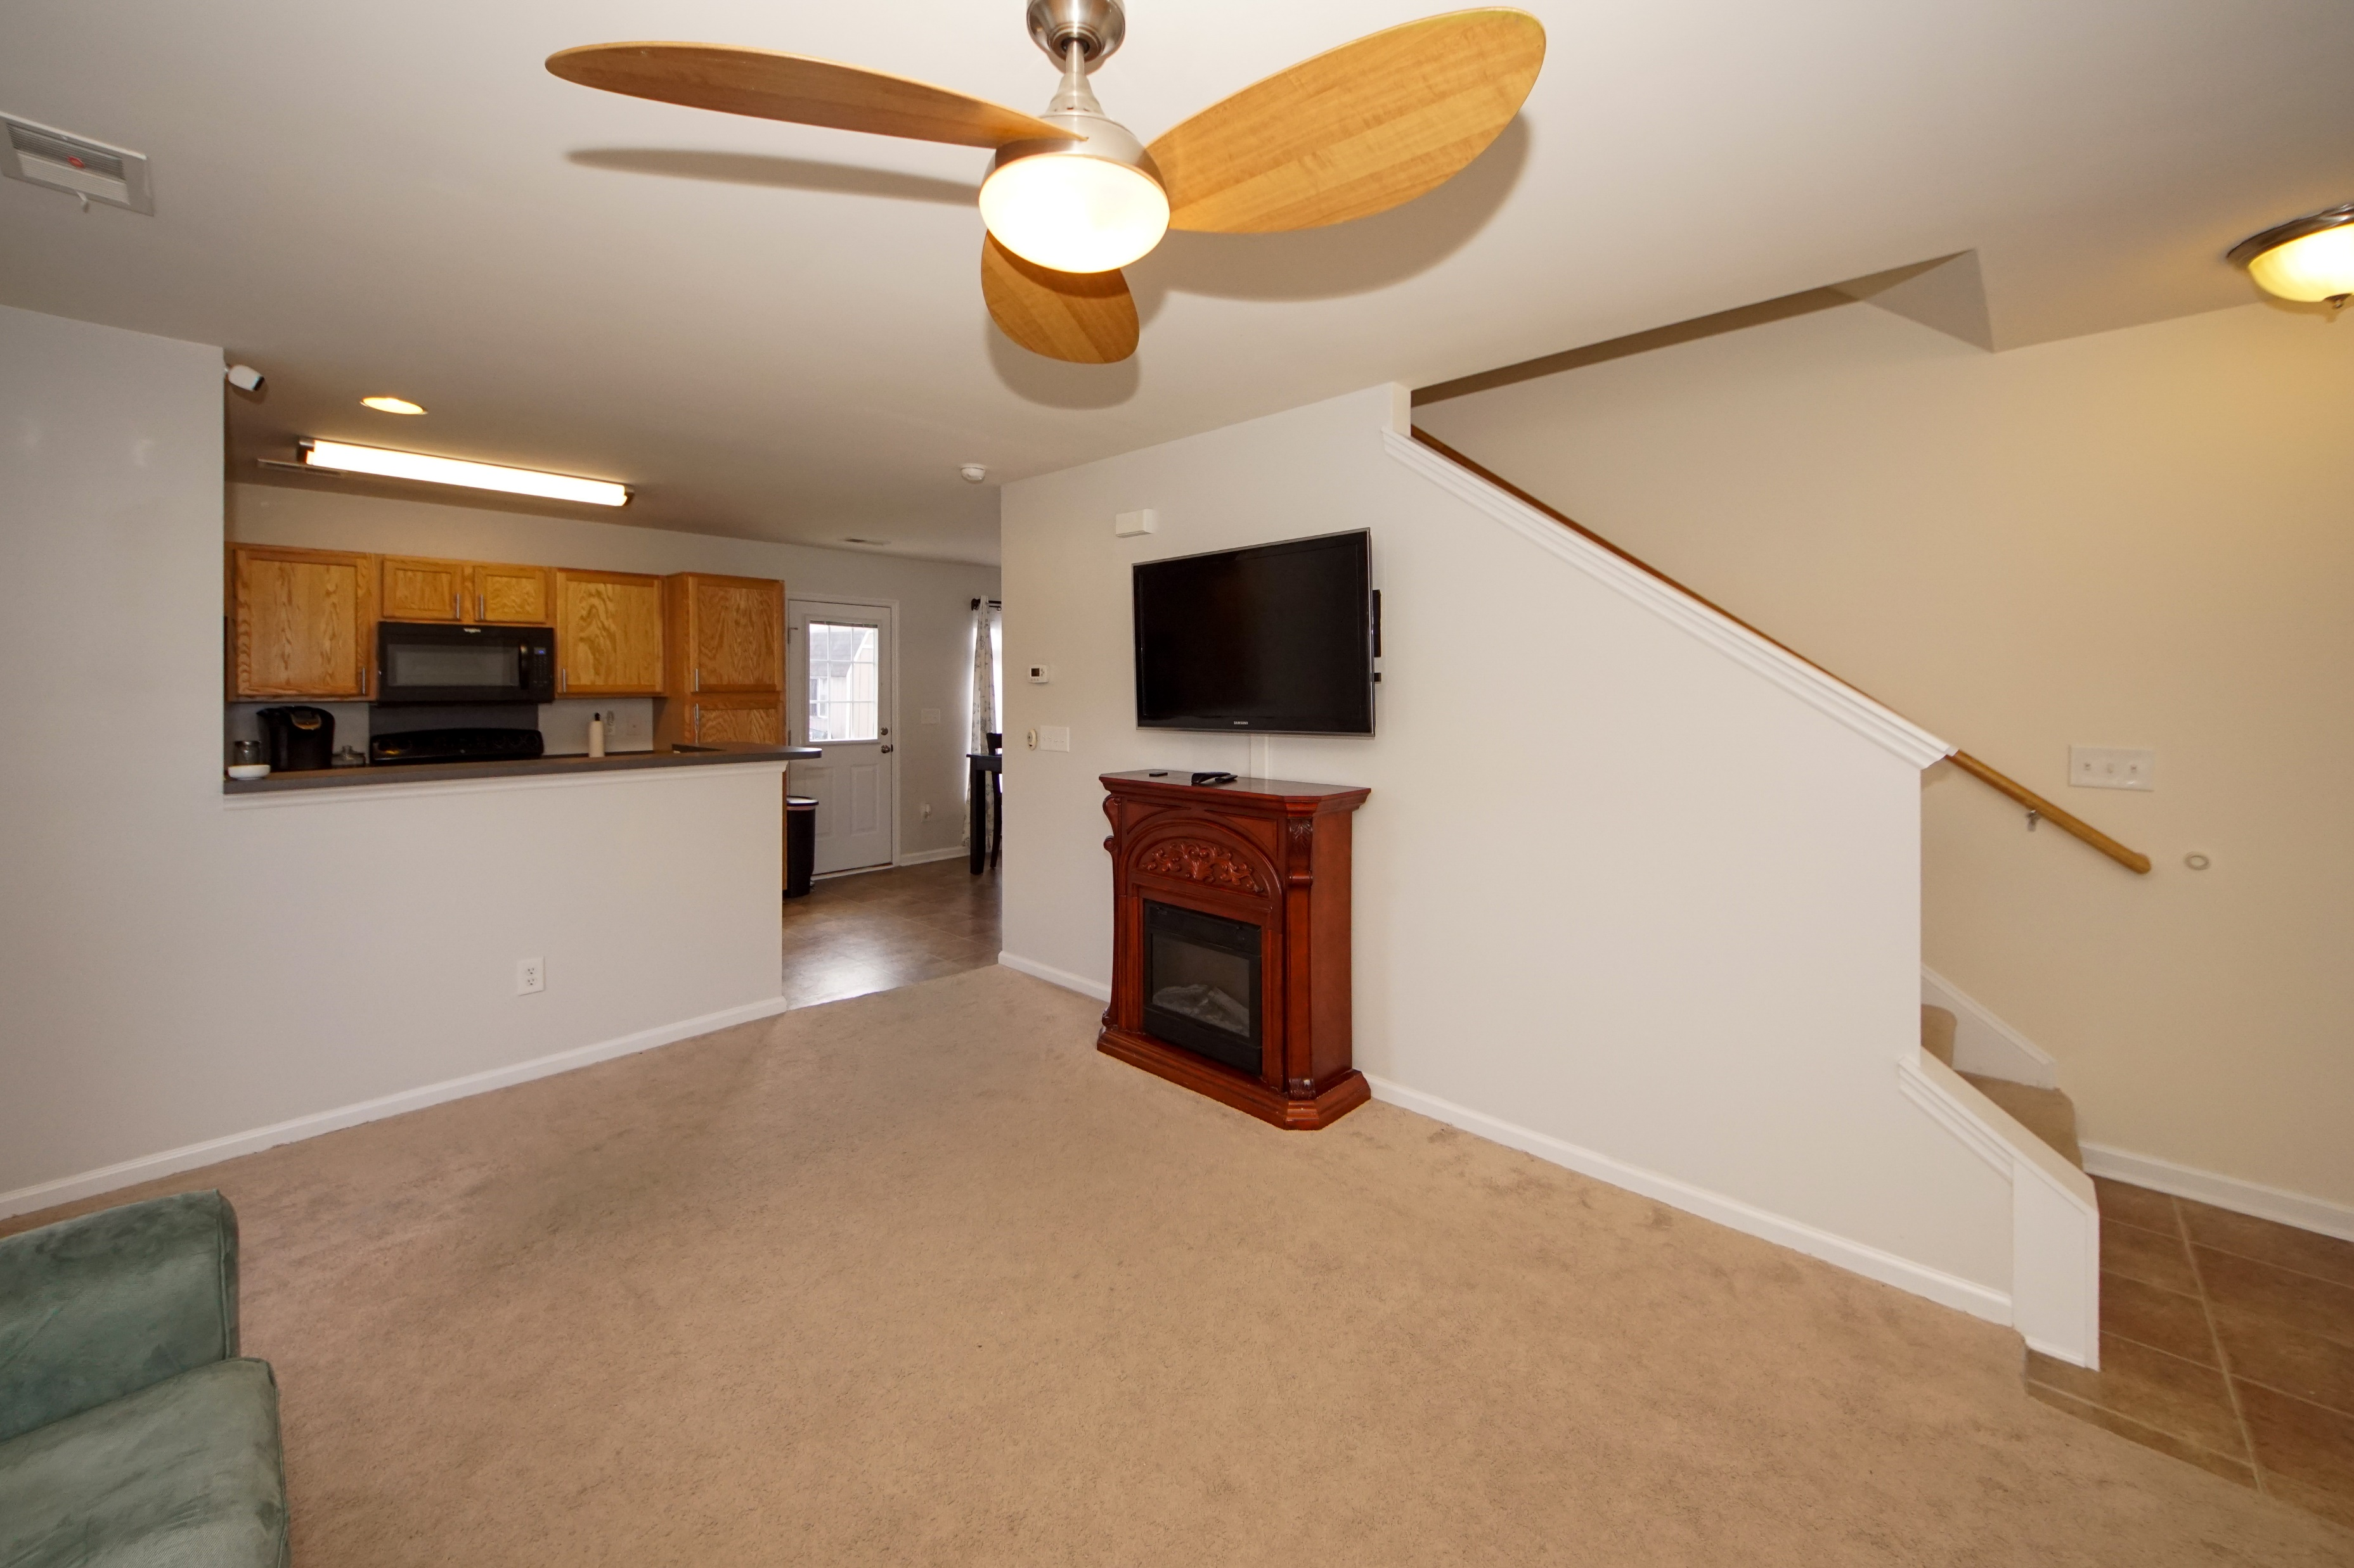
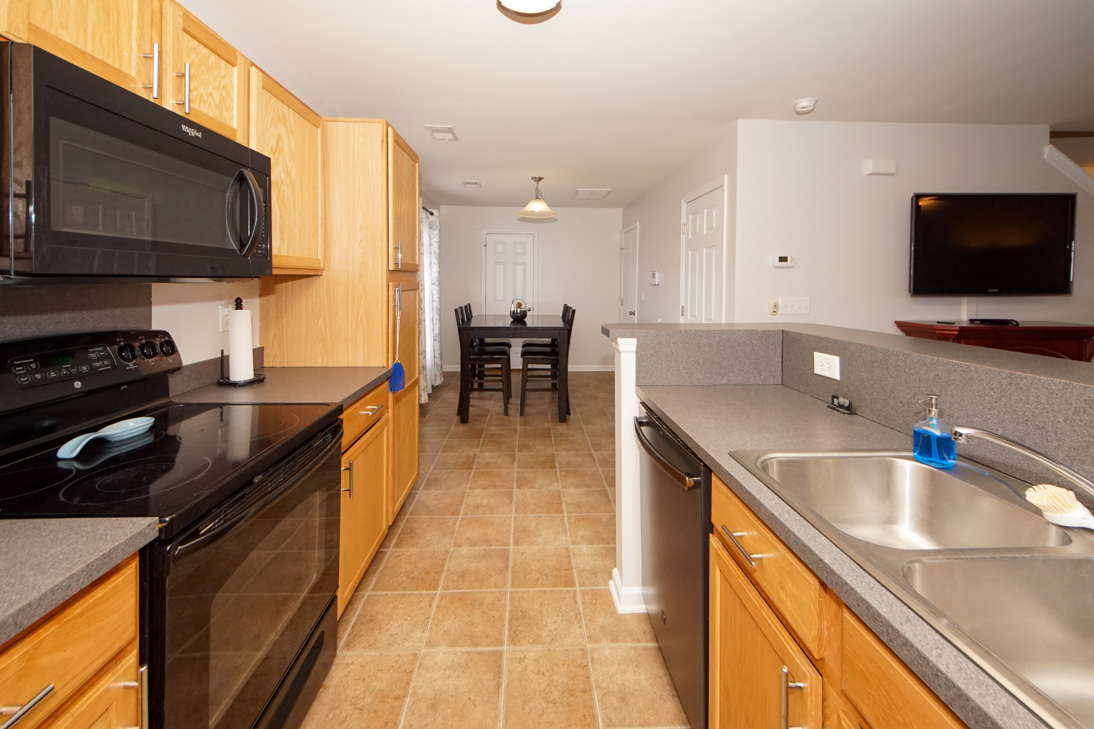
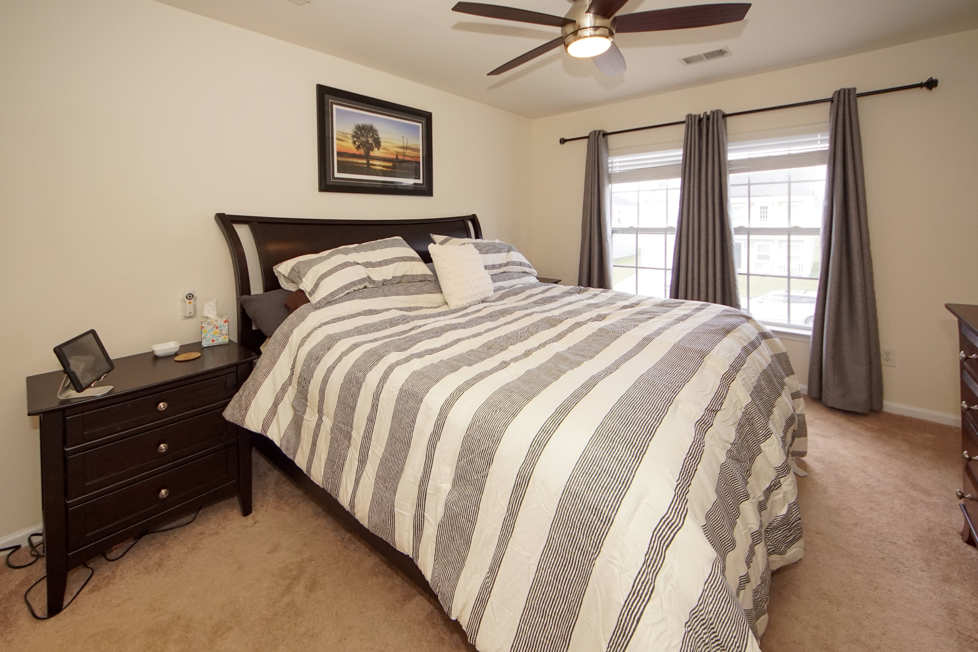
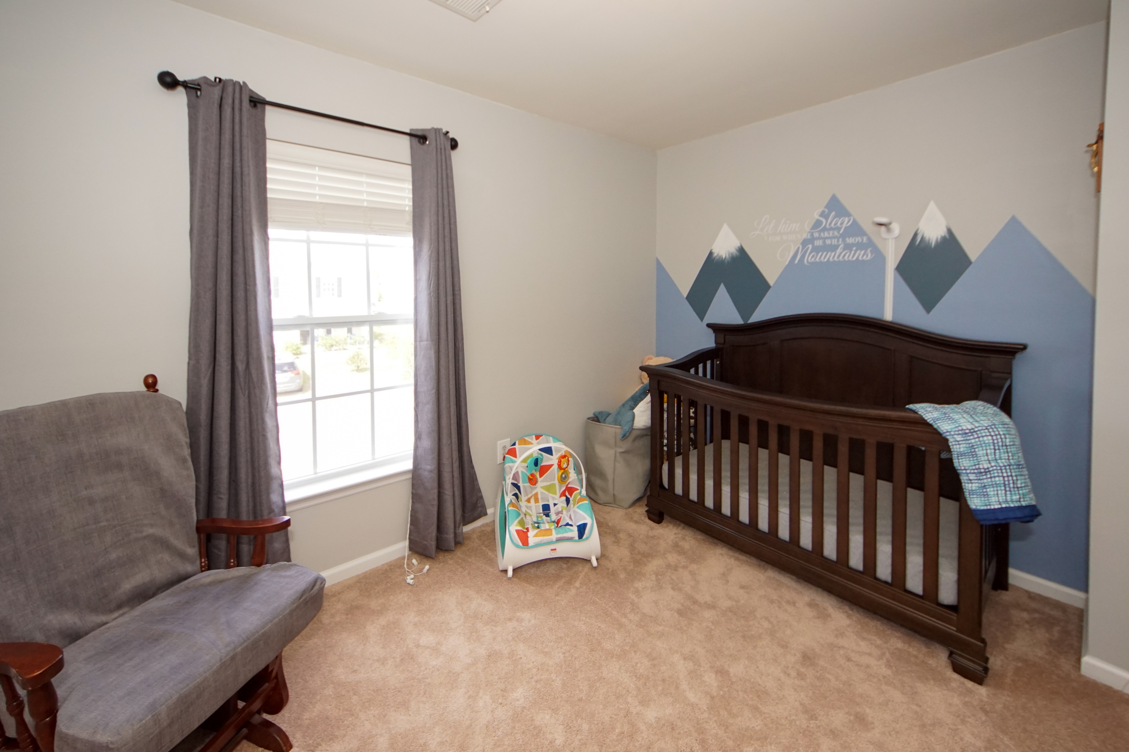
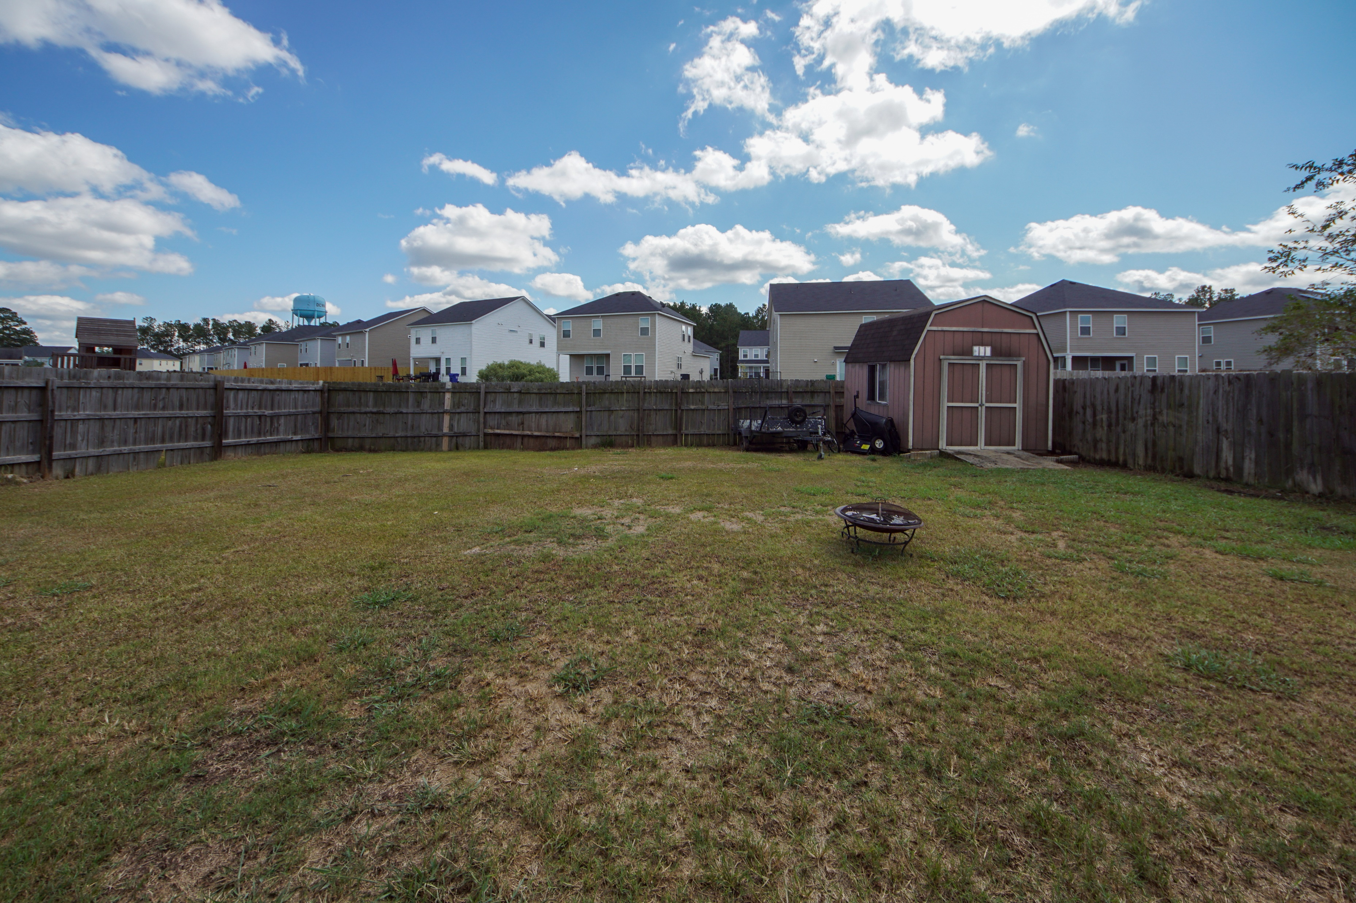


DRAFT
Just Listed in Drakesborough
1129 Flyway Road | Summerville | MLS# 19029019 | $195,000
Beautiful home on one of largest lots in the highly sought after Drakesborough neighborhood. Zoned for DD2 SCHOOLS. This one owner home has been meticulously cared for & loved. Open floor plan downstairs has a spacious living room, kitchen, and an eat-in/ dining area overlooking the backyard. Upstairs are 3 bedrooms, each with its own walk-in closet, two full bathrooms, and a great separate laundry room. You'll love the widened driveway that offers ample off street parking and the huge fenced in backyard that is perfect for family fun & grilling out. The property is next to a large green space and NO FLOOD INSURANCE is required. This home is conveniently located close to Volvo, I-26, Downtown Summerville, Nexton.. delicious local restaurants and entertainment. Backyard shed conveys along with all kitchen built-in appliances (new, awesome 3 rack dishwasher) and the garage refrigerator.
Greg Gelber
(843) 494-2354
greg.gelber@agentownedrealty.com
AgentOwned Charleston Group | 902 Savannah Hwy | Charleston, SC 29407-7802

