Slide 1

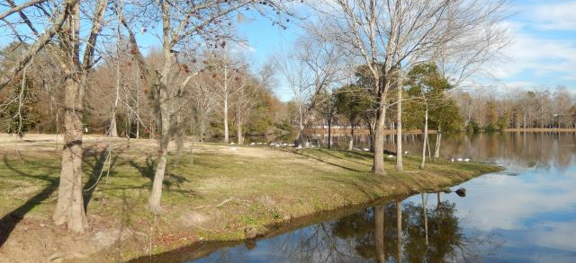
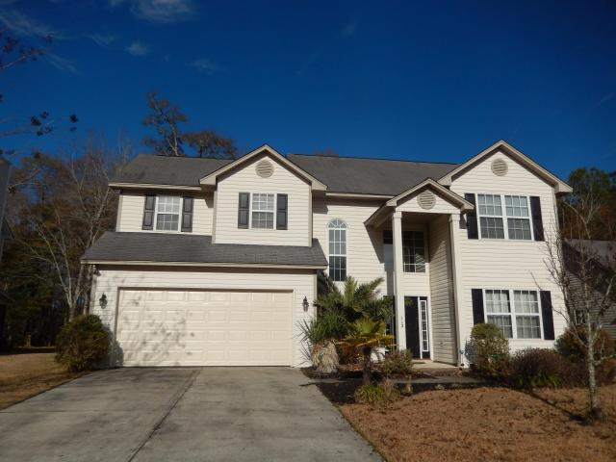
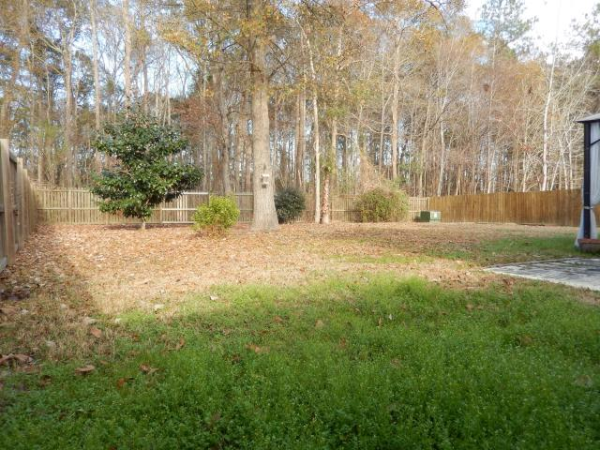
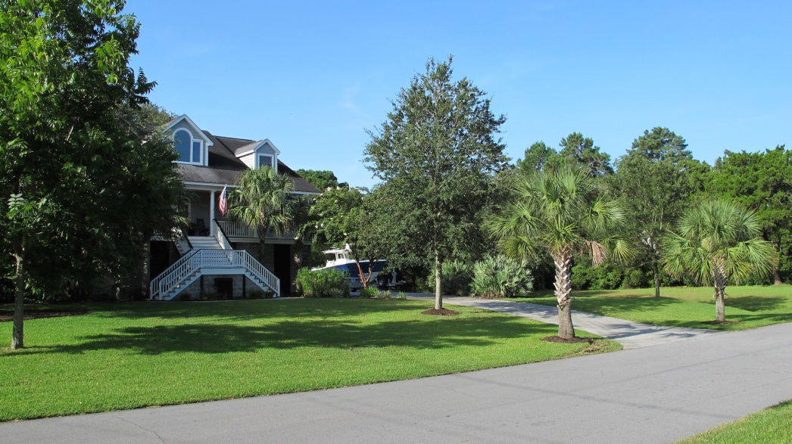
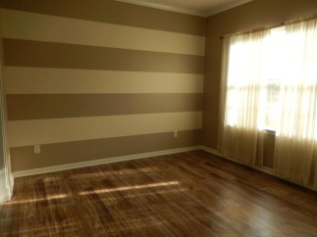
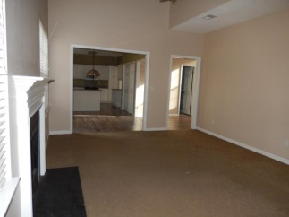
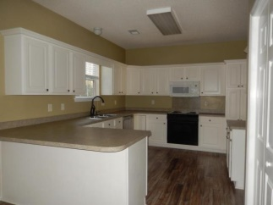
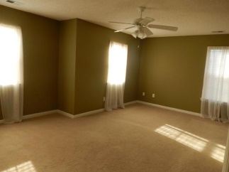
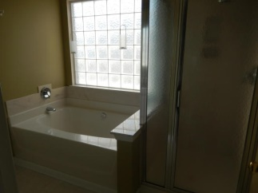
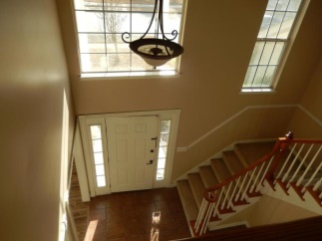

~ Amazing Value in Crowfield Plantation ~
112 Chatfield Circle
Goose Creek, SC 29445
MLS# 14031916
$229,900
Price Reduced
NEW PRICE! This house is ready for new owners and is priced to SELL! Upon entry you will be impressed with the grand two story foyer. Beautiful new floors throughout the entry, living room, dining room and kitchen are sure to stand out! The kitchen in this home is fantastic with plenty of room for more than one cook! There are plenty of cabinets and lots of counter space. The eating area is open to the family room- a perfect layout for families and entertaining! Enjoy the wood burning fireplace for cozy nights. The kitchen, eating area and family room all overlook the huge PRIVATE back yard! There is a privacy fence and the lot is wooded with no homes behind you! There is a large patio and it is perfect for outdoor dining and enjoyment. All four bedrooms are located upstairs. The master bedroom is very spacious and can accommodate large furniture. The master closet is sprawling and has built in shelving and storage. Double sinks grace the master bath, which also has a separate soaking tub and shower. The remaining three bedrooms all have great sized closets and all bedrooms have ceiling fans. The upstairs hall bath has a full tub and shower as well as a very large linen closet. Great storage is found throughout the entire house! This home has a smart floor plan and an elegant feel with the grand foyer and beautiful hallway overlooking the entry from above. The home is truly move in ready. Buyers take note that there was a 16 seer AC unit installed in 2012 (complete with a 10 year warranty), a new garage door in 2013, and new wood floors installed in April 2014! Come see for yourself why the current owners say they will really miss this house- the privacy offered in the back yard and access to all the wonderful walking and jogging trails. Crowfield Plantation is community living at its finest! Enjoy the many benefits of living in a magnificent Golf and Country Club Community. Residents can enjoy the many miles of walking and jogging trails, numerous play parks and swimming pools, RV parking, tennis courts, fishing, and park like setting. Don't delay- make your appointment to see this home while it is still available! If square footage is important, please measure.
Ellen O'Neil
843-300-8530
ekoneil@sbcglobal.net
www.southernlivingre.com
Southern Living Real Estate
2249 Salt Wind Way, Mt. Pleasant, SC 29466

