Slide 1
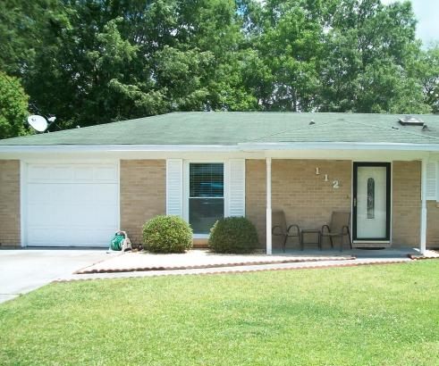
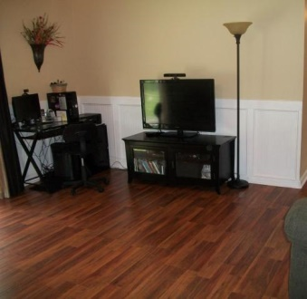
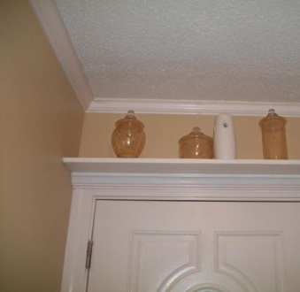
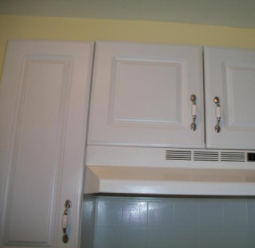
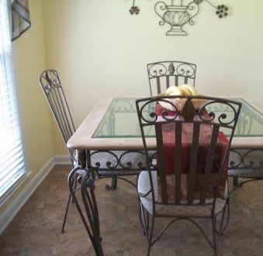
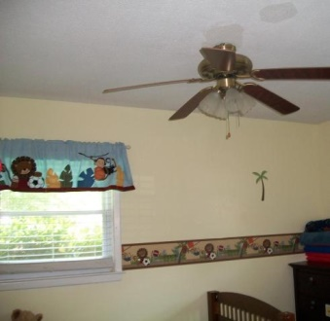
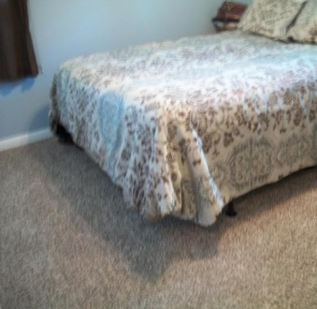
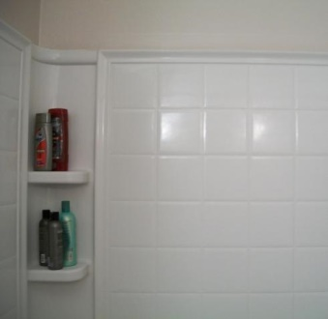
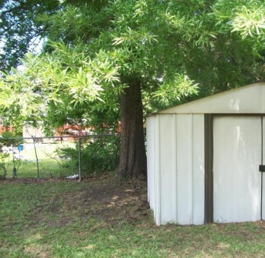
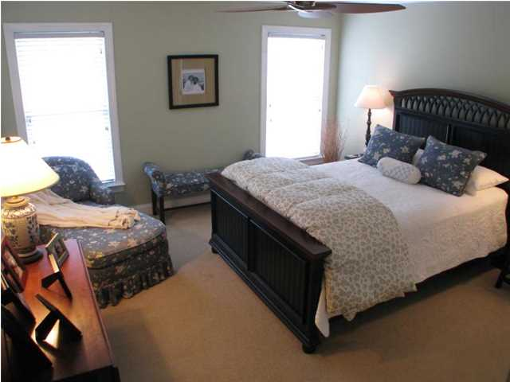
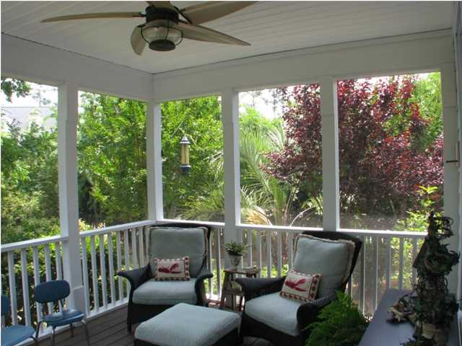
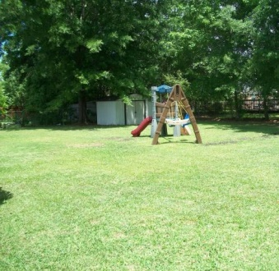
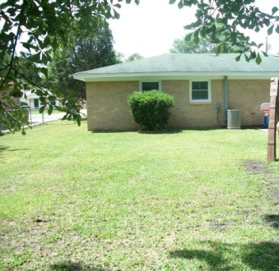


112 Clarine Drive
Beverly Hills
Goose Creek, SC 29445
MLS# 15012245
$112,500
3 Bedrooms | 1½ Baths | 1,025 sf
Welcome to your move in ready home that features foyer, 3 bedrooms, 1.5 bathrooms, living room, kitchen, breakfast area, fenced back yard and one car garage. As you enter into your new home you will notice the crown molding and laminate flooring. Living room has been freshly painted, has crown molding, wainscoting, ceiling fan and laminate floor. Kitchen has a stainless steel range and dishwasher, and white refrigerator. Master bedroom has new carpet and ceiling fan. Master bathroom has a new light fixture, new pedestal sink, and new toilet. The 2 other bedrooms have ceiling fans and one bedroom has laminate floor and the other bedroom has carpet. Hall bathroom has new countertop, sink, toilet and tub/shower. Home also have 2'' faux blinds. Large fence back yard and a one car garage. Great location ~ close to schools, shopping, Boeing, Naval Weapon Station, dining, I-26 and I-526.
Updated home in good location
Debbie Toombs
843-345-7895
debbie.toombs@cbunited.com
www.cbunited.com

