Slide 1

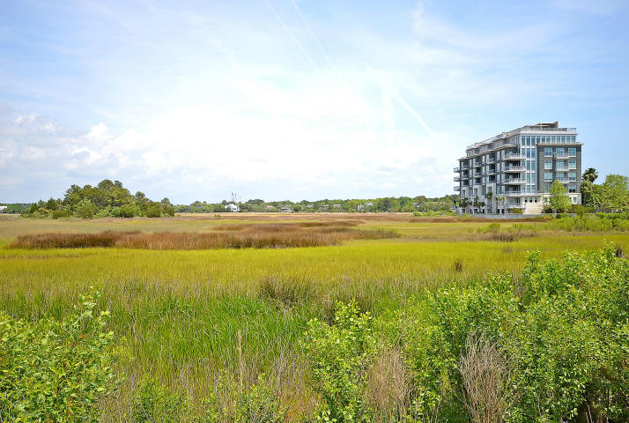
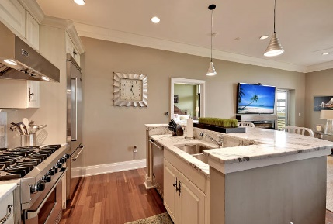
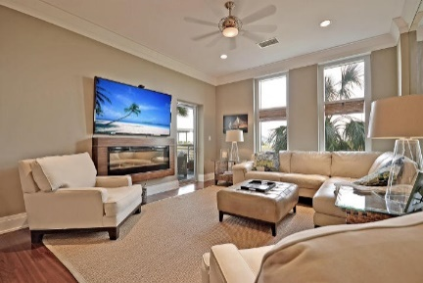
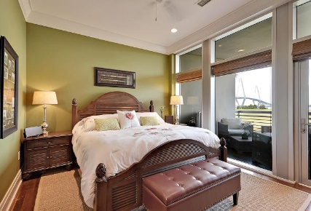
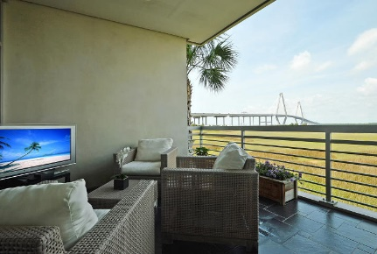



112 Cooper River Drive
Tides Condominiums
Mount Pleasant, SC 29464
MLS# 16011043 ~ $609,000
WATERFRONT LIFESTYLE and only minutes to downtown, shopping, dining and much more. Current owners have added many improvements in this custom 2 bedroom, 2.5 bath first floor unit. Upon entering one will appreciate the 10' ceilings, hardwood floors, natural stone counters, Viking appliances, custom floor to ceiling mirrors help to reflect the natural light and outdoor beauty, LED light fixtures, electric fireplace, covered terrace overlooking the Ravenel Bridge/river, and direct elevator access to secured parking garage and storage. The Tides offers amenities including a fitness center with sauna, steam room, massage room, club room, pool with a hot tub and gas grills. Walking paths and sidewalks connect the Tides to Mt Pleasant Waterfront Park and Patriots Point. You will not be disappointed. Buyer to verify all information in the above that deems important to them.
Listed Exclusively by
Christina Bucci
843-830-0888 Cell
Christina@sweetgrassproperties.com
Re/Max Elite LLC
91A Broad St.
Charleston, SC 29401

