Slide 1
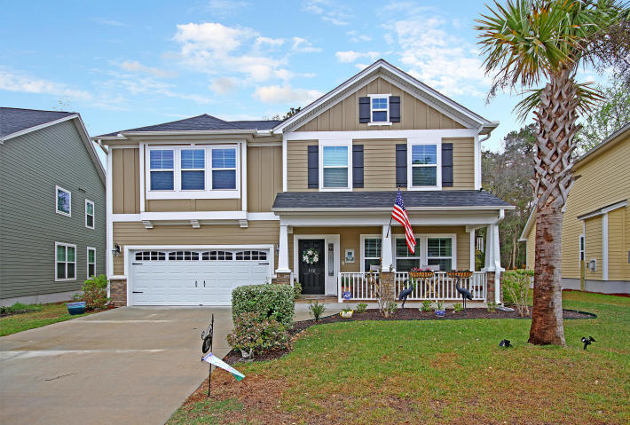
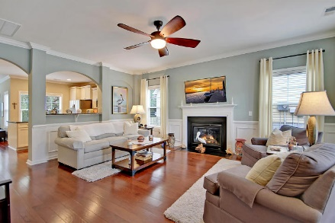
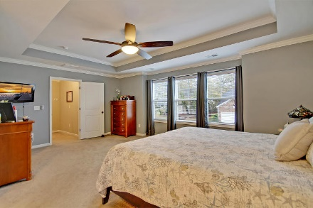
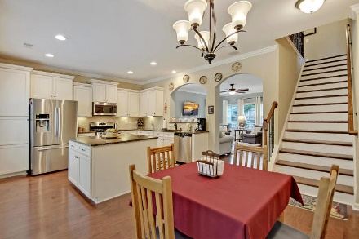
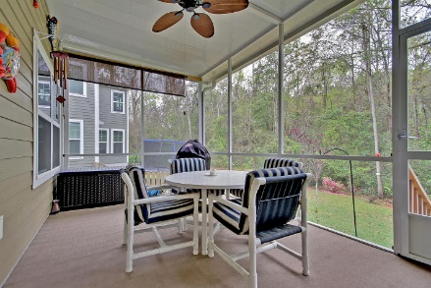
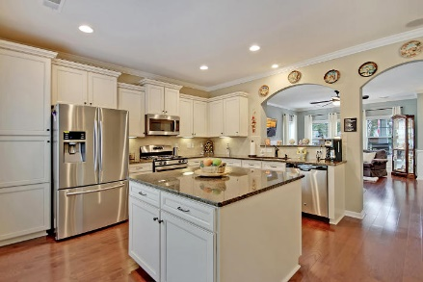
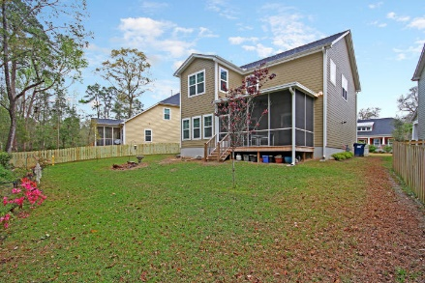
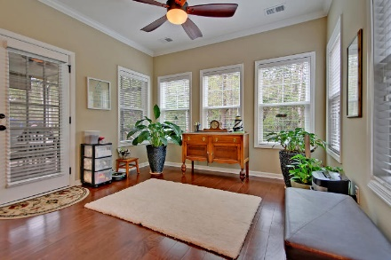
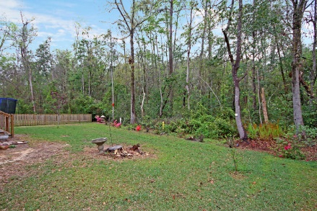

Open House Saturday, June 23rd from 1-3
112 Elliott Creek Lane
The Bluffs at Ashley River ~ Summerville ~ MLS# 18009219 ~ $359,000
This amazing home in historic Summerville shows like a model & backs to private wetlands. The spacious floorpan is loaded with upgrades like the wainscoting in the living room when you enter the home, the cozy fireplace, gleaming, hardwood floors, granite counters, center island and SS appliances in the kitchen, the front covered porch and the screened-in porch off of the kitchen that looks to the woods. The owner's retreat will be your new favorite getaway & features a tray ceiling, sitting area, huge walk-in closet and en-suite bath with dual vanity, walk-in shower & relaxing, garden tub. This home is conveniently located to Dorchester District 2 Schools, shopping & you'll love being able to cool off on a hot day in the neighborhood swimming pool. Move this one to the top of your list!
Additional features include:
Close to hospitals and Medical Offices
Great Breezes on the front porch
Energy efficient Home and Appliances
LED lighting throughout
Stereo system in the kitchen
All gutters have covers, so they never have to be cleaned out
Book your showing soon!
Ben Laaper ben@mattoneillteam.com 843-642-3546

