Slide 1
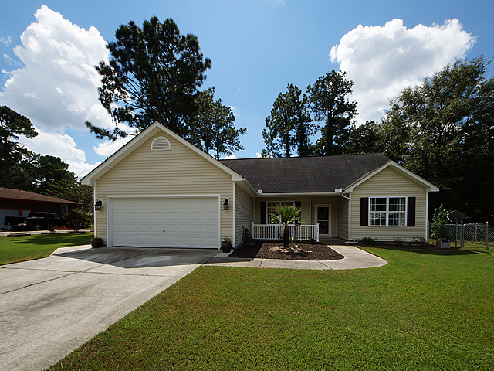
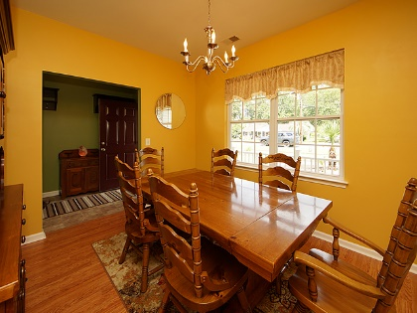
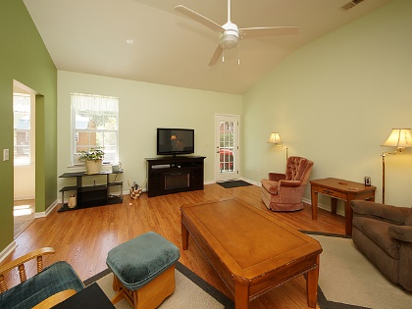
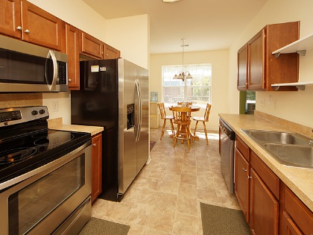
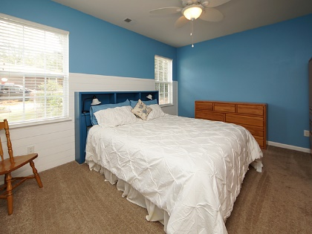
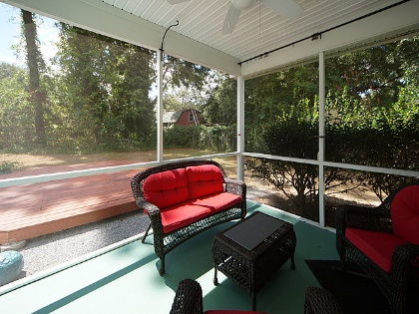
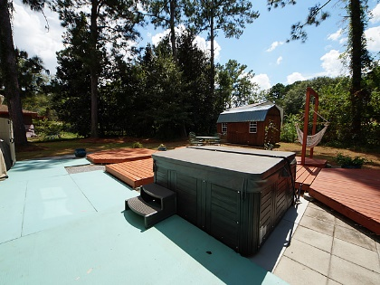
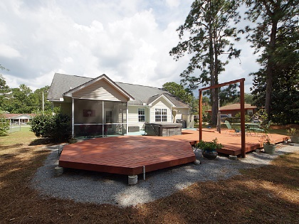


Just Reduced! Priced To Sell!
112 Farmhill Drive
Pine Forest - Summerville, SC 29483
MLS# 18025490 - $204,990
NO HOA, over ¼ acre lot and located in Central Summerville, should I saw more.....This well cared for home is ready for new owners! Move In Special, home comes will all appliances to include refrigerator, washer/dryer, newer hot tub and workshop! This beautiful home has over 1600 square feet of living space, 3 spacious bedrooms, 2 full baths, updated kitchen, formal dining room, screened in porch and a private backyard with workshop with power. As you enter the foyer you will notice the well-appointed formal dining room that is perfect for your family suppers. The open family room has an abundance of natural light and soaring vaulted ceilings.
The owners suite is split from the 2 additional bedrooms to give you more privacy. The in suite master bath has double vanity sinks, separate shower and soaking tub. The kitchen offers an eat in area with updated stainless steel appliances to include flat top stove, microwave, refrigerator and dishwasher. Other features that help accentuate this home include: large wood patio, RV power added on side of home, upgraded plumbing and lightening fixtures, fans throughout, vaulted ceilings in the 2nd bedroom, smooth ceilings, hardwoods in dining and family room, 2 car garage and fenced in back yard.
Come take your private tour today, priced to sell!
Bob Chambers, ABR
Office (843) 849-3005 · Mobile (843) 296-2546
bobchambers@infinity-realty.com
www.soldoncharleston.com
Infinity Realty | 1250 Fairmont Ave | Mt. Pleasant, SC 29464

