Slide 1
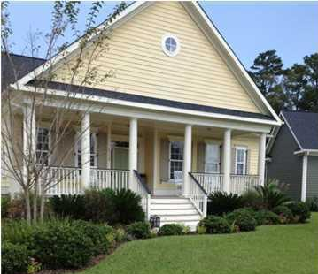
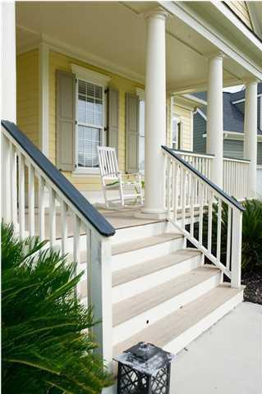
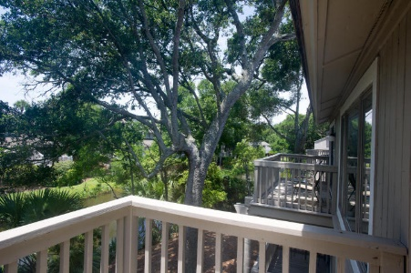
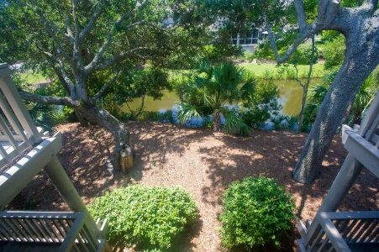
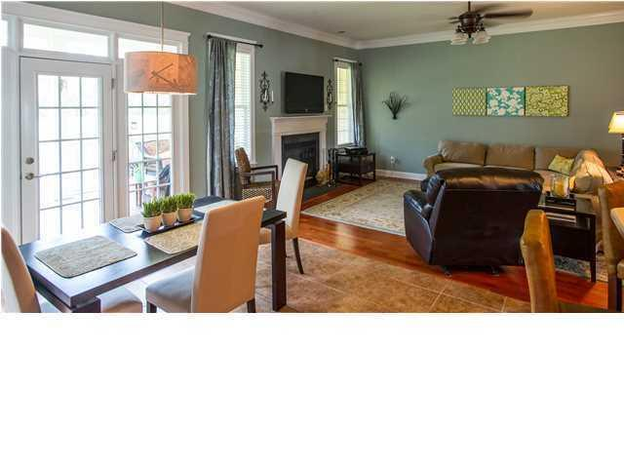
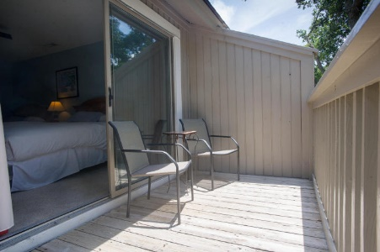
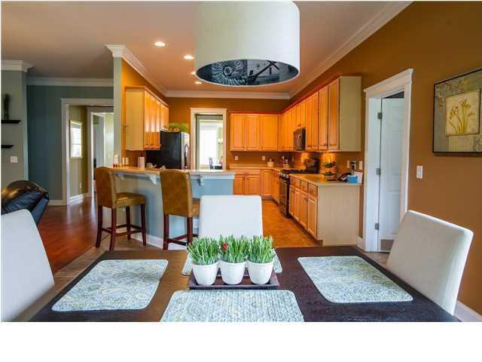
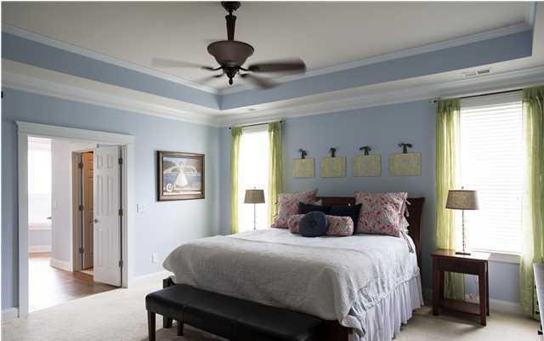
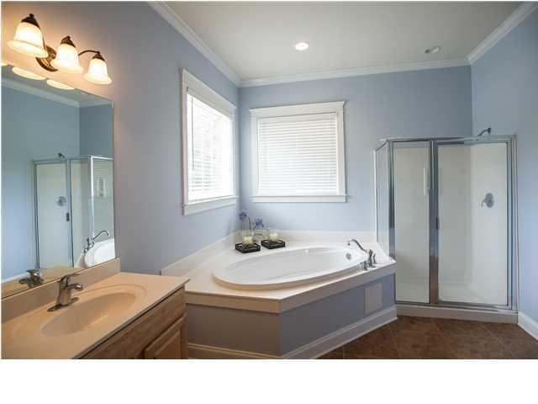


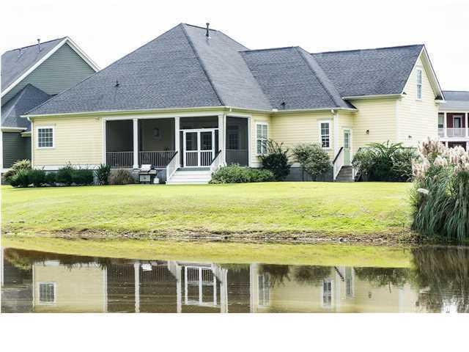
112 Heart Pine Circle Summerville ~ MLS# 15027835 ~ $410,000
New Listing!
Club at Legend Oaks
This beautiful Lowcountry style home is located on the golf course with amazing views. The floor plan offers a very easy lifestyle with one story living. The home has upgrades galore and is one of Meeting Street Builders better floor plans. The current owners added several upgrades to the home including tray ceilings in both the master bedroom and dining room, crown molding throughout, stainless appliances, Corian counter tops, an over-sized screened-in porch and much much more. The finished FROG (finished room over the garage) is large and is a great space for a home office or to be used as a guest suite. Hardwood and tile floors throughout this home create a sophisticated feel with easy maintenance. The major plus on this home is that it is turn key handicap accessible. The home has an open roll-in shower, double doors and a tastefully done ramp. Beautiful landscaping with palmetto trees add to the southern charm. Come see this house today, it wont last long!!!
Carey Nikonchuk
(843) 276-1701 M
cnikonchuk@gmail.com
www.palmettoproperty.net

