Slide 1
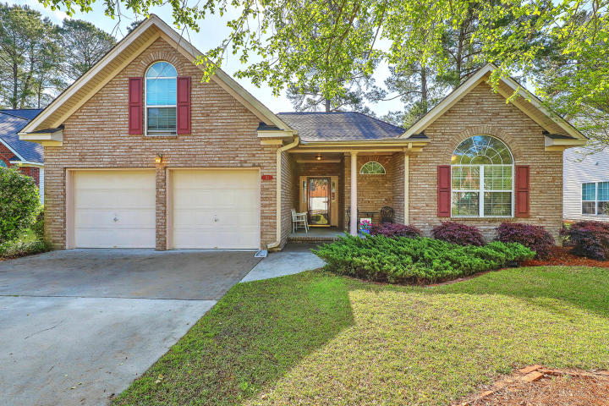
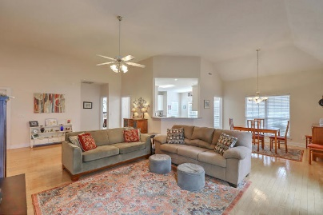
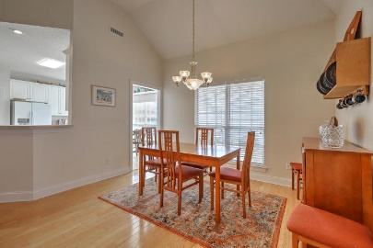
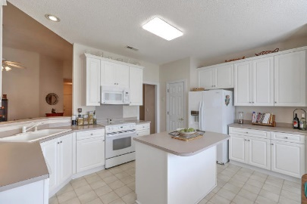
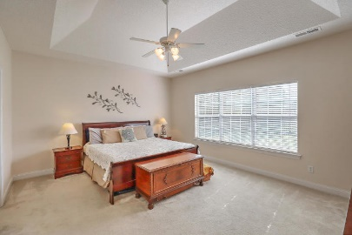
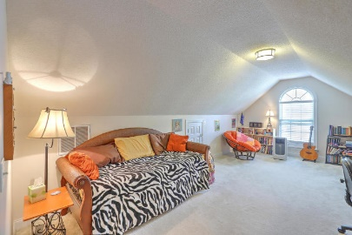
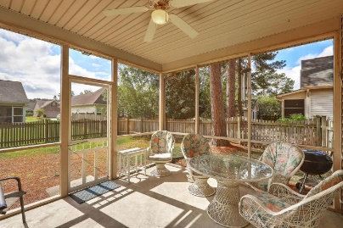
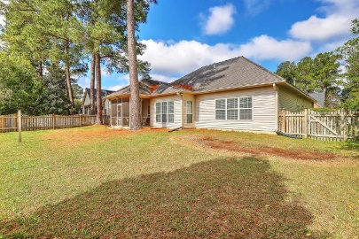


112 Royal Troon Court
Pine Forest Country Club | Summerville | MLS# 19009846 | $249,900
Just Listed!
Fantastic price and floor plan in highly desirable Pine Forest Country Club. This 1.5 story ranch offers open concept living with a neutral color palette. The covered front porch welcomes you in to a wide foyer, light wood floors and 2 nice sized bedrooms at the front of the home. Continue in to the combination living room/dining room with a cathedral ceiling and gas fireplace. The kitchen space is light and bright with loads of cabinet and counter space. All appliances to convey. First floor master bedroom with trey ceiling and a huge walk-in closet is at the rear of home and easily fits a king size bedroom suite. 4th bedroom is upstairs and has a large walk-in closet. There is also a spacious screen porch overlooking a fully fenced backyard that has a double-gate access on the right side and a single gate on the left side. Other details of the home include cathedral ceiling in front bedroom with modern light fixture, Separate AC unit in 4th bedroom can convey, kitchen pantry, backyard has a post that can hold a hammock and connect to nearby tree, Protect Gutter system, laundry room has sink with splash guard, extra shelving, washer and dryer can convey, extra fridge in garage can convey, Gas hot water heater 2011. Home is being sold "As Is".
Beth Mandell
M 803-463-7734 | O 843-871-2121
bmandell@century21properties.com
www.bestcarolinahomedeals.com
Century 21 Properties Plus of Summerville | 118 W Richardson Ave | Summerville, SC 29483

