Slide 1
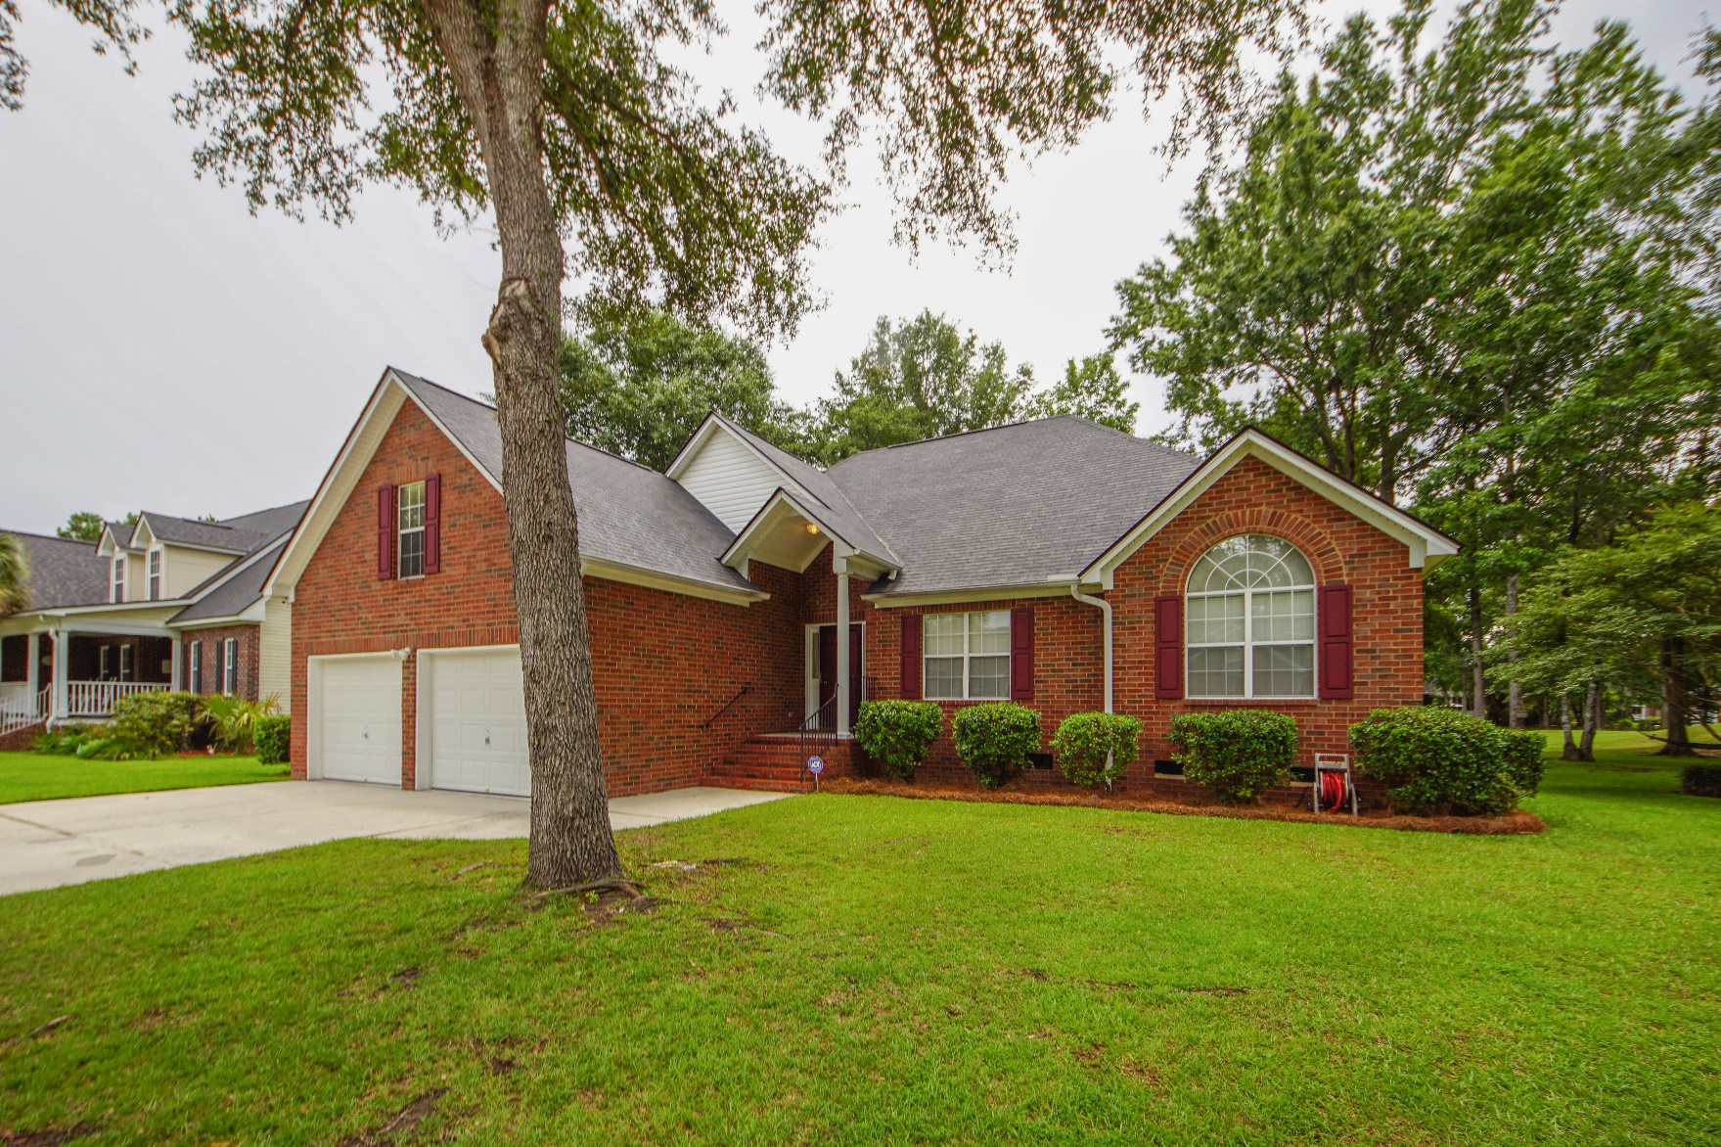
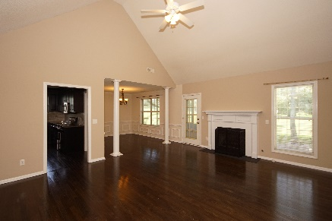
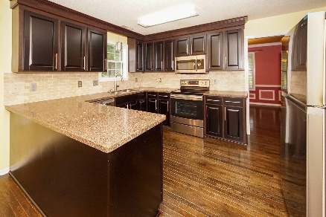
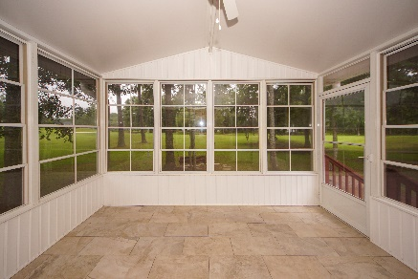


112 Spalding Circle
Crowfield Plantation :: Goose Creek, SC 29445
MLS# 19019204 :: $350,000
4 Bed / 2 Bath
Just Reduced!
On The Golf Course In Crowfield Plantation!
Elegant one story brick home on the Golf Course in Crowfield Plantation! Open concept reveals newly stained hard wood floors, gas fire place, remodeled kitchen with new appliances, new back splash and a sunroom with a perfect view! Master bedroom is down stairs and the master bath has a large walk in closet, separate shower and large soaking tub with his and her vanities. Finished room over the garage could be a second living space, office or fourth bedroom. Roof was installed 2016 and the sellers have serviced the AC unit and inspected the fireplace to make this home ready for a new owner. Spalding Circle is a block away from the Crowfield Golf and Country Club and a community with play parks and walking trails.
Connie White, Broker
843-532-3356
connie@chrepros.com · conniewhiterealestate.com
Charleston Homes · 597 Old Mt. Holly Road · Suite 301 · Goose Creek, SC 29445

