Slide 1
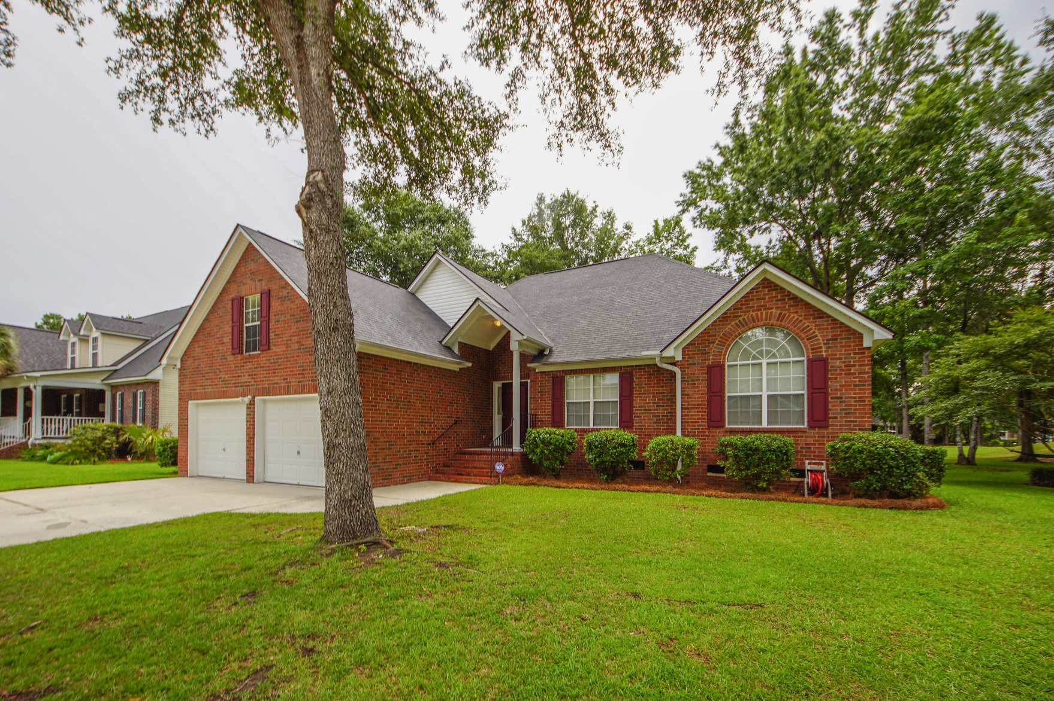
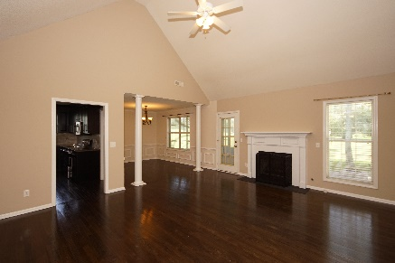
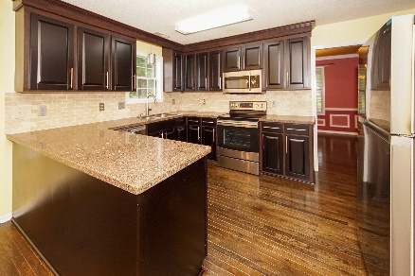
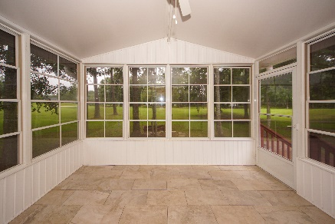


112 Spalding Circle Crowfield Plantation :: Goose Creek, SC 29445 MLS# 19019204 :: $339,800 4 Bed / 2 Bath
New Paint & Recently Remodeled
On The Golf Course In Crowfield Plantation!
****Realtors Bring Your Buyers***
Seller is changing colors in bathrooms to include vanity and counter tops.
We heard your feedback!!
Come show this home again!
Connie White, Broker
843-532-3356
connie@chrepros.com · conniewhiterealestate.com
Charleston Homes · 597 Old Mt. Holly Road · Suite 301 · Goose Creek, SC 29445

