Slide 1
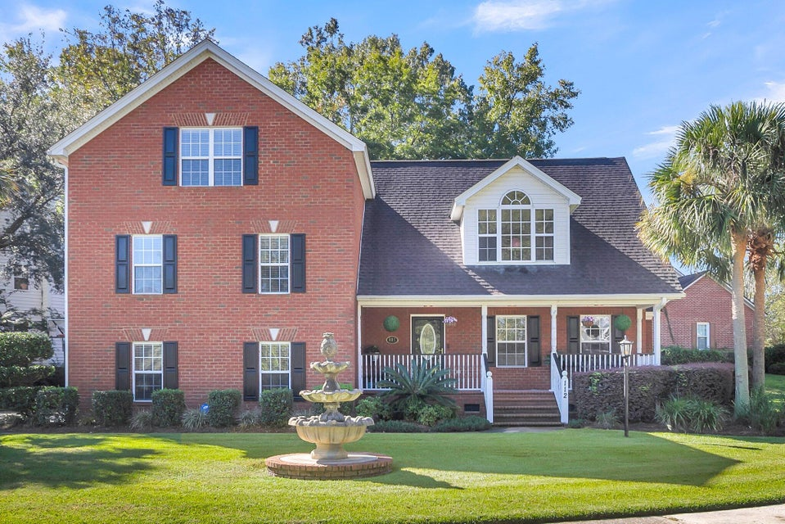
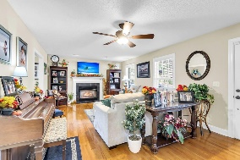
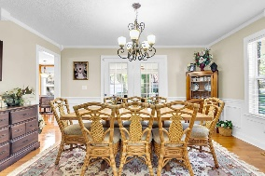
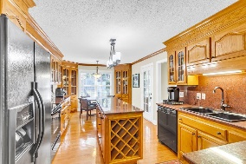
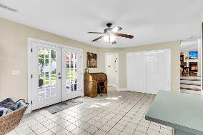
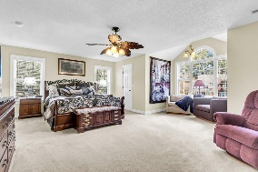
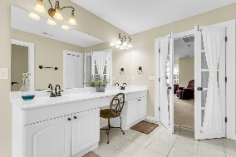
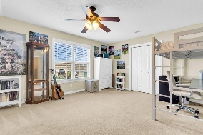
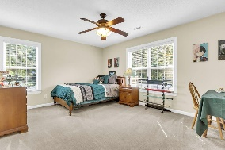
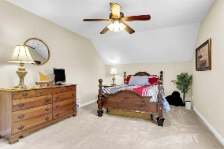
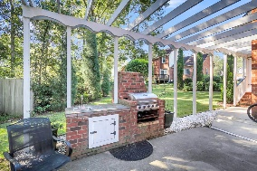
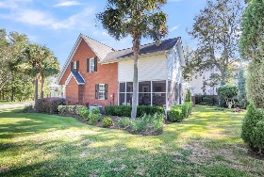
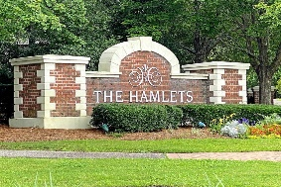
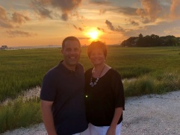

Beautiful 6BR~4BA Home in Golf Course Community
112 Ashley Hill Drive
Crowfield Plantation
Goose Creek, SC 29445
MLS# 24025268
$849,000
4 Bedrooms | 3½ Baths | 3,820 sf
Welcome to 112 Ashley Hill Dr in the lovely golf course community of the Hamlets in Crowfield Plantation! If you have a large family or live multi generational, this is the perfect home for you! This well kept home offers 6 bedrooms and 4 and a half baths. There's space for everyone! Located on a cul de sac and across the street from a lake. The large front porch welcomes you home! Enter to find a large living room offering a wood burning fireplace and hardwood floors. Though the living room is the dining room, offering ample space and lovely trim work. Perfect for entertaining! Off of the dining room is the screened in porch. The kitchen has an island, eat in kitchen area and beautiful built in corner cabinetry. Some of the custom cabinetry is glass front for added elegance.
Head downstairs and there's a bonus room with a half bath and laundry closet. This space can be utilized many different ways and has access to the back patio. Under the pergola off the back of the house is the outdoor kitchen area. A great spot for grilling and entertaining. Off of this bonus room is also the oversized two car garage. Head back upstairs up to the next level and you'll find three very large bedrooms with a full bath in the hallway. A third bedroom on this level would make a perfect mother in law suite with its own full bath. On its own level of the house, is the primary suite. This room is a great size, has the largest primary closet you've even seen, plus an additional closet, a seating area and a gorgeous primary bath with a stunning new shower, jetted tub and dual vanities. Up one more level of the home, you'll find two more bedrooms and a full bath. This home is a must see!
Larry & Kathy Mazalatis
Larry Cell 843-693-0529
Kathy Cell 843-693-0159
mazteamrealty@gmail.com
AGENTOWNED REALTY | 1800 TROLLEY RD | SUMMERVILLE, SC 29485

