Slide 1
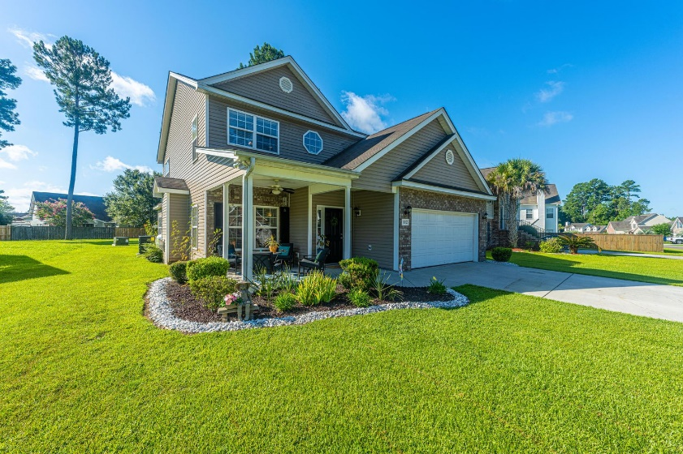
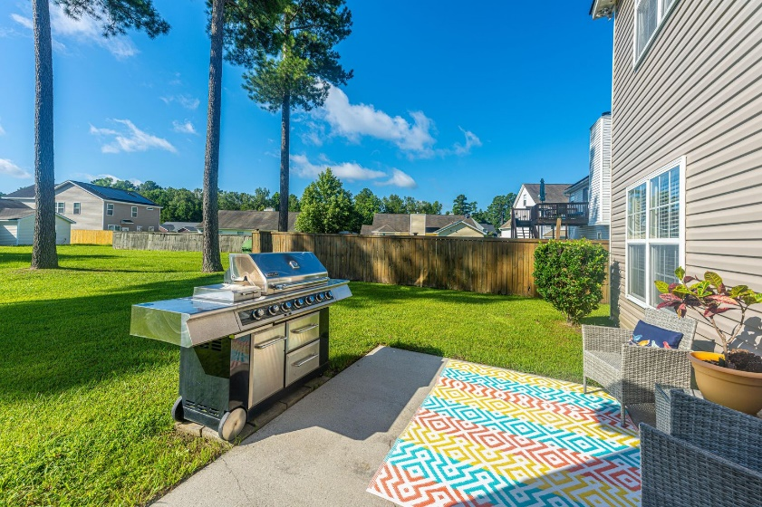
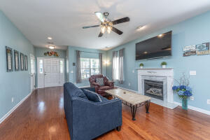
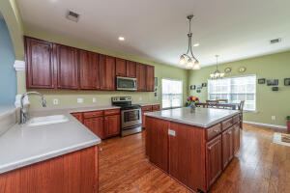
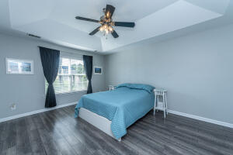
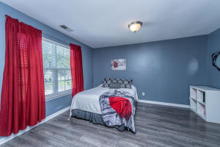
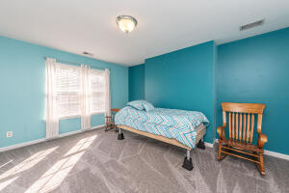
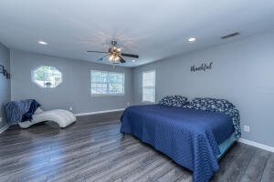



Why wait for new construction?
This Park Circle area home is LESS THAN 2 YEARS!
New Summerville Listing - 5 Bedrooms
112 Felder Creek Road
Felder Creek · Summerville, SC 29486 · MLS# 22019384 · $370,000
MOVE IN READY 5 Bedroom-3.5 Bath. Large Yard-Cane Bay Schools-Summerville Charm! Lovely architectural style home with brick accents, interesting archways, open concept, gleaming hardwoods, and master down. This home welcomes you with a full size front porch that allows owner to enjoy the mild weather or curl up with a good book and watch hummingbirds at the feeders. The great room has a gas fireplace to anchor the room but is open to the spacious kitchen. There are upgraded cabinets, stainless steel appliances, a 2 year new dishwasher and easy to clean beautiful Corian countertops, pantry and a huge island that is great for buffet style dining and entertaining or an excellent preparation space for the serious chef. The downstairs master suite has a walk-in closet, luxury bath with jetted tub, dual sinks, elongated toilet. The upstairs loft/hallway adds more living space for an office or school work area. The large four bedrooms upstairs are separated by Jack and Jill bathrooms, 1 with dual sinks. Each bedroom has many windows to expose the natural light. There is a patio off the back door with a very large, deep back yard. New in 2022 - HVAC unit. Water heater replaced in 2019. All new flooring in the master bedroom/bath, other 4 bedrooms and up steps and upstairs loft/hallway. Hurry and make an appointment to view this home!
Take a Virtual Tour: https://my.matterport.com/show/?m=vxVxj7HN5Le
Del Shaffer
843.408.6821
dshaffer@carolinaoneplus.com
2713 Highway 17 North
Mt. Pleasant, SC 29466

