Slide 1
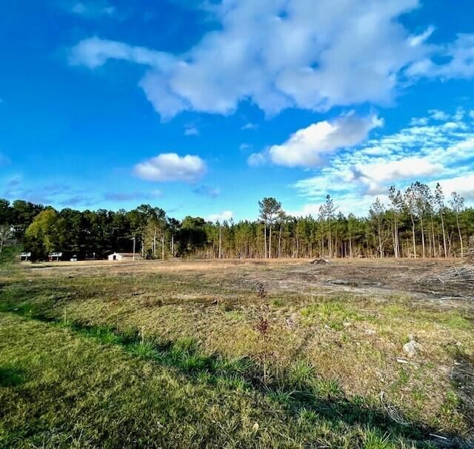
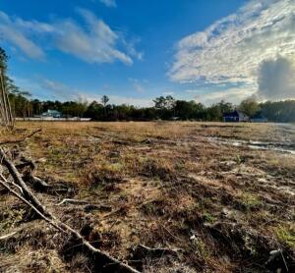
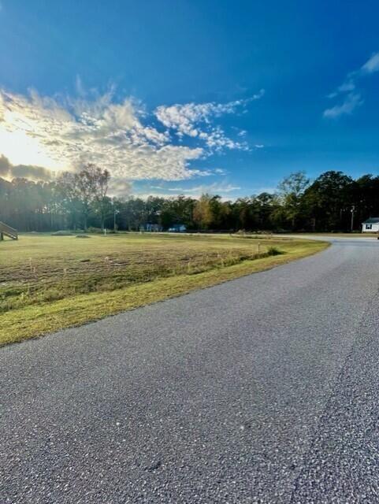
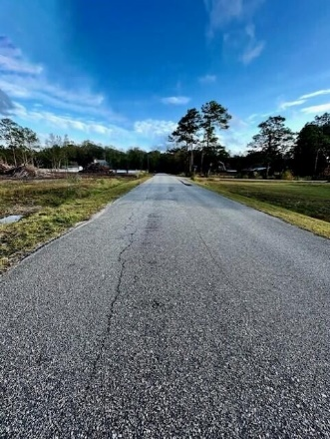
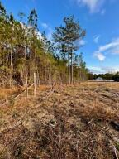
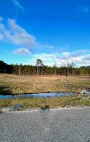


112 Hazel Drive Knightsville Farms | MLS# 22028997 | $170,000
$25K Price Reduction 1.46 Acres Summerville
$1,000 Buyer's Agent Bonus
For Ratified Contract That Can Close By 9/27/2019
HUGE price reduction! Down $25,000. Sellers are motivated! Looking for a homesite already cleared and ready for you to build the home of your dreams? This is it! This 1.46 acres is on the edge of Summerville - in Knightsville; a rare find. This property is only 2 miles from shopping & restaurants in downtown Knightsville, and just a few minutes' drive to downtown Summerville. The sewer and water tap fees have already been paid, making the process to build that much easier for its new owner. An easy drive to I-26. Only a block away from Jedburg Junction. AND the best part? ... it's located in the much sought after, highly-acclaimed, and award winning DDII School District.
Tammy Thompson
843-412-1856
tammylthompson@live.com
https://www.coldwellbankerhomes.com/
Coldwell Banker Realty | 4969 Centre Pointe Dr. Ste 103 | Charleston, SC 29418

