Slide 1
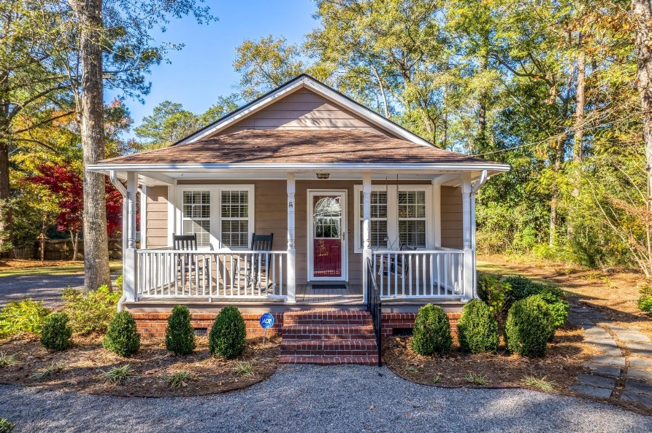
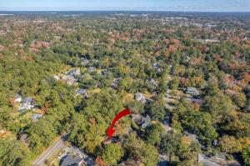
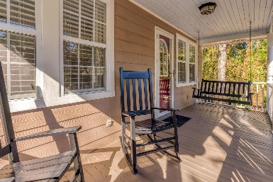
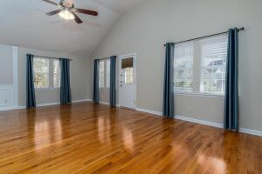
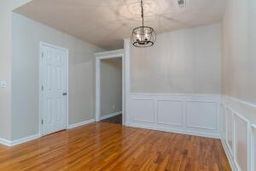
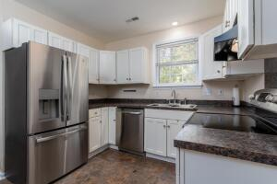
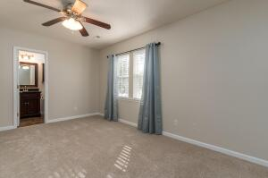
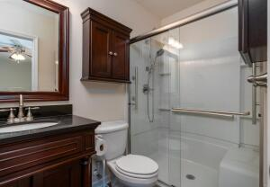
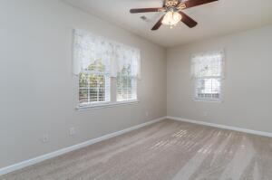
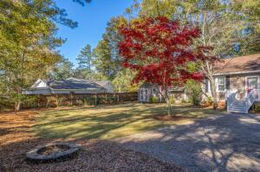


112 Simmons Avenue
Summerville, SC 29483 ~ MLS# 22029769 ~ $420,000
$1,000 Agent Bonus + Another $30k Price Reduction
Classic 3 BR/2.5 BA low-country cottage offers one-story, low-maintenance living in the heart of Summerville's highly desired Historic District. This well-designed and impeccably maintained home exudes under-stated elegance with a simple, efficient flow. Inside the front door is an open living/dining room area with vaulted ceiling, gleaming hardwood floors, and many windows that provide abundant natural light. Kitchen includes newer stainless-steel appliances and generous cabinet space. Large master BR includes BA with walk-in shower. Two other BRs have a full Jack & Jill BA between them. Interior has been freshly painted with brand new, premium carpet in all BRs. This prime location offers a nice setback from neighbors to enhance privacy and quick, easy access to the many restaurants, shops, and activities in downtown Summerville.
Christopher McCormick
Office - 843-871-9133
Cell - 843-224-3204
cj.mccormick@agentownedrealty.com
AgentOwned Premiere Group
1800 Trolley Rd
Summerville, SC 29485

