Slide 1
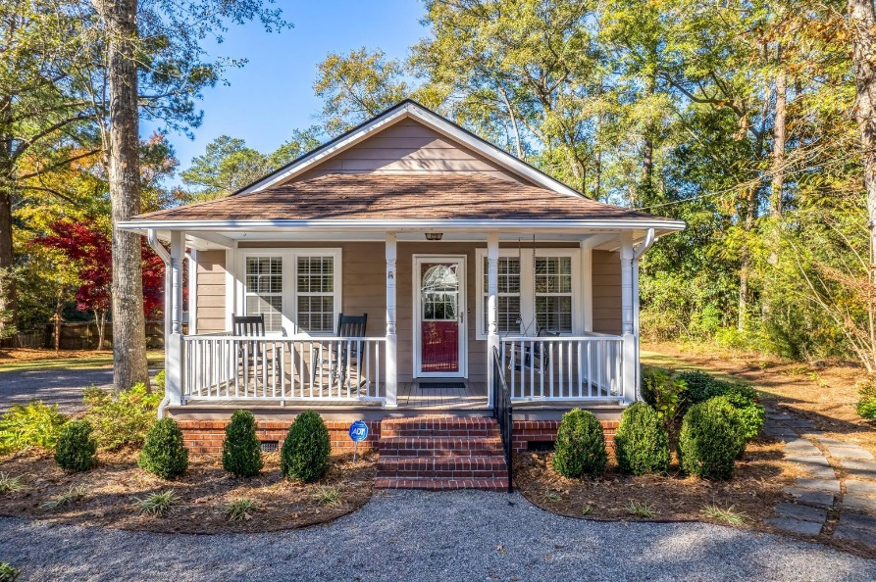
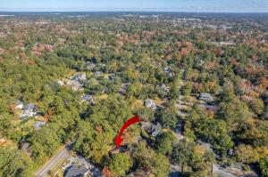
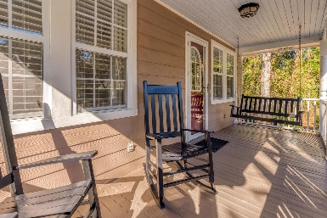
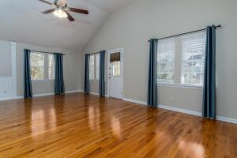
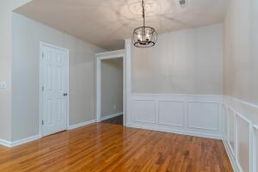
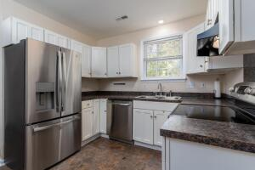
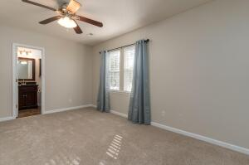
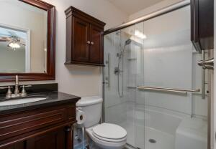
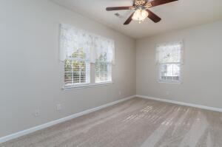
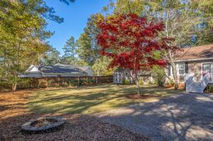


112 Simmons Avenue Summerville, SC 29483 ~ MLS# 22029769 ~ $480,000
Historic District Open House 12/10
Turnkey 3BR/2.5BA ranch in heart of Summerville's Historic District. One-story design evokes spaciousness w/vaulted ceiling, gleaming HW floors in LR/DR,& many windows providing abundant natural light. SS appliances in kitchen & updated BAs include walk-in shower in MBR. Freshly painted interior w/new premium carpet.Prime location offers privacy & direct access to restaurants/shops/activities downtown. Other features: Low- maintenance, well-insulated home w/broad front porch; true wrought-iron fence; Luxury Cement siding; architectural-shingle roof; Leaf Guard gutters; ample, professionally landscaped yard w/built-in irrigation; storm doors; large parking lot; 2out-buildings for extra storage. All window treatments & appliances convey, including new fridge & Fr Load Washer&Dryer
Christopher McCormick
Office - 843-871-9133
Cell - 843-224-3204
cj.mccormick@agentownedrealty.com
AgentOwned Premiere Group
1800 Trolley Rd
Summerville, SC 29485

