Slide 1
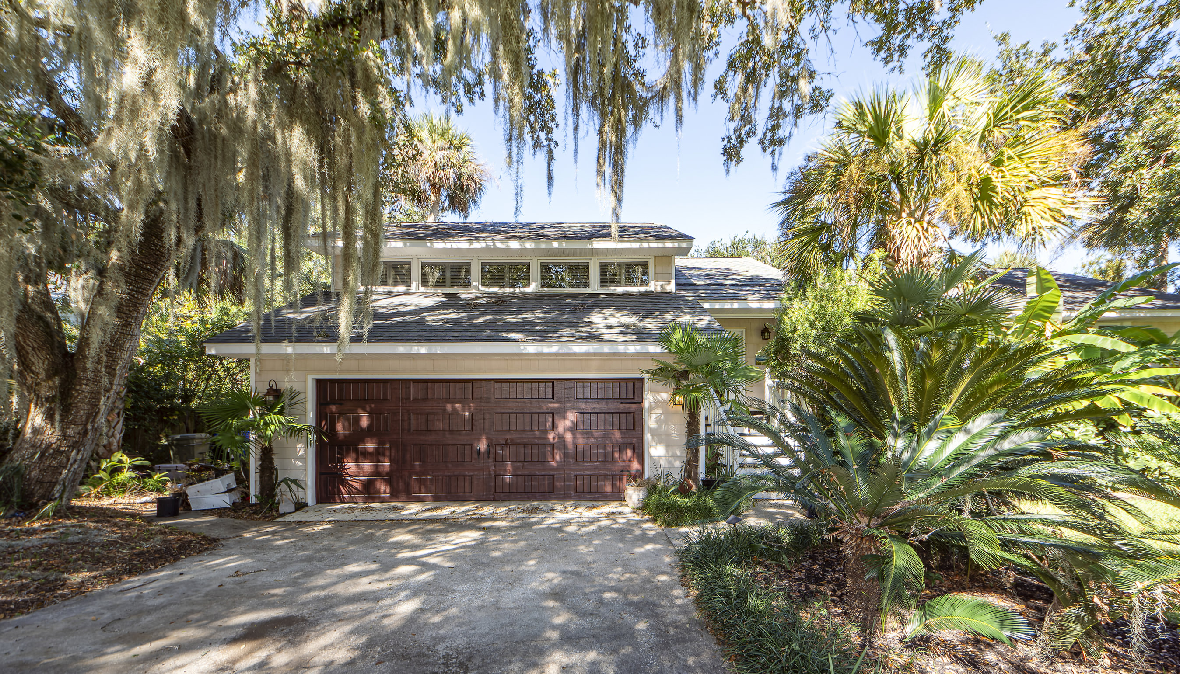
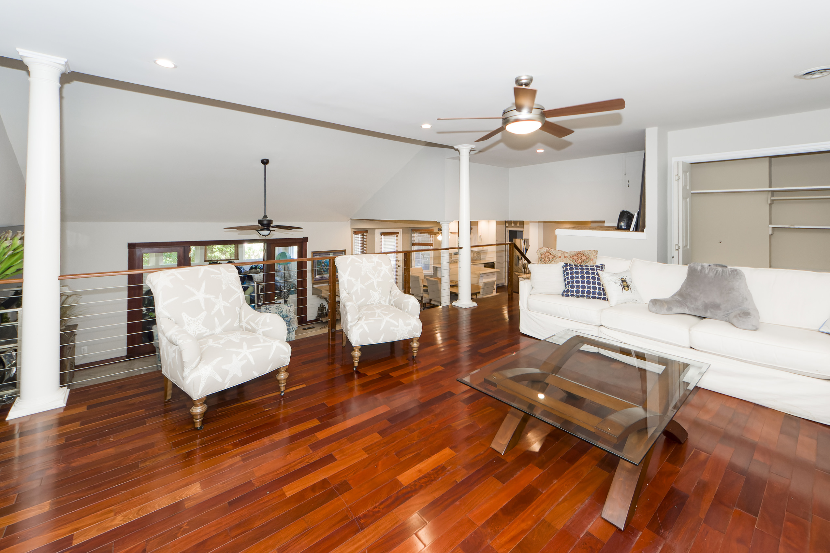
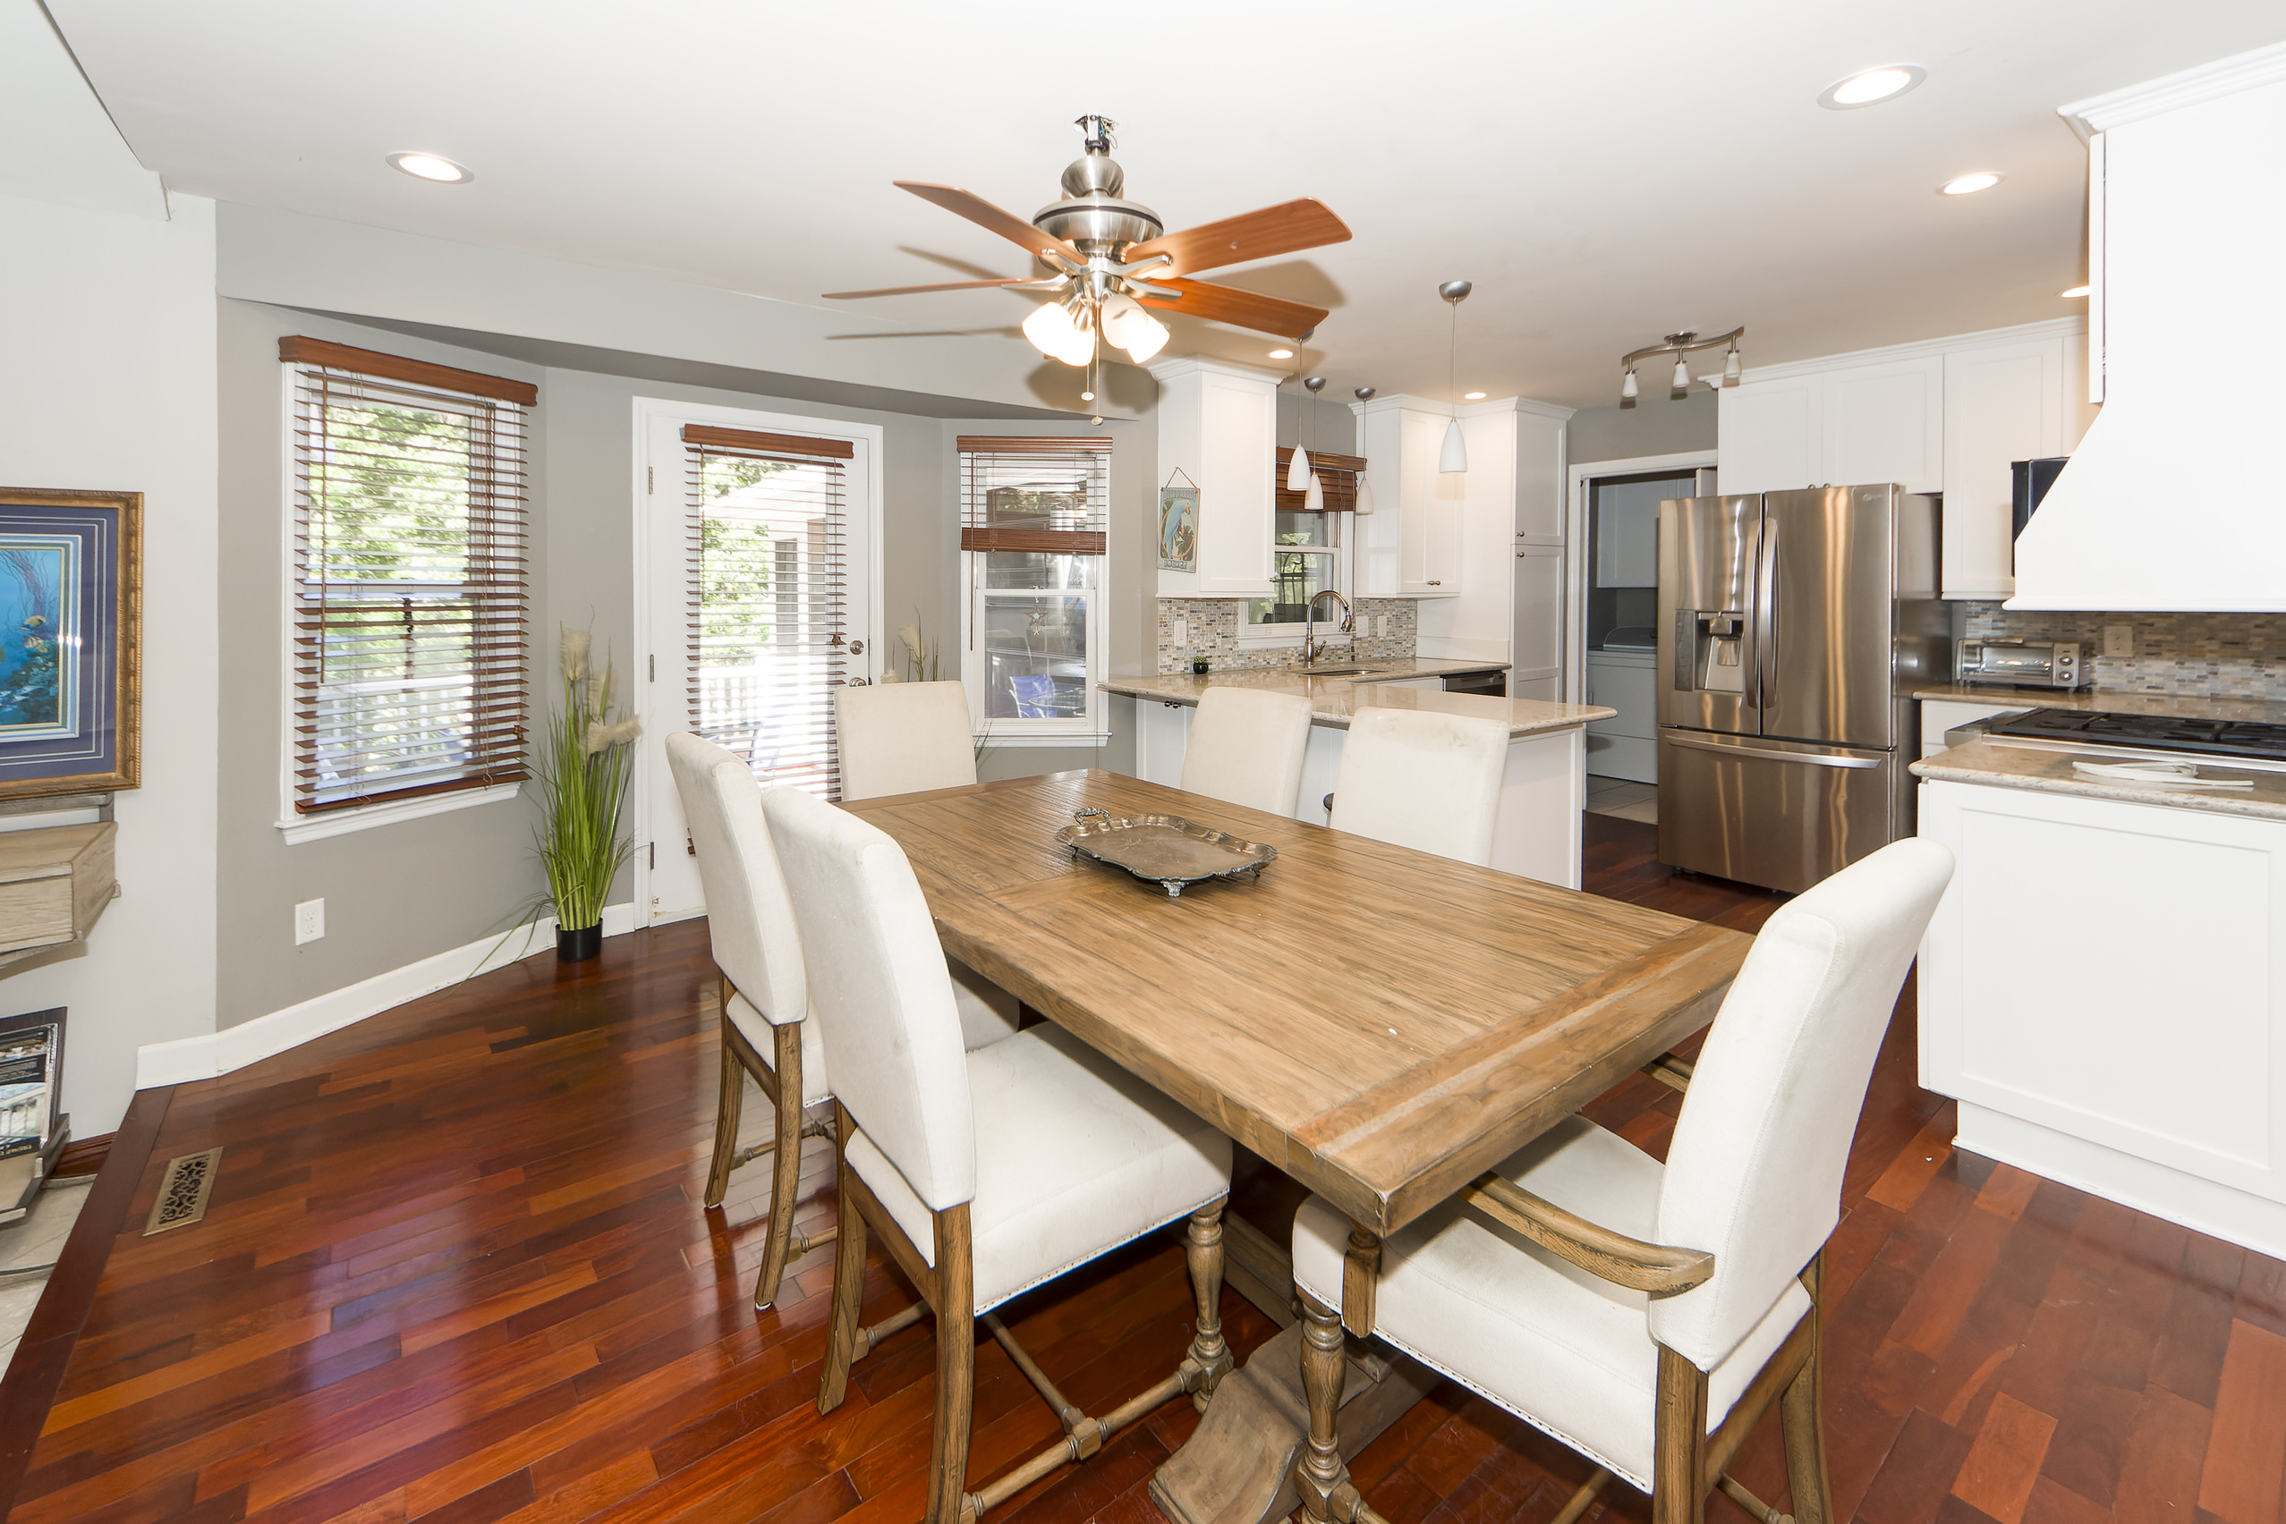
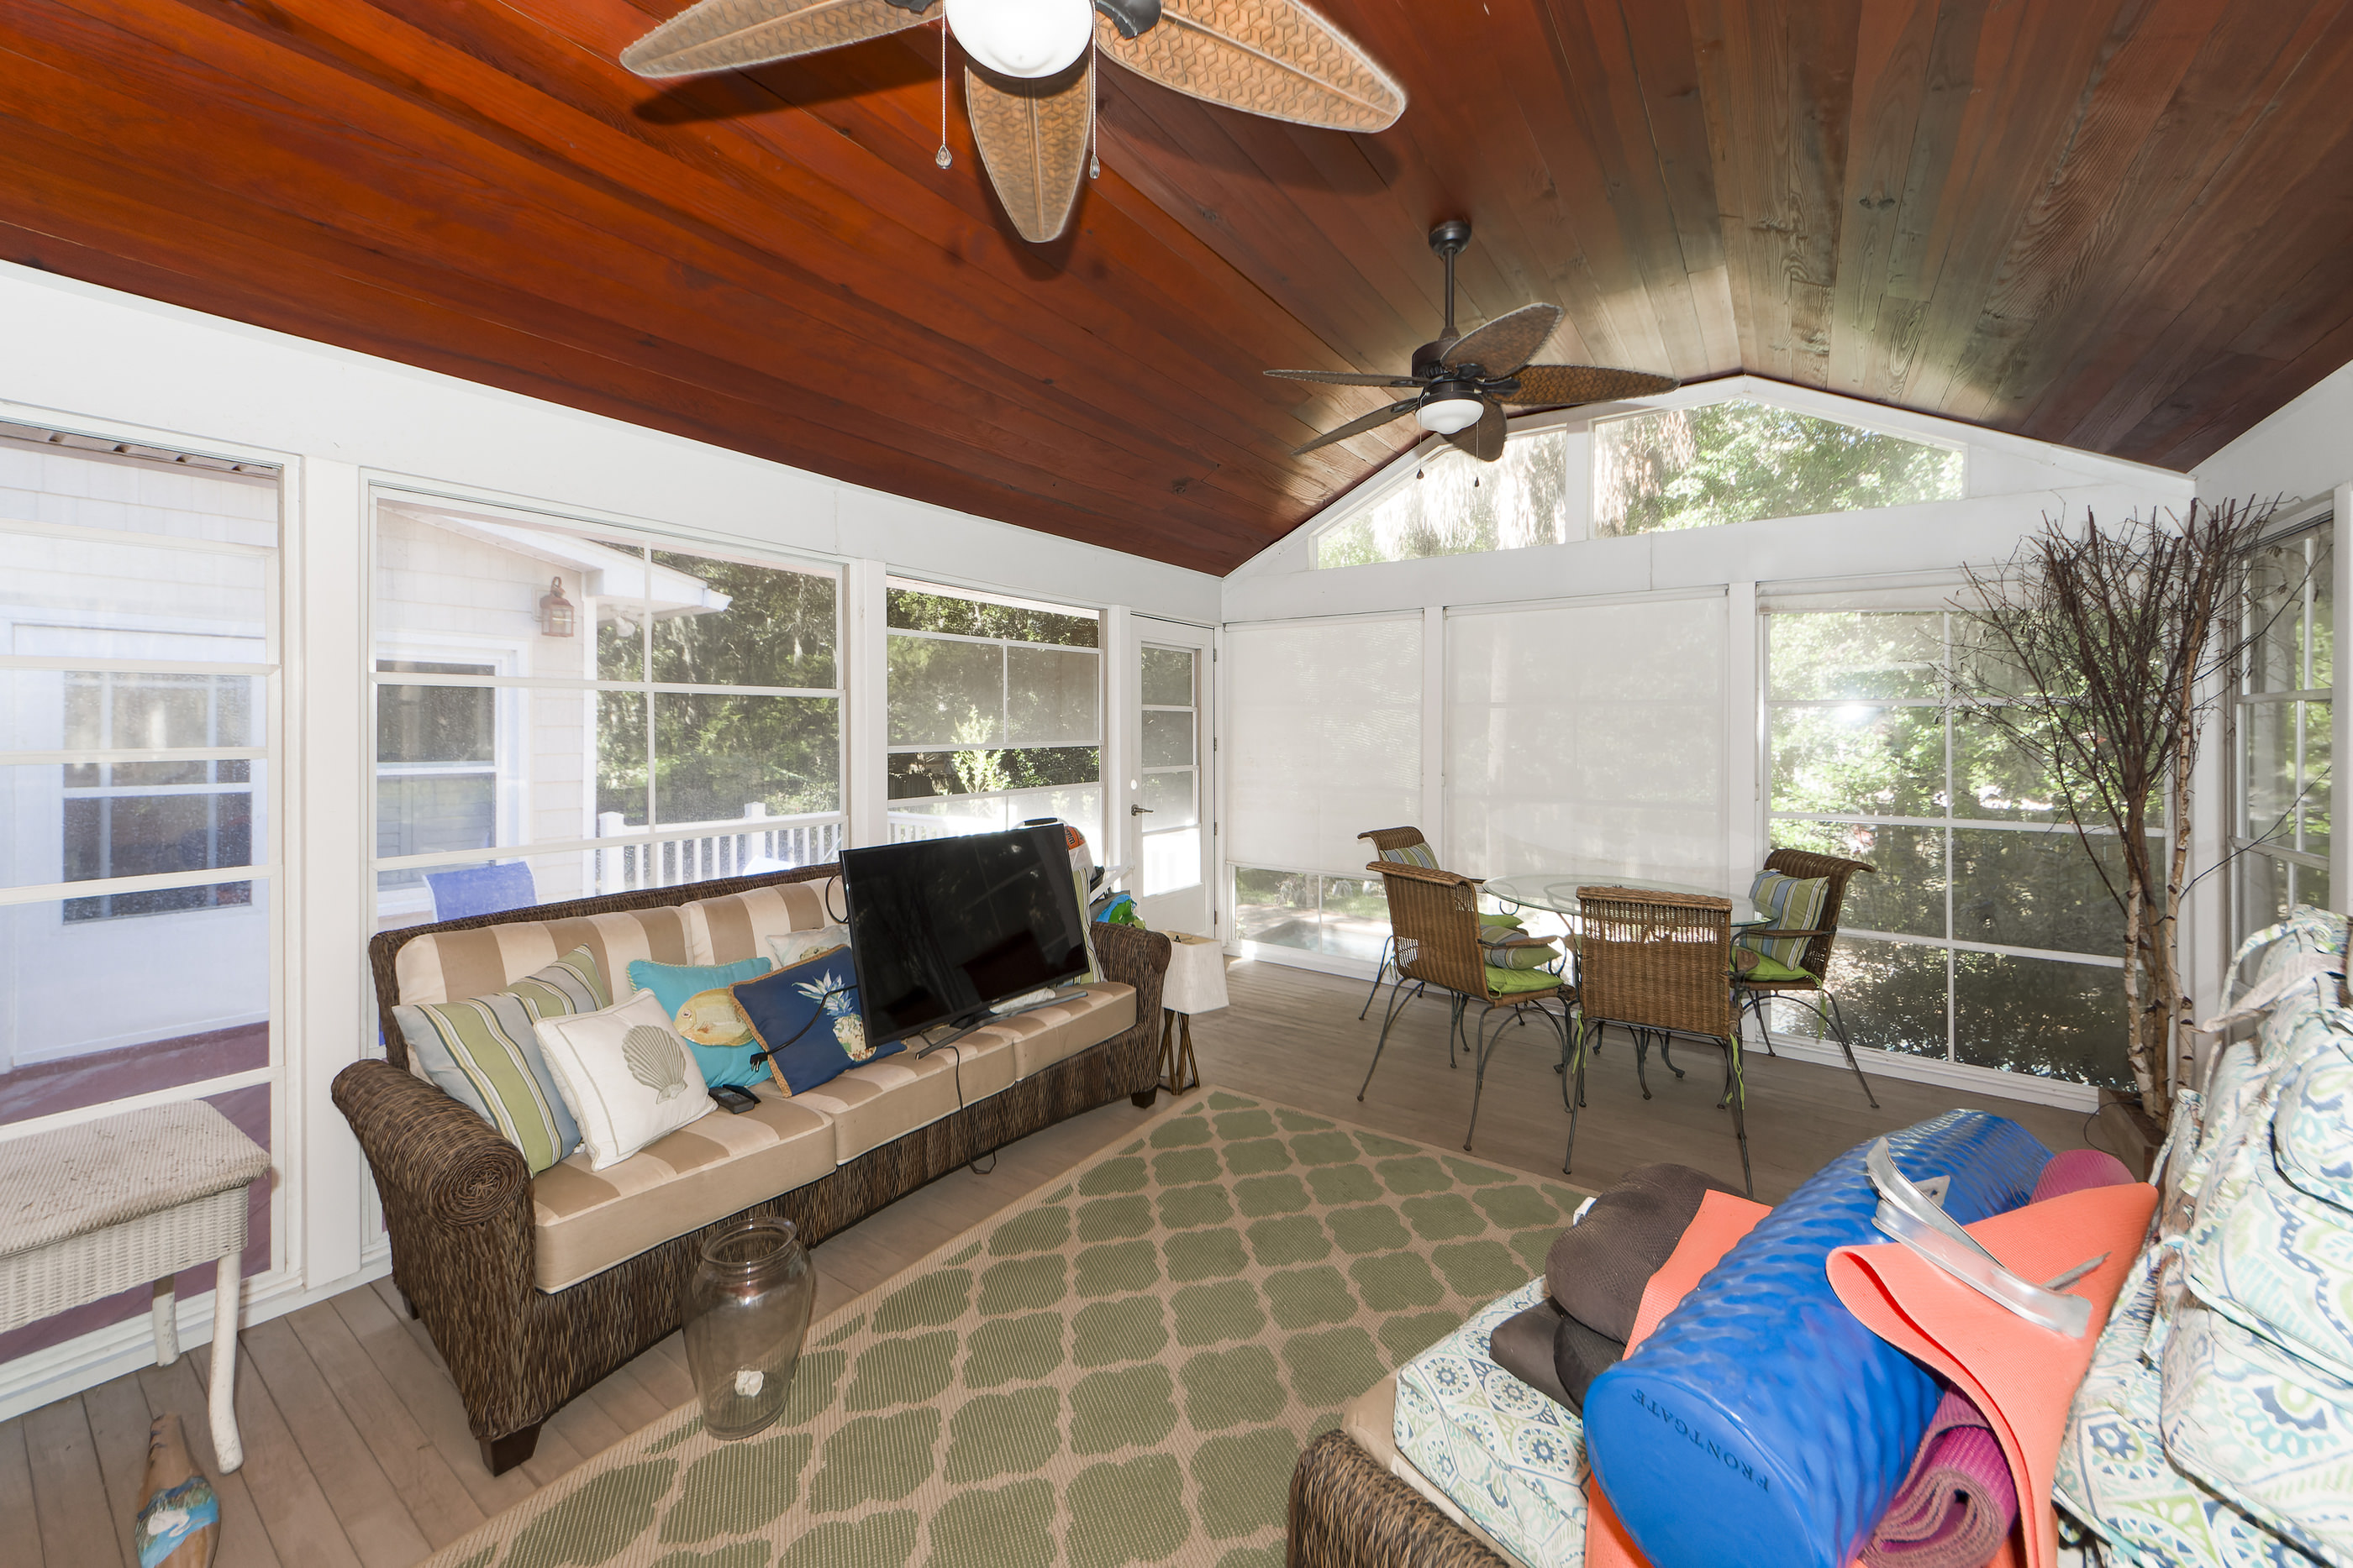
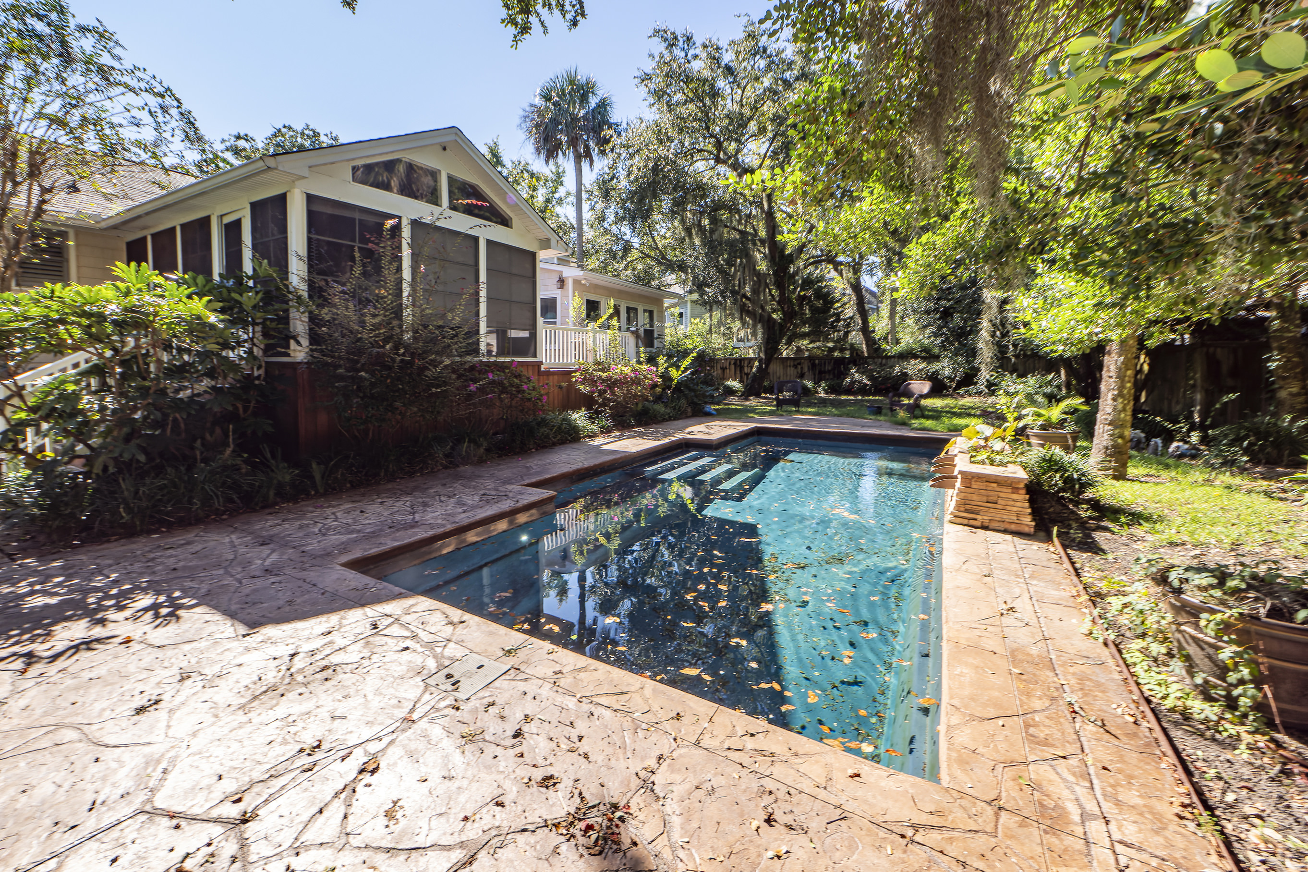
Price Reduced - Show & Sell!
112 Sparrow Drive
Forest Trail | Isle of Palms, SC 29451 | MLS# 23024026 | $1,429,000
Home needs TLC & is being sold in as-is condition, no repairs. Open floor plan with a loft that can used as a den or office. The kitchen has Wolf dual fuel range/oven, dishwasher, & tile backsplash. The hall bathroom shower has the river rock floor. The screen porch & deck is off the kitchen. 16x32 saltwater pool with waterfall. The yard has a separately metered irrigation system and landscape lighting. Blown foam insulation is under the home.
Slideshow Tour
Charles Salmonsen
M (843) 224-0300 | O (843) 388-6613 | charles@salmonsen.com
Salmonsen Realty | 864 Lowcountry Blvd Ste B | Mt Pleasant, SC 29464

