Slide 1
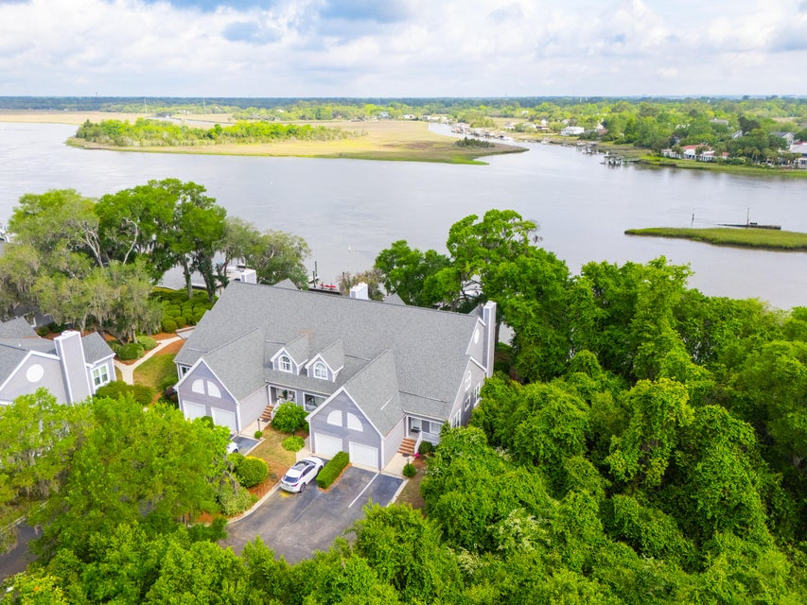

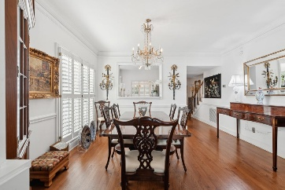
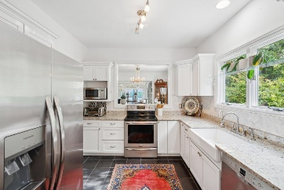
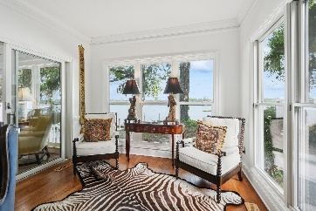

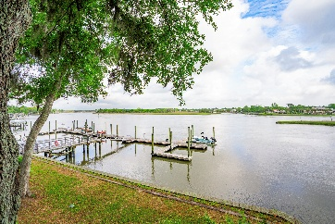
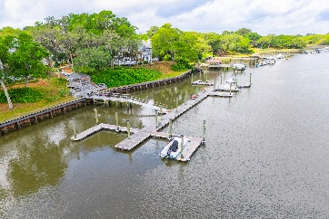


Brokers Open House Thursday 5/8 11am-1pm
Light Lunch Will Be Served
112 Waterfront Plantation Drive
Waterfront Plantation | Charleston, SC 29412
MLS# 25011904 | $1,595,000
Discover this remarkable townhouse perched upon a 25-foot high bluff (flood zone X), offering breathtaking views of the intra-coastal waterway. This sought-after end unit boasts unparalleled vistas of Wappoo Creek, ensuring both an exceptional location and privacy. Situated a mere 10 minutes from Downtown Charleston, just off Maybank Highway, the property encompasses a generous 4.65-acre lot adorned with majestic live oaks. This intimate townhouse community comprises only 12 units, providing shared access to a community pool and dock. Enjoy the privilege of owning a dedicated dock space along the intra-coastal waterway.
Edmund Major
843-343-6666 C edmund@flywaysc.com
www.flywaysc.com
Flyway Real Estate, LLC
1630 Meeting St. Bldg 1
Ste 302
Charleston, SC 29405

