Slide 1
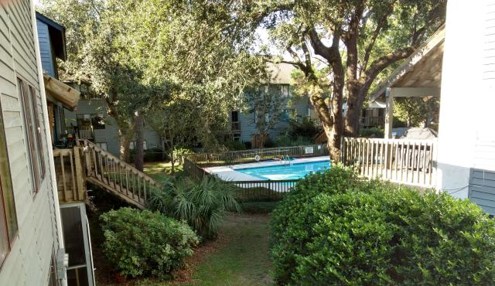
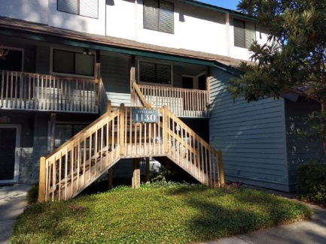
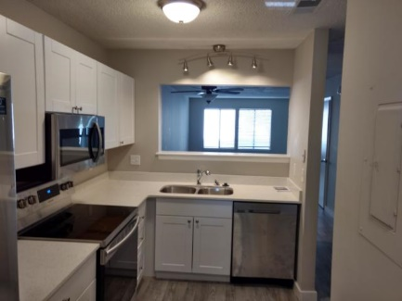
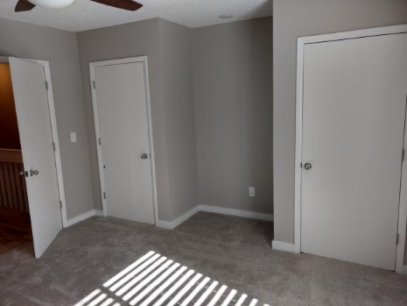
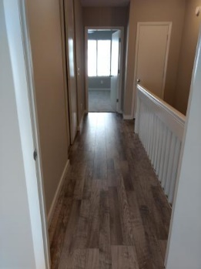
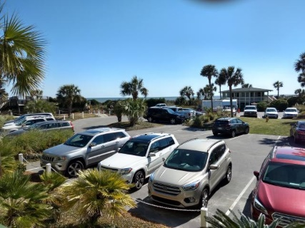
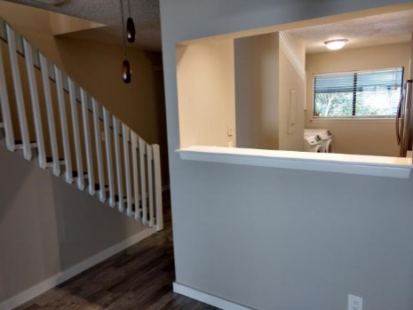
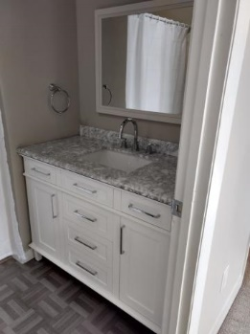
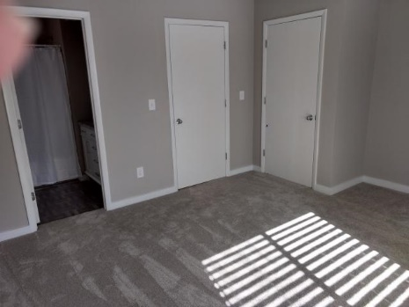


New to the Market!!
GREAT LOCATION!!
1130 Silent Harbor Court K
Snee Farm Lakes ~ Mt Pleasant ~ MLS# 19027064 ~ $239,000
2 Bedroom | 2½ Bath | 1,262sf
There have been numerous upgrades!
Including but not limited to it's Brand New Kitchen with all new cabinets , quartz counter tops, sink, fixtures, new stainless steel appliances, washer and dryer. New hot water tank , Lighting fixtures, and Ceiling Fans. New laminate flooring, on main level, and Upstairs Landing. Fresh paint throughout.
Frank Rutigliano
843-813-4961
frutigliano@kwchs.com

