Slide 1
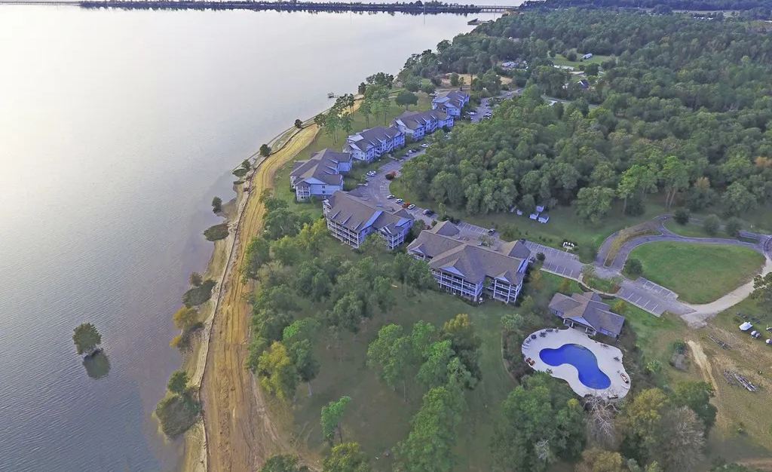
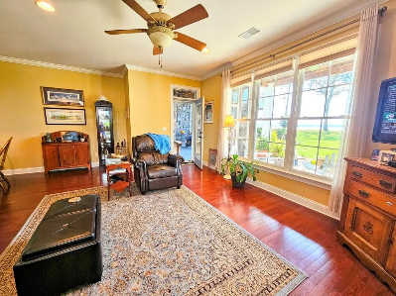
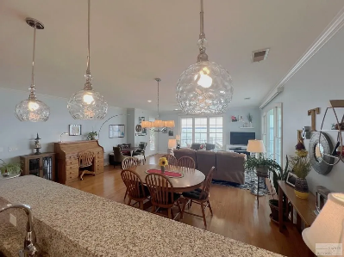
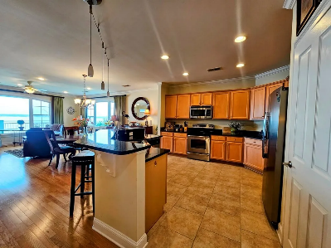
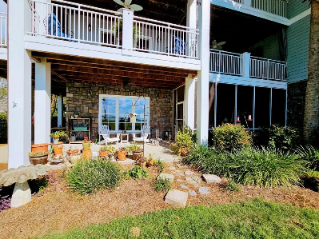
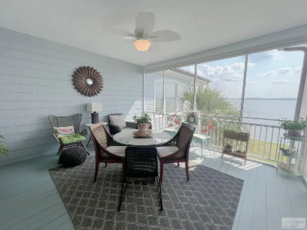
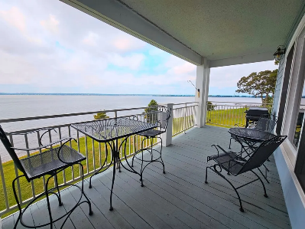

North Shore on Lake Marion Open Houses Sunday October 13th from 2-4pm
1130 BRIDGEVIEW LN
# C101
MLS# 165805 | $360,000
2 BED | 2 BATH | 1,531 SQFT
1170 BRIDGEVIEW LN
# D301
MLS# 157994 | $599,999
4 BED | 4 BATH | 2,365 SQFT
1172 BRIDGEVIEW LN
# D302
MLS# 165279 | $485,000
3 BED | 3 BATH | 1,957 SQFT
Lake Homes Realty, LLC
Elloree, SC 29047
www.SCLakeLife.com
Kristie Anderson
(803) 387-9459
kristie@sclakelife.com

