Slide 1
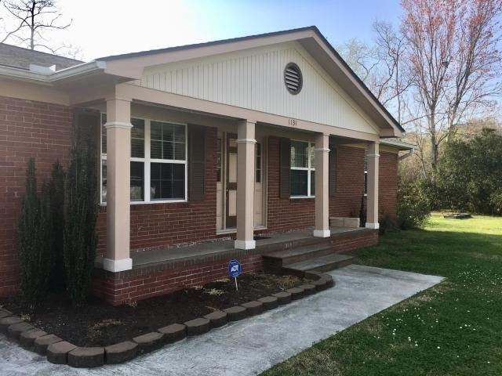
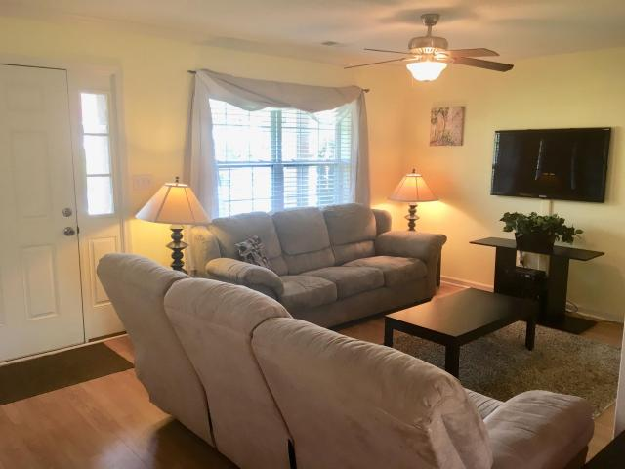
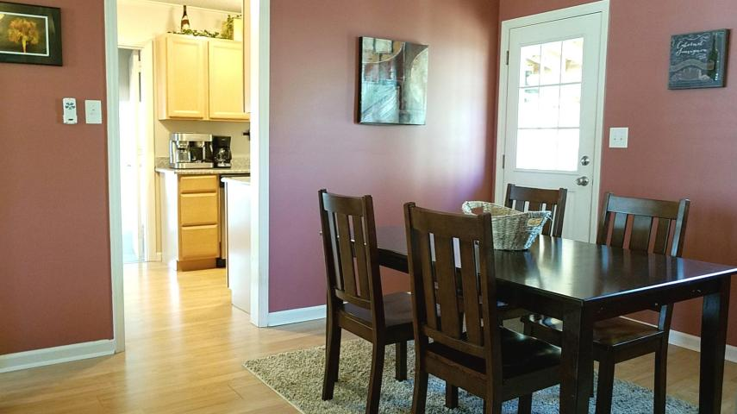
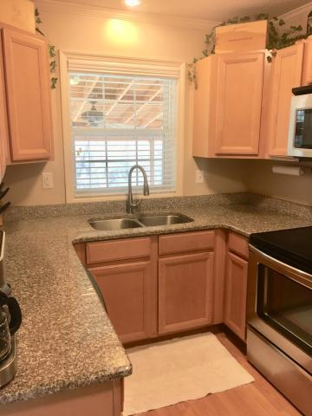
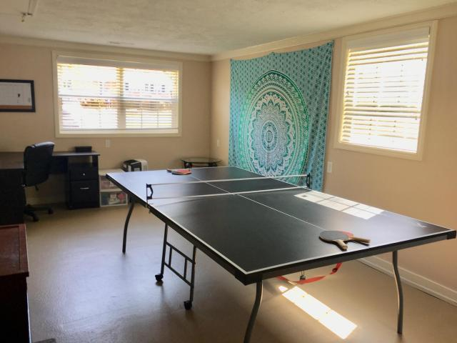
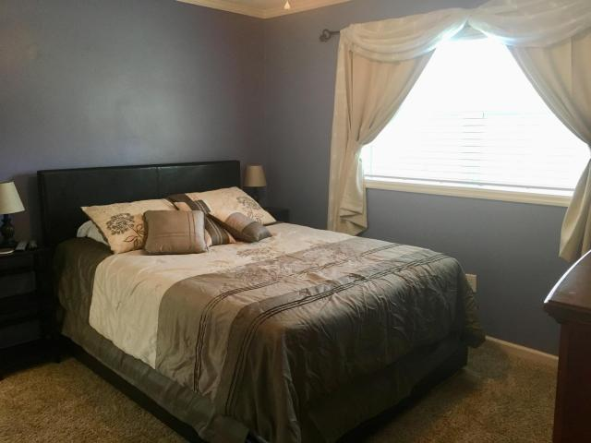
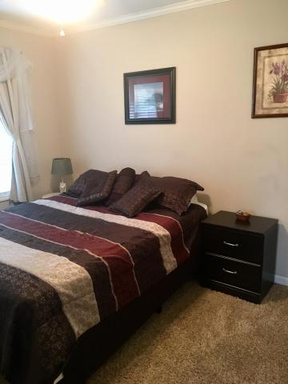
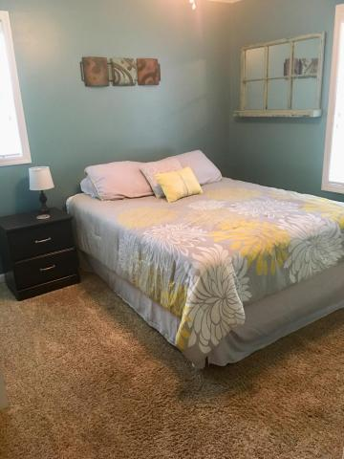
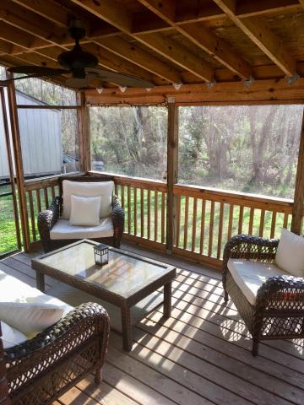
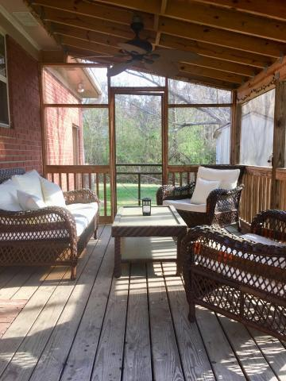
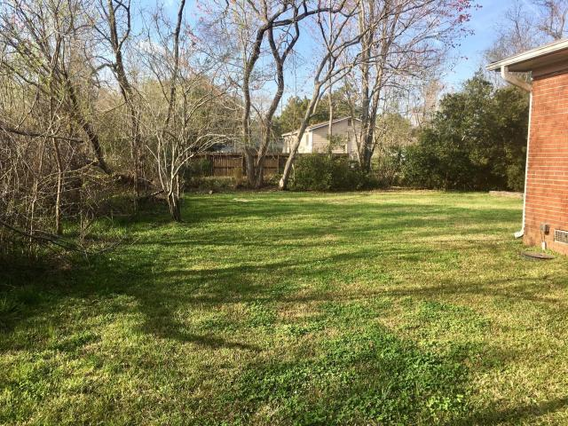


Best Deal on James Island! Renovated and Only $285!
1131 Oceanview Road
Pineview · Charleston · MLS# 18006076 · $285,000
Move right in, this house is turn key. Minutes from beach or connector to downtown. Roof was replaced in 2012 and HVAC, including ductwork, was new in 2014. Kitchen offers lots of storage and granite counters. Master bedroom has ensuite bath. Converted garage area makes for great flex space! Use as a den, game room, home office, playroom...many possibilities. The large yard offers plenty of room to spread out. Shed conveys and offers good storage for your bikes and tools! Relax on your screened porch at the end of the day and take a load off. Easy to see!
Keller Williams Realty Charleston West Ashley
1180 Sam Rittenberg Ste 105
Charleston, SC 29407
Amy Zonarich Powers
Realtor
(843) 534-3523
amy@amyzonarich.com
www.liveandlovecharleston.com

