Slide 1
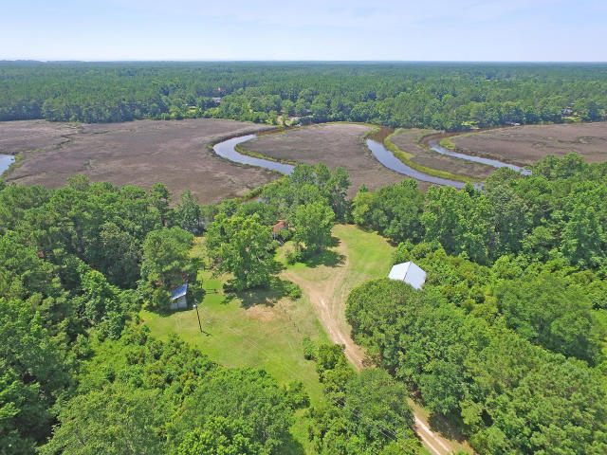
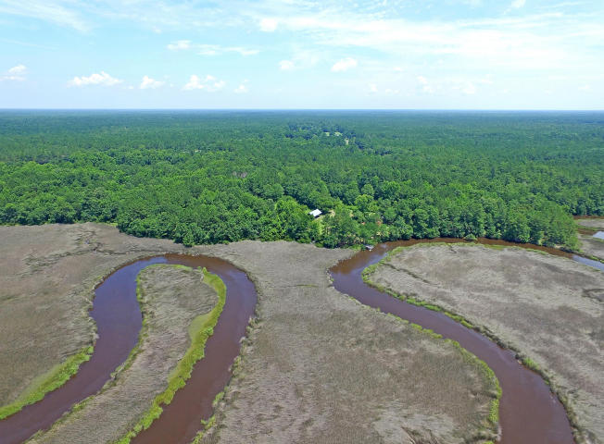
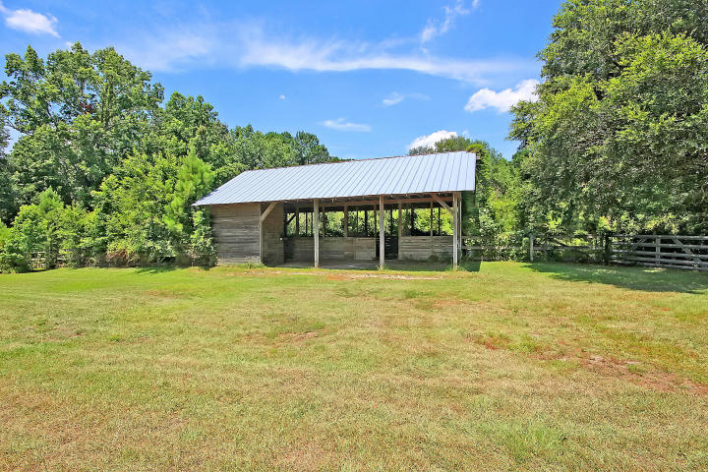
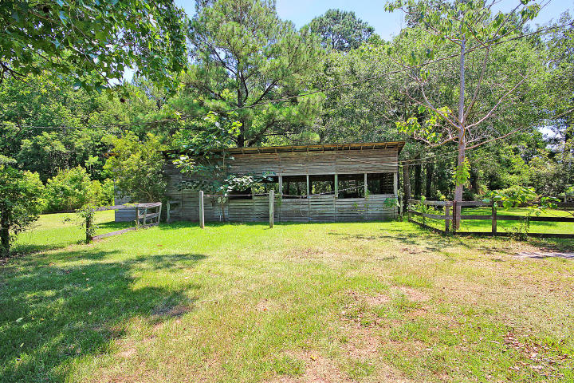
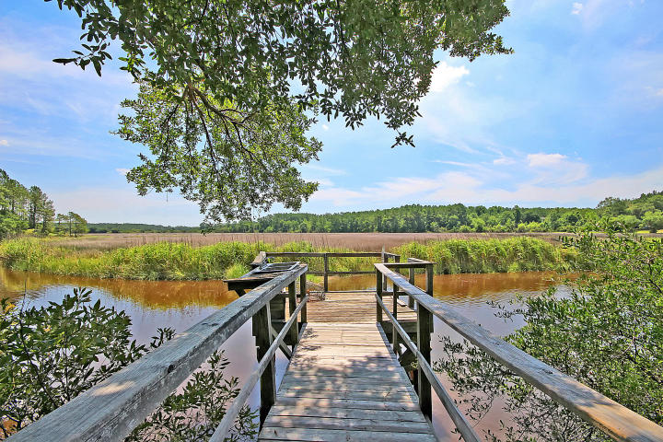
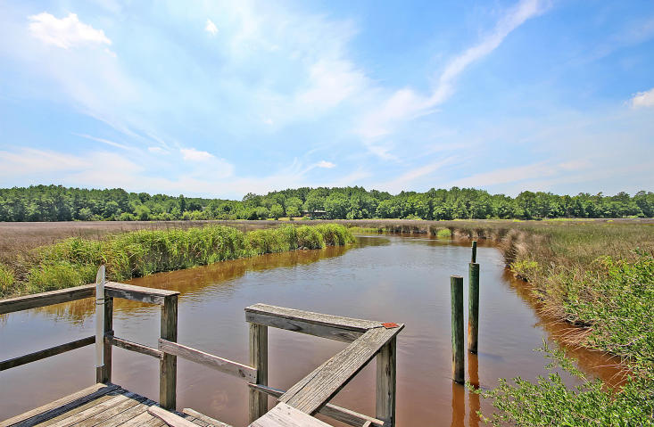
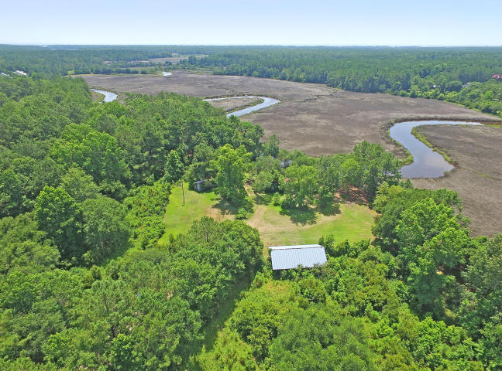

Deep Water Lot Waiting For Your Dream Home
1132 Theodore Brunson Road
Awendaw, SC 29429 ~ MLS# 16017341 ~ $1,175,000
Deep water with direct access to the Intracoastal! 19 acres with 1200 Ft of water frontage on the Awendaw Creek means endless possibilities. Whether you’d like to custom build the home of your dreams and take advantage of the barns, pasture and riding trails for your horses or you’d like to sub-divide the land up to 10 times for development of prime water front real estate, this is an incredible opportunity. Privacy abounds, beautiful is at every turn and the serenity of the creek that weaves its way back and forth through the marsh is simply gorgeous. Zoned agricultural.
See more at http://www.philshepard.com/1132-theodore-brunson
Ben Laaper ben@mattoneillteam.com 843-642-3546

