Slide 1
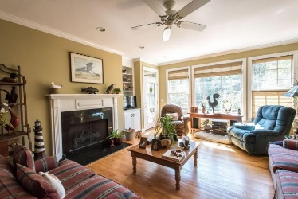
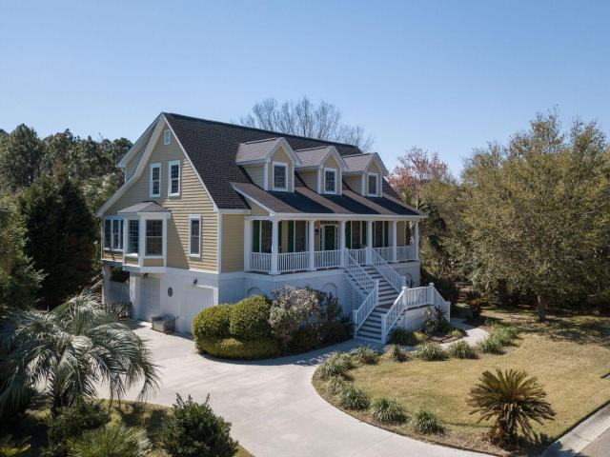
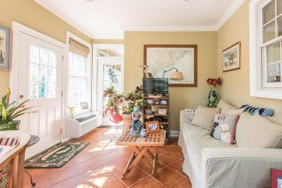
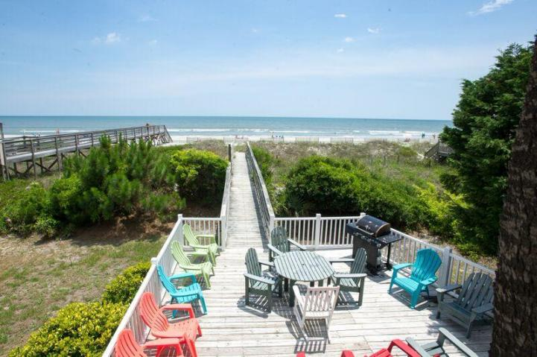
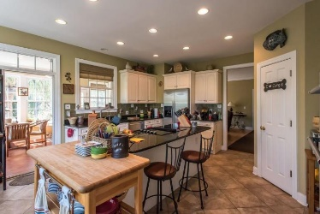
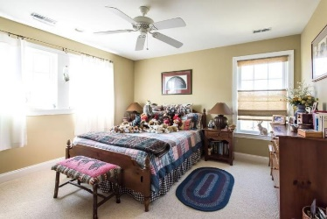
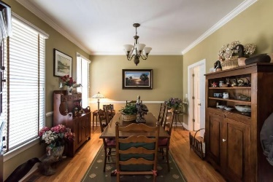
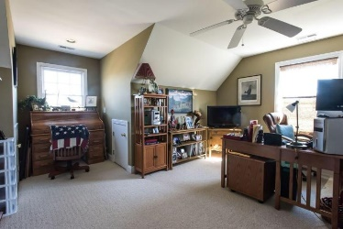
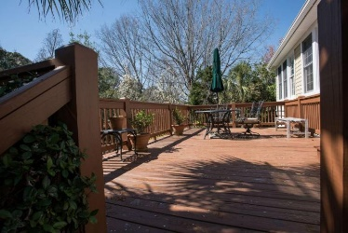
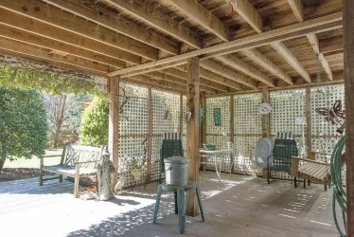
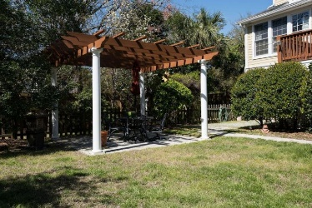
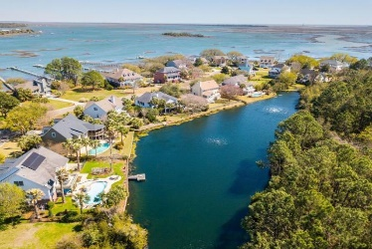


Luxury Waterfront Home On James Island
1133 Sea Eagle Watch
Seaside Plantation · Charleston, SC 29412 · MLS# 18006449 · $724,900
BEAUTIFUL LOWCOUNTRY DESIGN BY HILTON GEORGE WITH ELEVATOR. 4 BEDROOMS PLUS LARGE LIVING ROOM, 3 1/2 BATHS. GRANITE COUNTER TOPS IN KITCHEN & BATHS. BEAUTIFUL SEOARATE DINING ROOM. LOT BACKS UP ON QUIET LAGOON AND FACES CLARK SOUND ACROSS THE STREET. TOP QUALITY CONSTRUCTION BY ONE OF AREAS FIRST BUILDERS. HOME HAS HARDWOODS, CERAMIC TILE AND EXCEPTION VIEWS WITH GORGEOUS SUNROOM OVERLOOKING LAGOOON WITH ACTIVE TURTLES AND BEAUTIFUL WATER FOWL. MASTER BEDROOM IS ON THE MAIN LEVEL AND GUEST ROOMS ARE UPSTAIRS GIVING A NICE SEPARATION FOR VISITORS. ONE OF THE LARGEST LOTS ON JAMES ISLAND AND THE AREA BEHIND HOME IS LIKELY NONBUILDABLE AS WETLANDS GIVING THE ILLUSION OF EVEN MORE SPACE. WORKOUT AREA AND GARAGE SHOWER/PET BATHING AREA IS IN ADJACENT TO GARAGE INSIDE. BOAT LANDING IS IN THE NEIGHBORHOOD AS WELL AND MAKES FOR EASY LAUNCH INTO SEASIDE CREEK. THE FLOW IN THE HOME IS SPECTACULAR AND ENTERTAINS VERY WELL. MANY WINDOWS ALLOW IN NATURAL LIGHT AND THE SUNROOM WILL MAKE ANY VISITOR ENVIOUS. THERE IS MORE CLOSET AND STORAGE SPACE IN THIS HOME THAN ANY OTHER SEEN IN SEASIDE ESTATES WHICH IS THE PREMIERE NEIGHBORHOOD IN SEASIDE PLANTATION. ESTABLISHED LANDSCAPING LOOKS FANTASTIC WITH NICE GATED FEATURES. HOUSE RECENTLY PAINTED AND IN EXCELLENT CARE AND CONDITION. MUST SEE.THIS GORGEOUS HOME.
Bryan Thompson
Office - (843) 769-5100
Mobile - (843) 452-1686
bryan.thompson@agentownedrealty.com
www.bryanthompsonrealestate.com
AgentOwned Charleston Group | 902 Savannah Hwy | Charleston, SC 29407-7802

