Slide 1
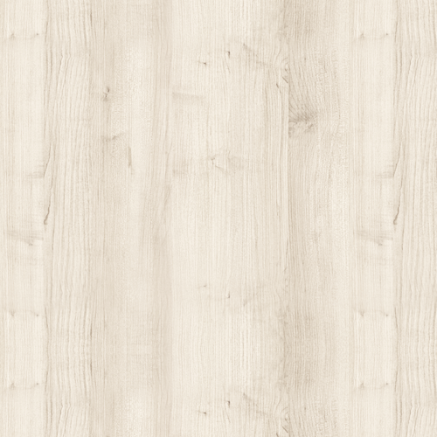
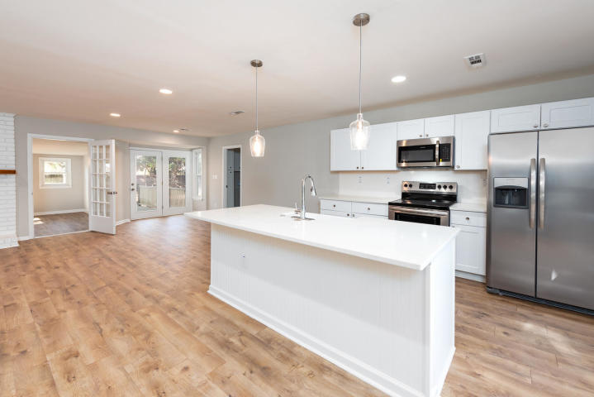
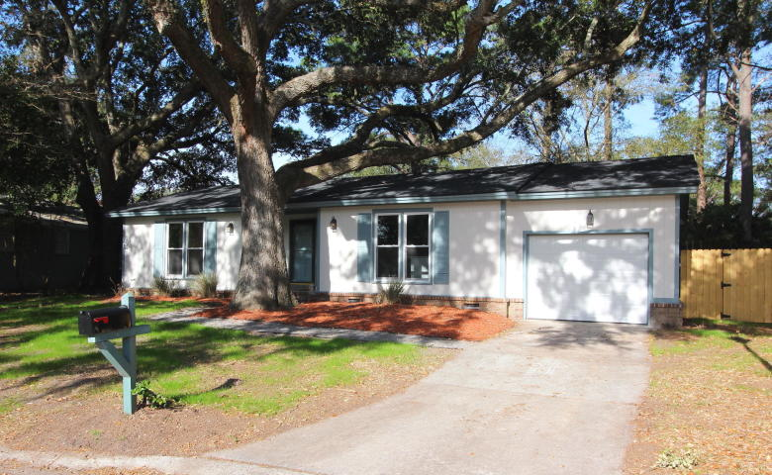
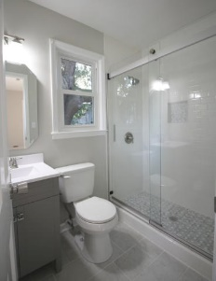
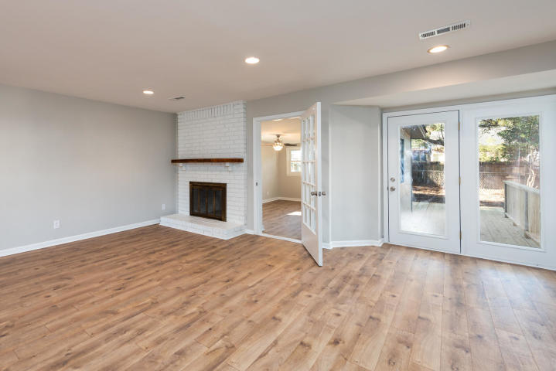
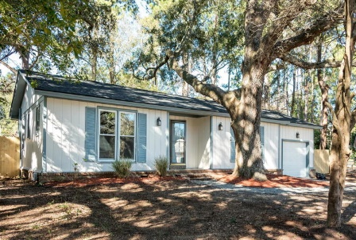


Reduced To Sell! Great Mount Pleasant Location Under $400k!
1134 Lee Shore Lane
Harborgate Shores ~ Mount Pleasant, SC 29464 ~ MLS# 19001041 ~ $399,900
Nestled among the large live oaks is 1134 Lee Shore Lane. This home has been completely renovated, inside and out. upon entering, you're greeted by a large open concept floorplan and new flooring. The kitchen is equipped with all new appliances, cabinets, beautiful countertops, and farm sink. Beyond the living area is a separate den that would make a great office or kids play area. Just behind the den is the backyard with a new deck that cascades into a large backyard with a workshed. Back through the hall are the 3 bedrooms with the new ensuite master on the left. All new upgraded tile, vanities, and fixtures in both baths with great attention to detail. The home is conveniently located close to Coleman Blvd and Sullivan's Island and great shopping. Hurry and schedule your visit today! !
Peter Stanley
M 843-300-8251
petermstanleyjr@gmail.com
Brand Name Real Estate
4 Carriage Lane Suite 106
Charleston, SC 29407

