Slide 1
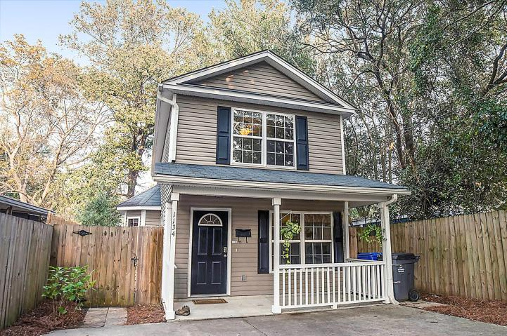
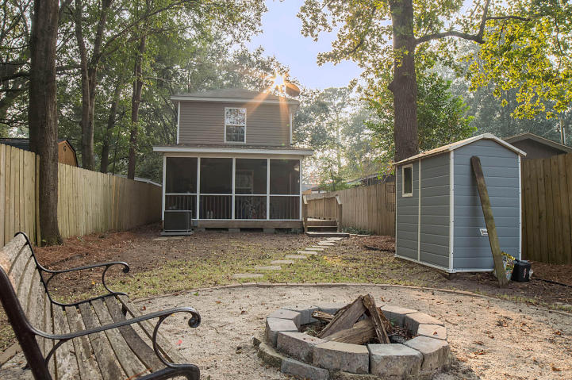
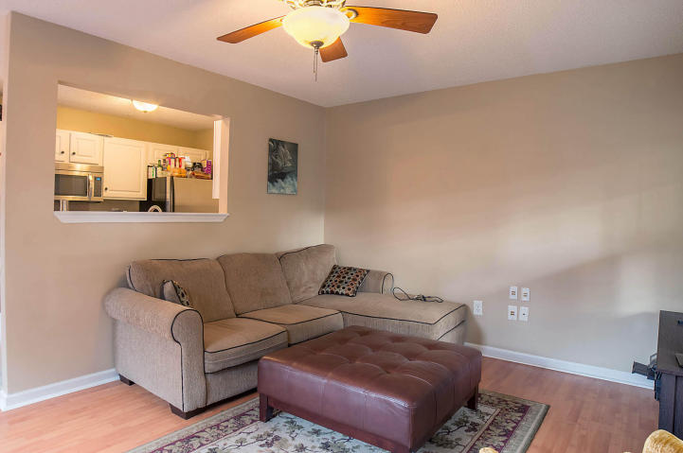
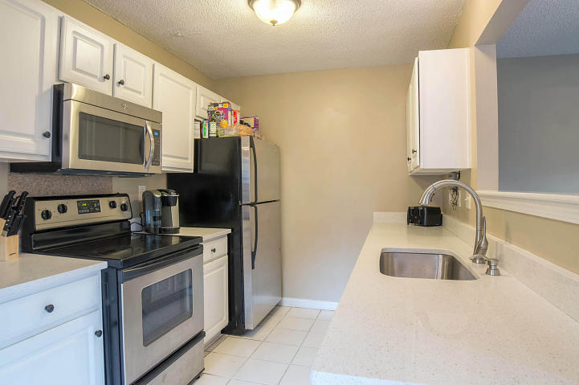
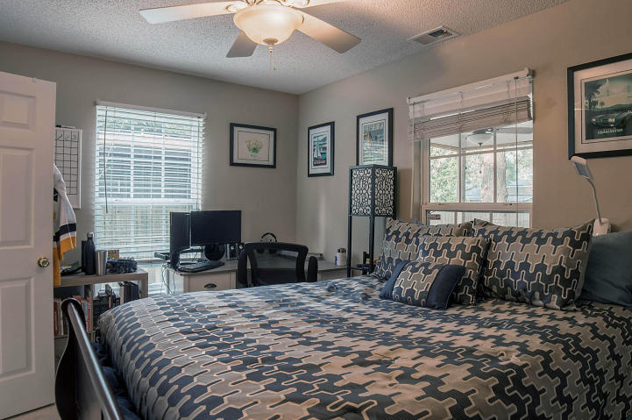
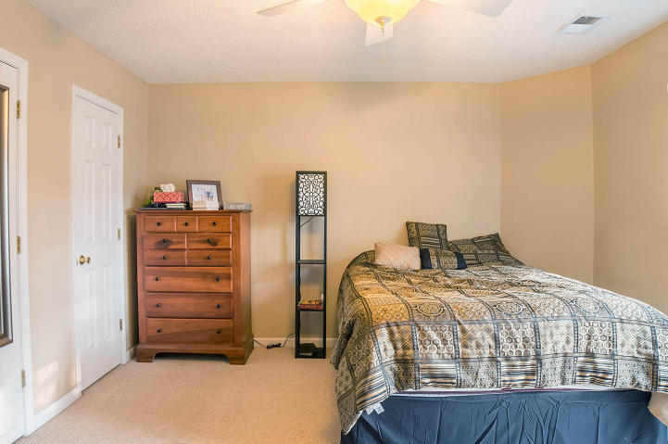
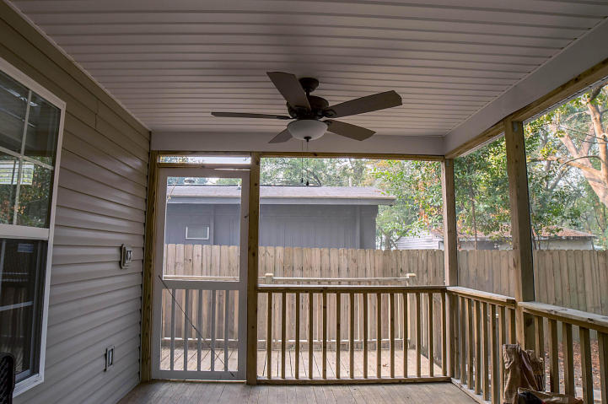


1134 Leesville Street
North Charleston ~ MLS# 17012545 ~ $266,500
Seller is offering a buyer $4,000 towards updating/closing costs/repairs w/acceptable offer. Brand new HVAC and air handler installed 6/5/2017.
3 Bed / 2 Bath
1,324 Sq Ft
Great Location
Updated Kitchen
Structured Wiring
Screened Porch
Fire Pit
Well kept, open 3BD/2BA PARK CIRCLE home conveniently located and in walking distance to bars and restaurants. This home features white tile in the kitchen and both baths, laminate hardwoods downstairs and berber carpet in all 3 bedrooms. The kitchen offers white cabinets, NEW stainless appliances, NEW quartz countertops with a NEW deep one compartment stainless sink and faucet. The home is wired for surround sound and security system. The home has a large screened in porch off the back with two NEW ceiling fans. Step out back and you'll find the yard completely enclosed with a wood privacy fence, small storage shed and a fire pit.
Leah M. Rust
843-709-9211 Mobile
843-856-8800 Office
leahmrust@gmail.com
Coldwell Banker RESIDENTIAL BROKERAGE

