Slide 1
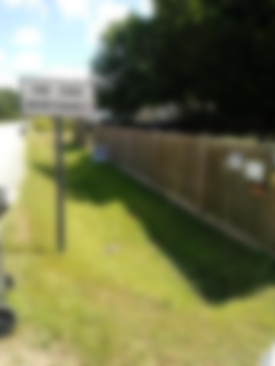
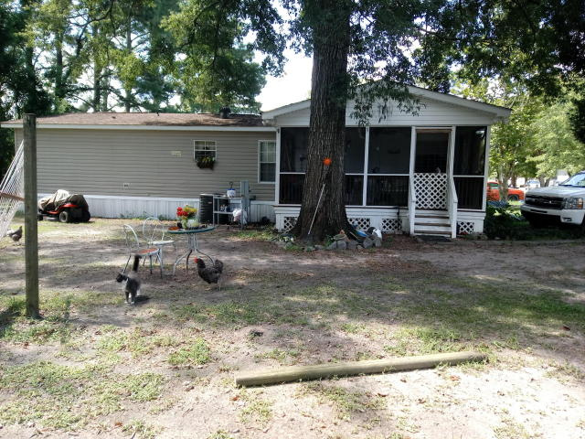
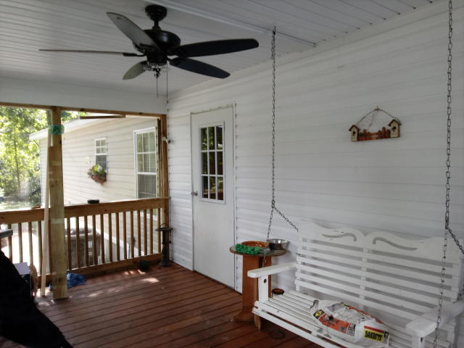
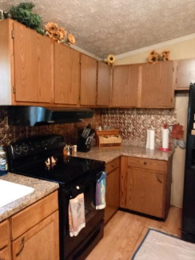
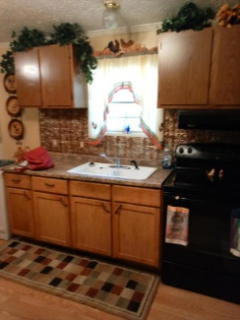
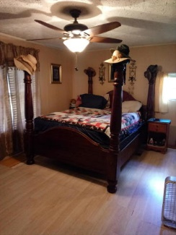
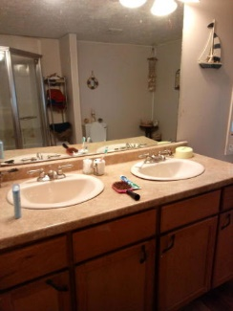
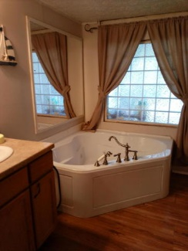
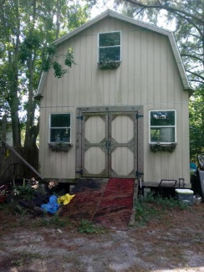


1134 Wilhite Drive Caromi Village | Ladson, SC 29456 MLS# 18024062 | $160,000
3 Lots for the Price of One
Starbucks card to first 10 agents
1996 Double wide mobile home with 3 lots. Owners have replaced the shingle roof and updated the AC within the past 3 years. They also added a screen porch. Home sits on one lot, empty lot then the last lot has a wood utility building with upstairs that is unfinished that could become an apartment. Great investment property!
Liz Butler M (843) 367-6604 | O (843) 795-6221
lizbutlerhomes@gmail.com | www.AgentOwned.com
AgentOwned Charleston Group | 902 Savannah Hwy | Charleston, SC 29407

