Slide 1
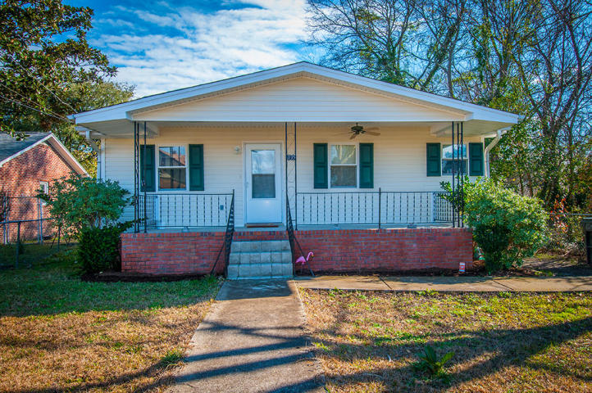
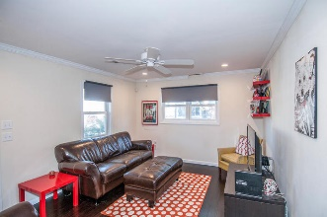
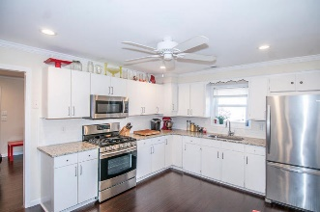
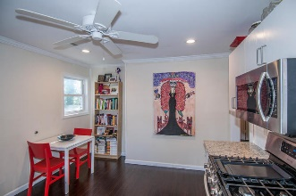
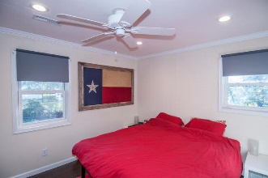
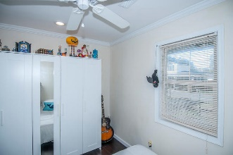
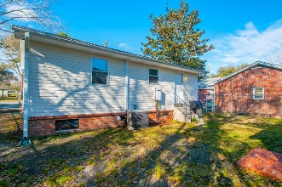

Updated & Upgraded
Open House Saturday 12-3 Refreshments Provided
1135 Forbes Avenue
Maryville :: Charleston, SC 29407 :: MLS# 16004923 ::$169,900
Check out this beautifully updated, cottage style home located in the Avondale/Magnolia corridor for under $200K! This 2 bedroom, 1.5 bath home has great updates including new bamboo flooring, granite kitchen counters, and brand new Rinnai tankless water heater. It features smooth ceilings, recessed lighting, stainless appliances, crown molding, tiled shower/bath, relaxing full front porch, large eat-in kitchen, fenced in yard, backyard storage shed, and more. This Maryville location is very convenient to the Avondale shops and restaurants, downtown Charleston, I26, I526, and all parts of town. It's walking distance to Home Team BBQ. Come see it today.
Scott Baskin
843-324-4139 M | 843-972-2400 O scott.r.baskin@gmail.com | www.scottbaskin.com
RE/MAX Advanced Realty
311 Johnnie Dodds Blvd
Mt Pleasant, SC 29464

