Slide 1
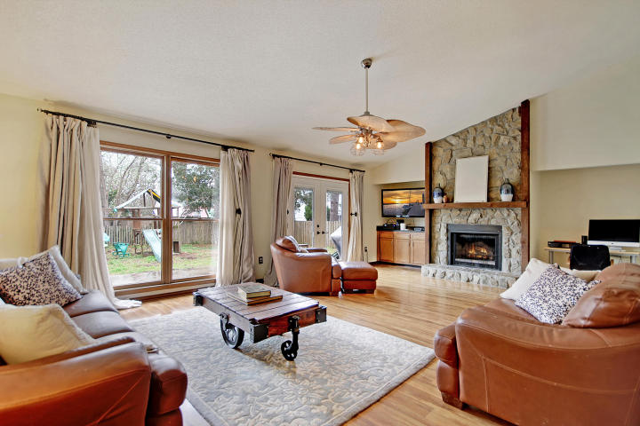
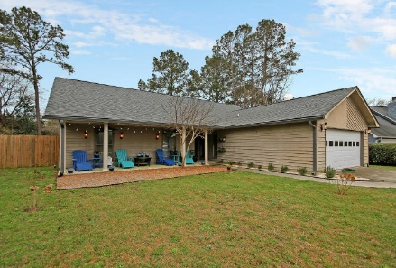
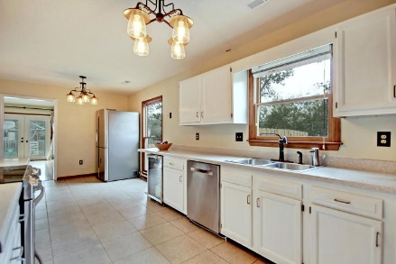
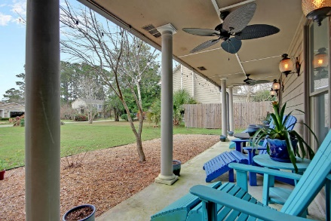
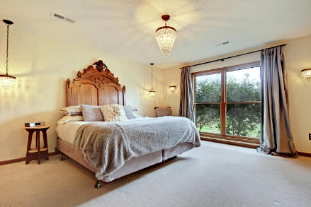
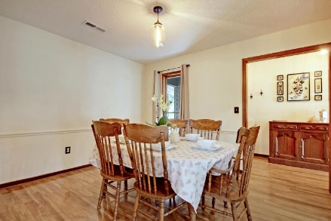
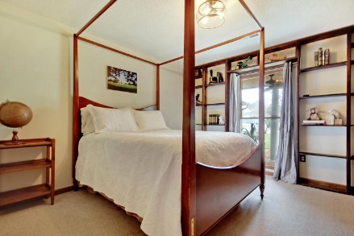
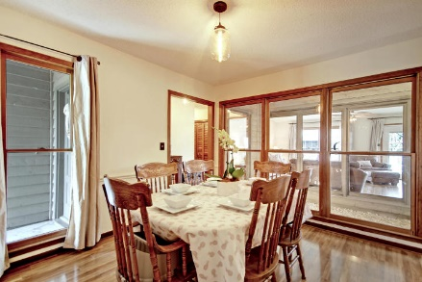
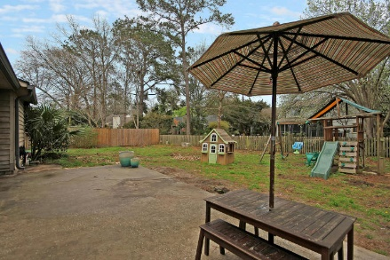
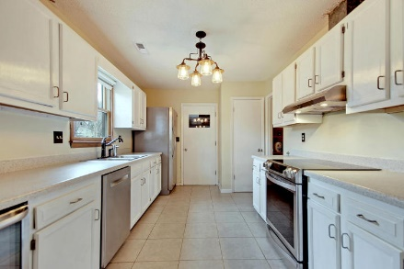
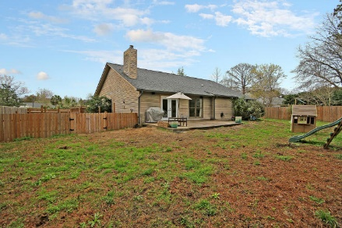

Open House
March 17th from 1-3
Price Reduced
For Quick Sale
Open House Saturday 12-3
1137 Club Terrace
Snee Farm ~ Mount Pleasant, SC 29464 ~ MLS# 18005344 ~ $429,900
One level living with a third of an acre in Mount Pleasant awaits you on this beautiful Snee Farm cul-de-sac. The heart of the home is the spacious living room with its vaulted ceiling, floor to ceiling window to let in natural light, fireplace with stone surround & access to the patio & huge backyard.
The kitchen has top of the line, special order stainless steel appliances, a built-in wine fridge, an eat-in area & allows access to the laundry room & dining room. Whether you're relaxing on the front porch with a ice cold sweet tea or enjoying an afternoon barbecue on the back patio this home has beautiful spaces inside & out to enjoy the lowcoutry! You're also conveniently located to shopping, dining, downtown the beaches and the community pool, tennis & golf course.
Additional features include:
Eat in space in the kitchen as well as a full dining room at the front of the house off the kitchen
New AC system has built in house-wide air purification system which is great for reducing allergens
Large, fully fenced-in backyard
Subdivided fenced area great for pets or a garden off the kitchen
Book your showing soon!
Katie Wishneff kwishneff@mattoneillteam.com 843-870-8784

