Slide 1
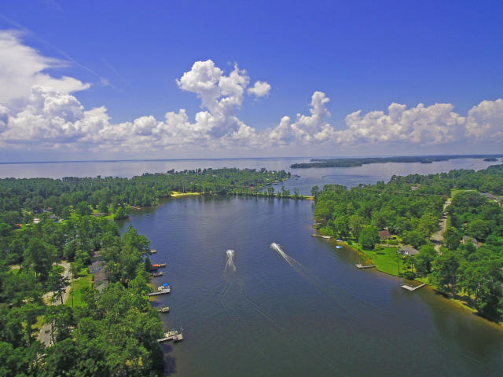
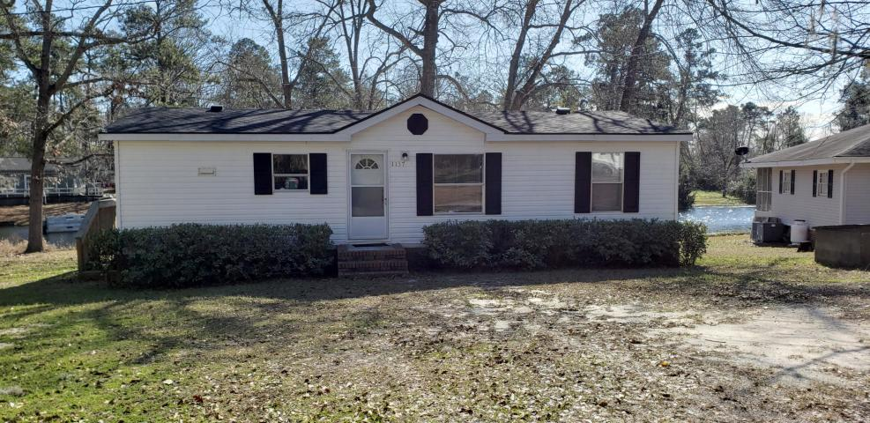
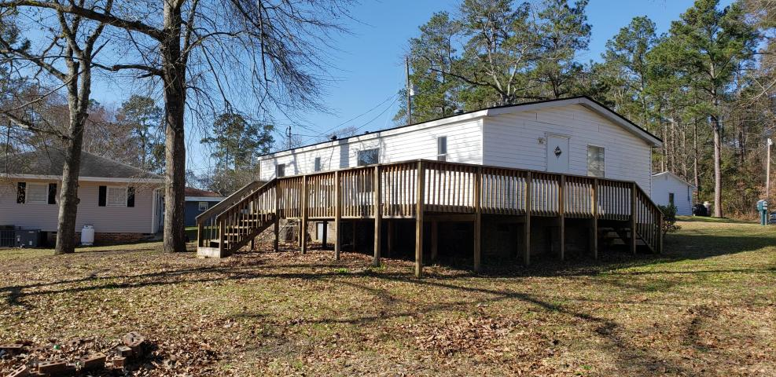
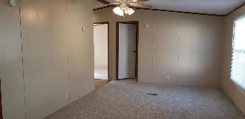
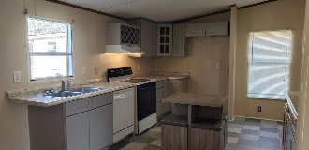
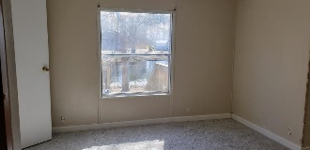
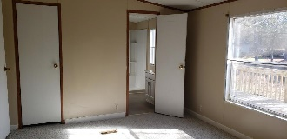
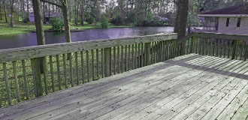
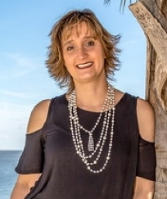
BACK ON THE MARKET
1137 Delano Street
Manning, SC 29102 ~ MLS# 20002280 ~ $100,000
3 bedroom 2 bath Detitled Mobile home sitting on the Church Branch area of Lake Marion. This home sits on a deeded lot.
Be on the lake this summer.
Lake Homes Realty, LLC
Elloree, SC 29047
www.SCLakeLife.com
Kristie Anderson
(803) 387-9459
kristie@sclakelife.com

