Slide 1
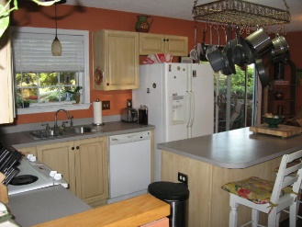
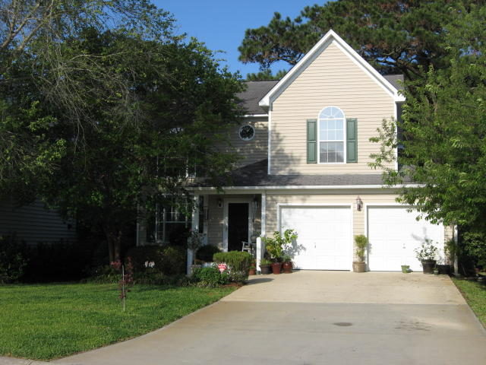
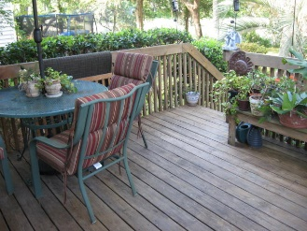
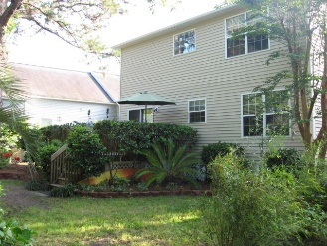
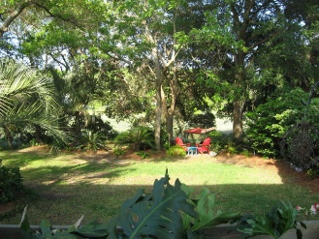
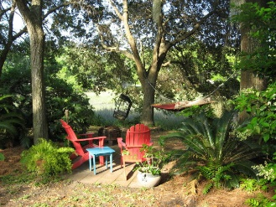


Tidal Creek Hideaway
1138 Tidal View Lane
Bayview Farms · James Island MLS# 16011257 · $365,000
Maria Latto
REALTOR, GRI
(843) 327-1025
maria@agentownedrealty.com
www.agentowned.com
This is nature lovers dream at this quiet marsh front tidal creek home. You can access Clark Sound and Charleston Harbor around medium to high tide. Gorgeous views from your 12x14 deck and a huge backyard! There is also an in-ground sprinkler system. Open floor plan and high ceiling in the Great room with a wood burning fireplace. Separate dining room off the great room and a large and spacious kitchen. Beautiful family home in the much sought after Bayview Farms Subdivision. Lender paid closing costs of 0.50% of the loan amount, redeemable only at time of closing when financing is completed by the Seller's preferred lender. Closing costs credit must be mentioned at application and may only be applied to offset actual costs.
AgentOwned Charleston Group
902 Savannah Hwy
Charleston, SC 29407
Real Estate ● Mortgage Insurance ● Business Brokerage

