Slide 1
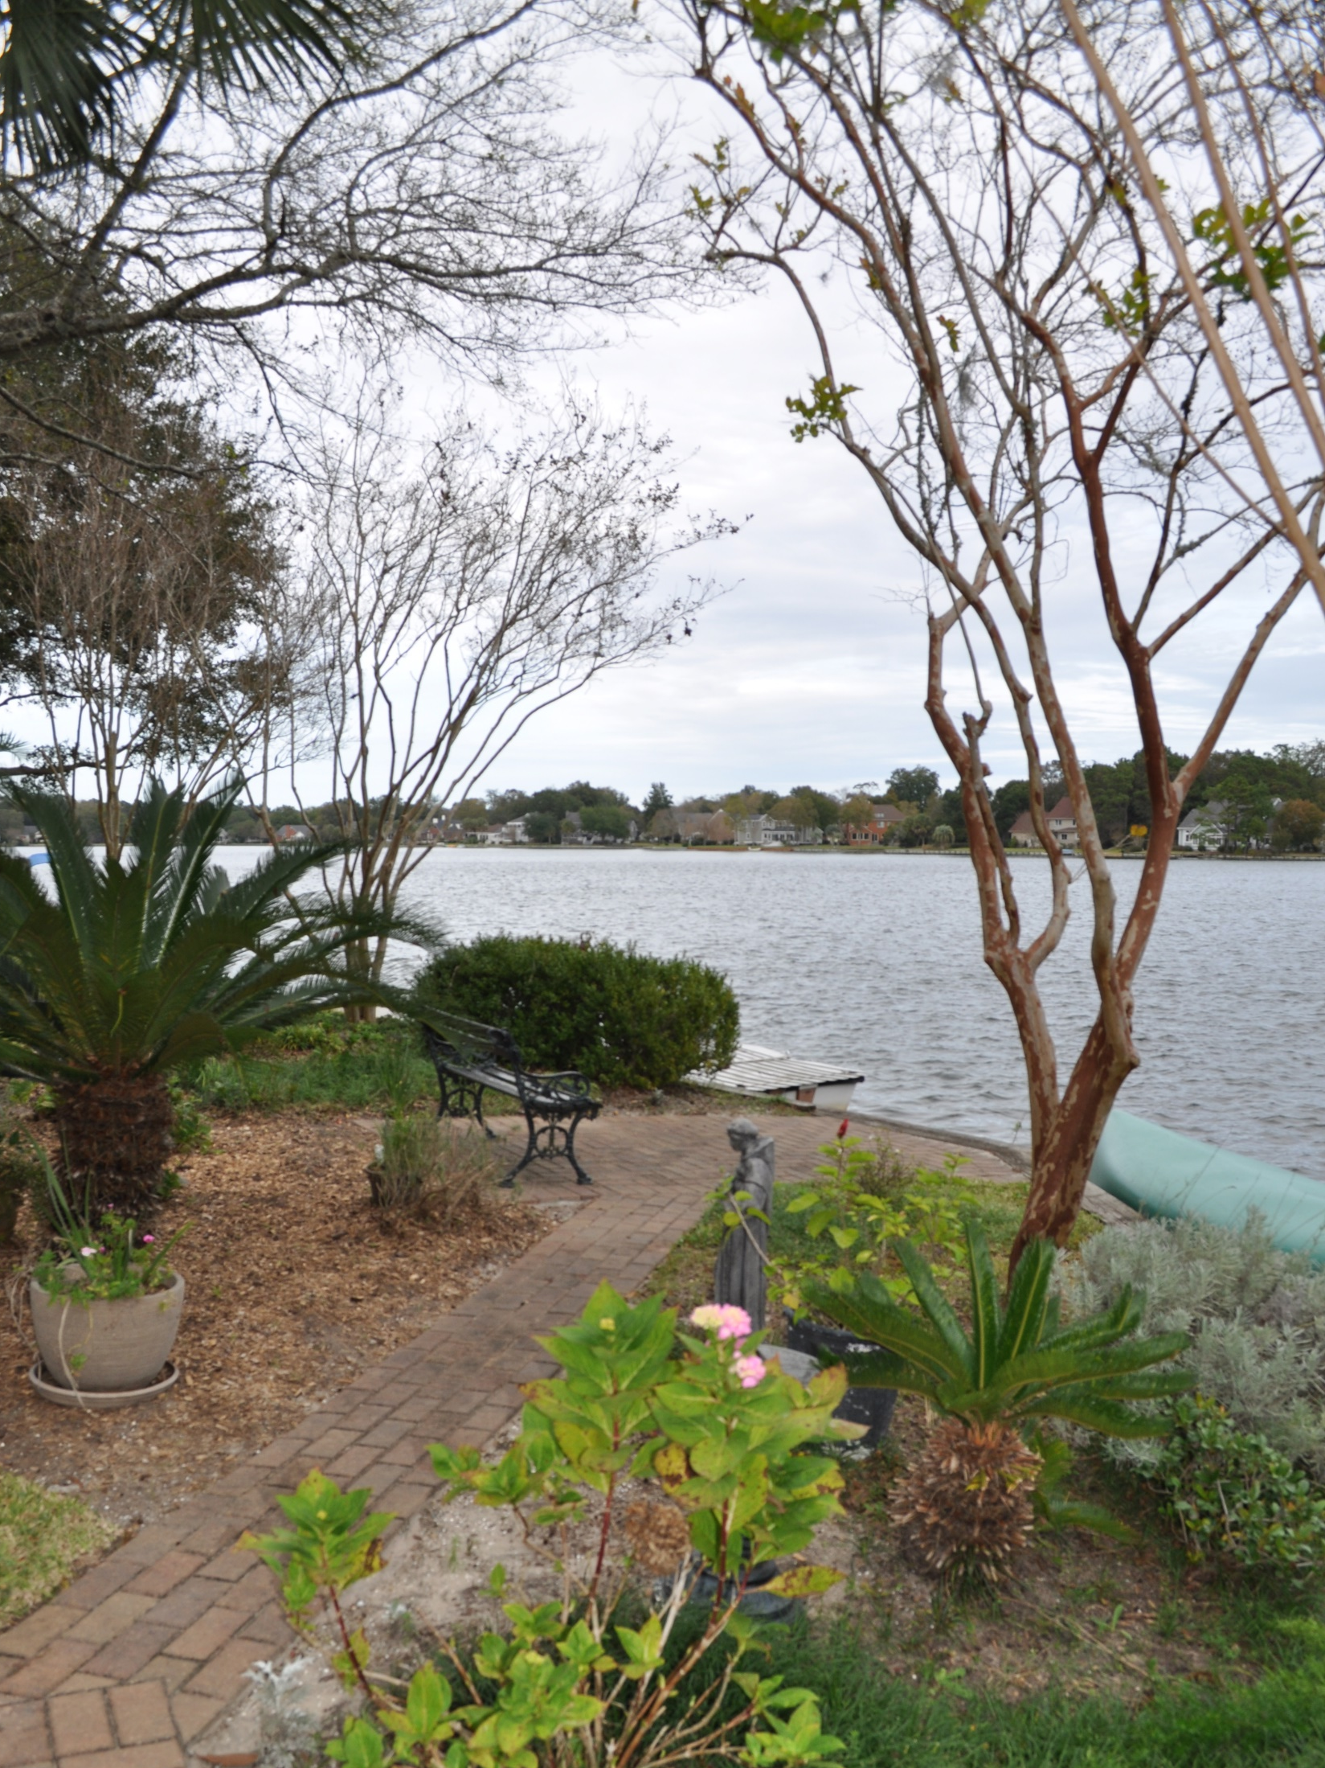
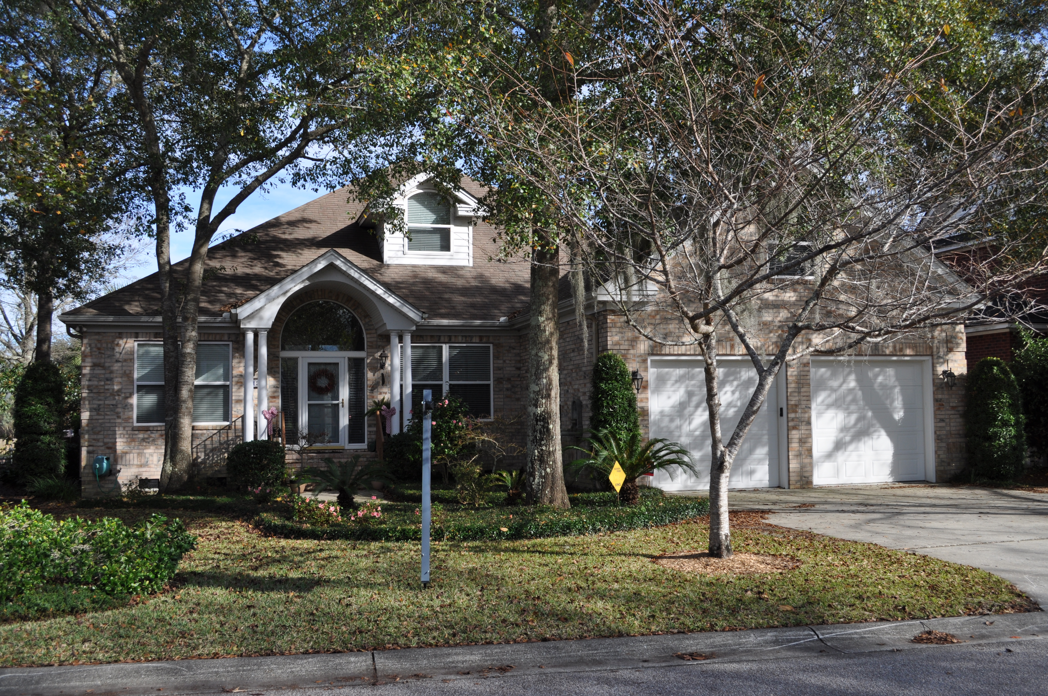
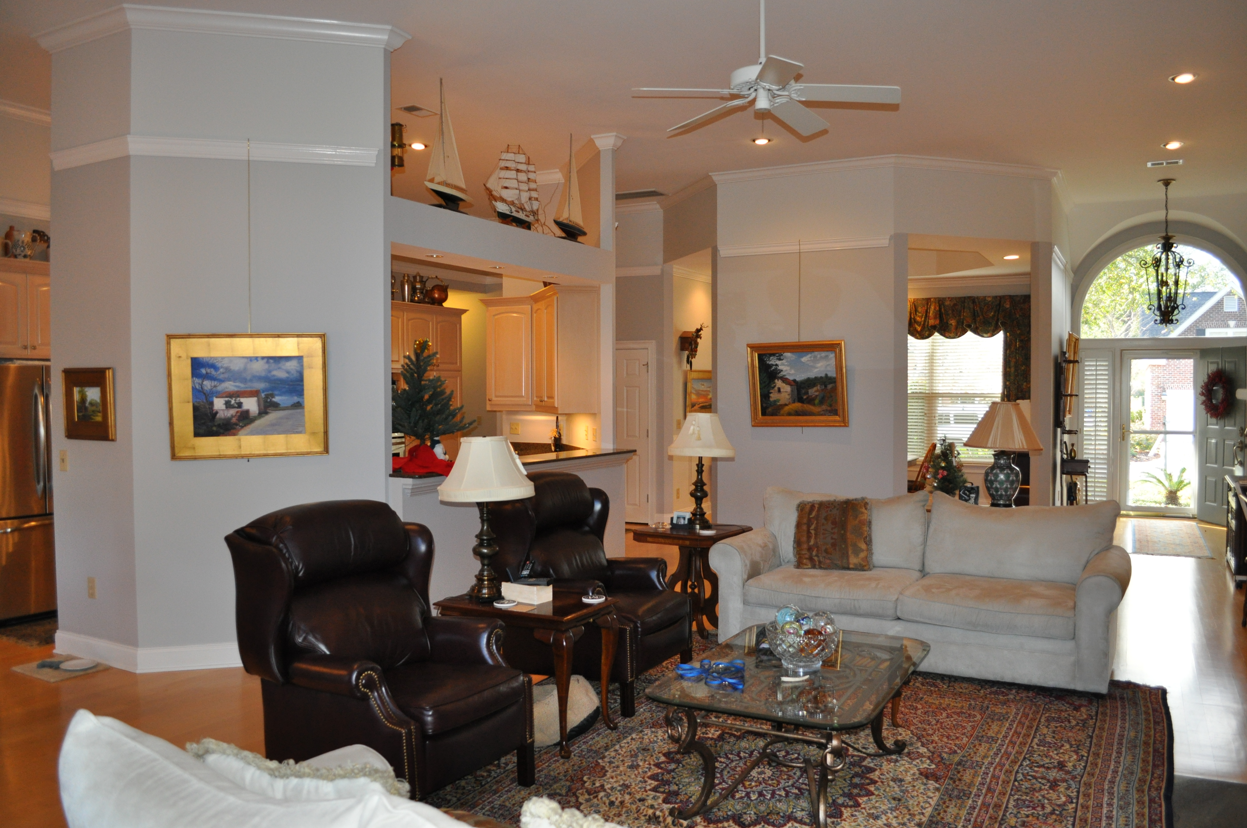
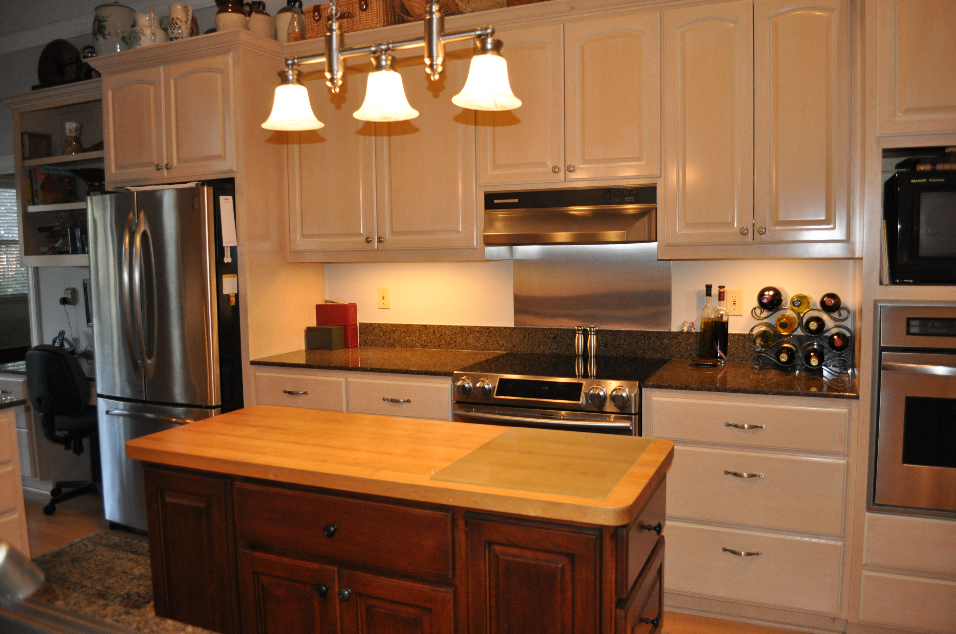
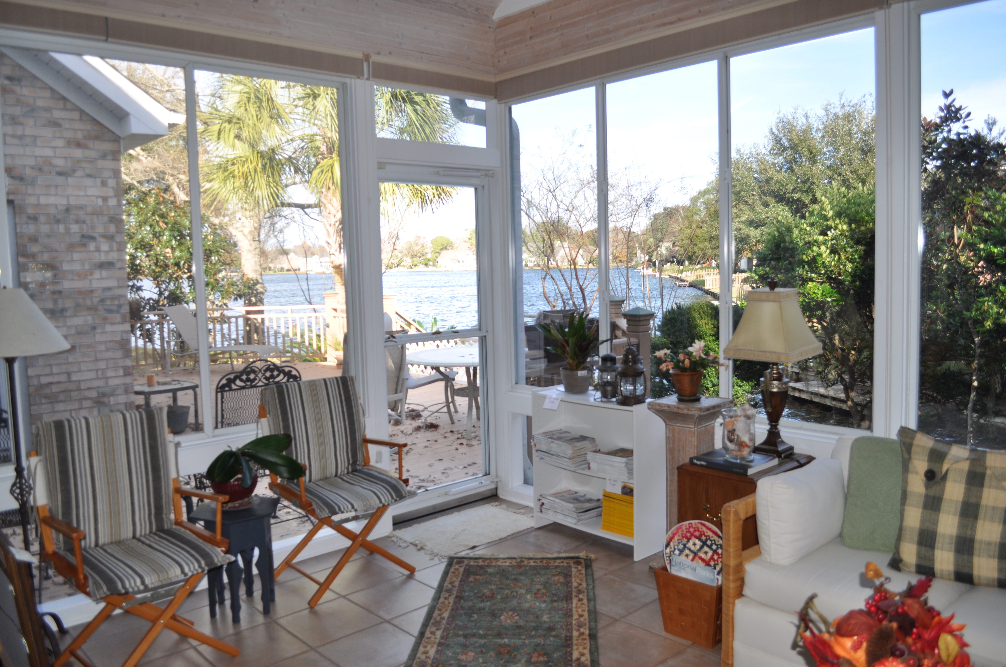
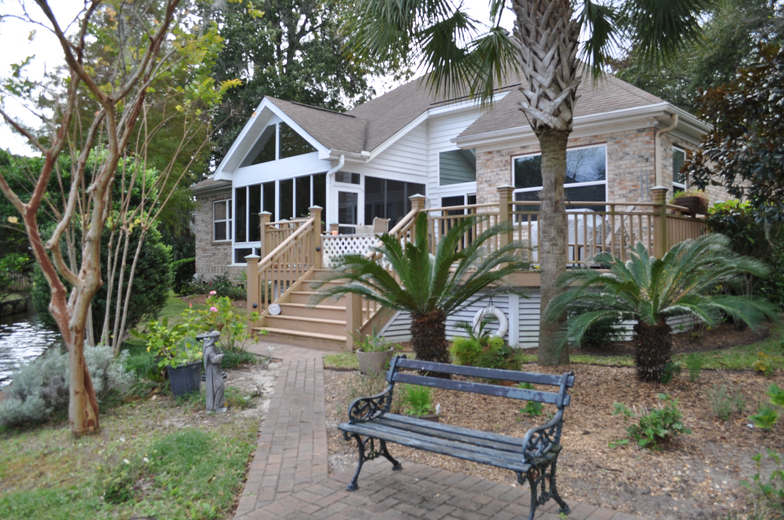
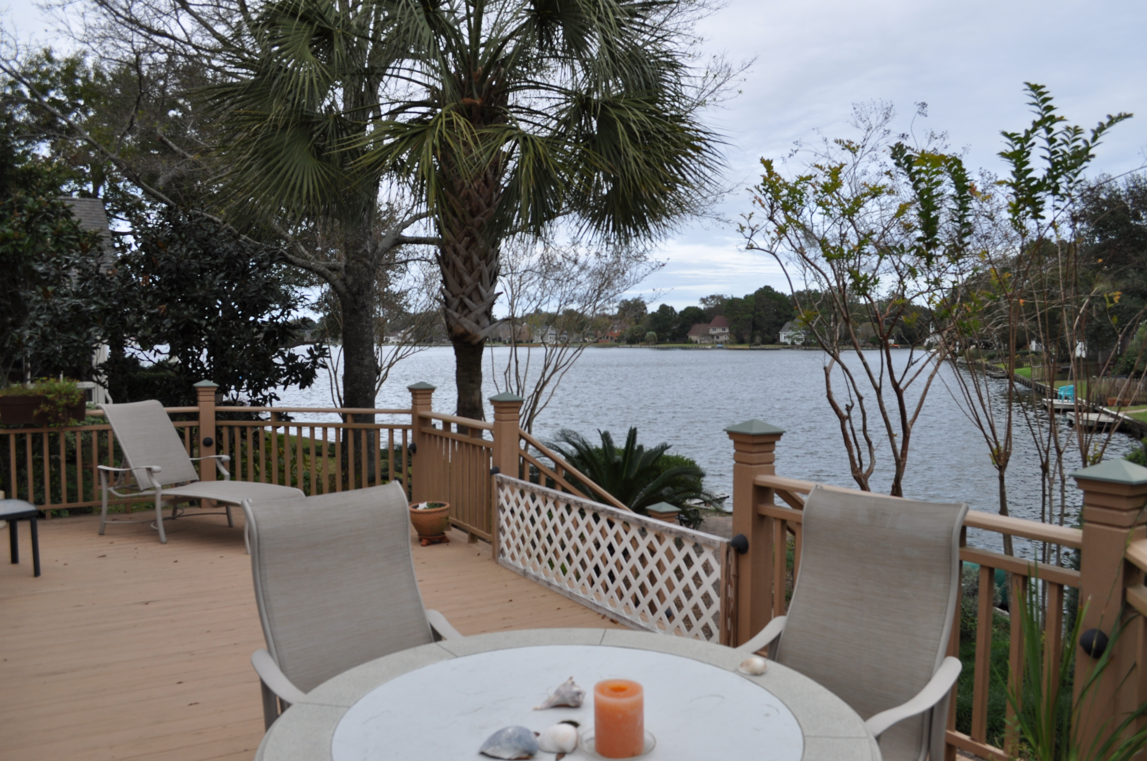



1138 Waterfront Dr
Hidden Lakes ~ Mt Pleasant ~ MLS# 16000069 ~ $765,000
GORGEOUS VIEWS OF THE BIG LAKE!
This wonderful, custom brick ranch sits on the corner of the big lake and a canal in Hidden Lakes Subdivision. All of its 4 bedrooms are on the ground-floor, plus it has a very large FROG with it’s own 1/2 bath upstairs that could be used as a 5th bedroom! (FROG does not have a closet, but does have easy access to the huge attic storage) The owners incorporated heaps of wonderful details into this high-quality home when they had it custom built in 1999. Some examples are the oversized, two-car garage (approx. 24′ x 24′) with 8′ x 9′ garage doors instead of the standard 7′ x 8′ doors; a hot water loop throughout the kitchen and bathrooms; solid-wood cabinetry; granite counter tops and stainless appliances in the kitchen.
The Boulevard Company, LLC
Mark Macpherson
mark@beachbreak-properties.com
843.367.5640 Mobile

