Slide 1
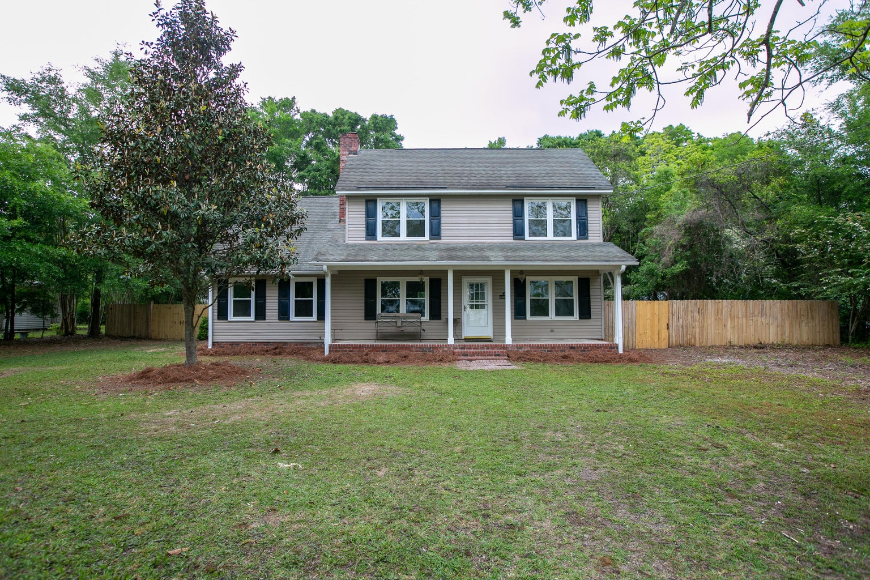
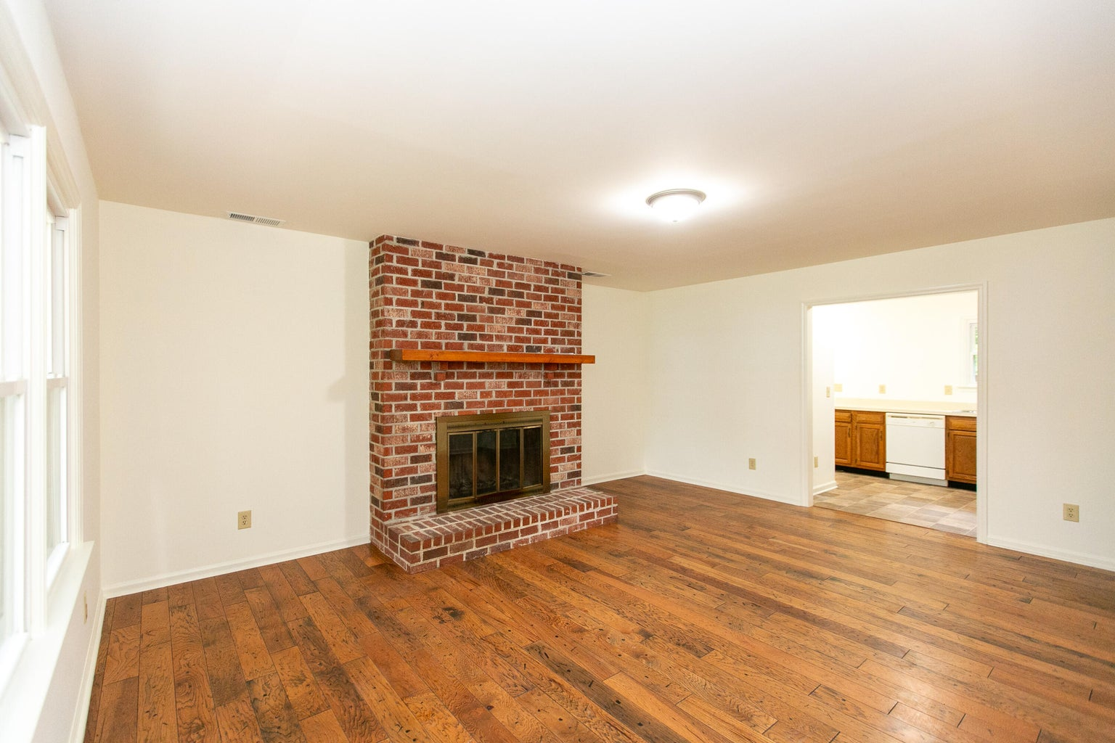
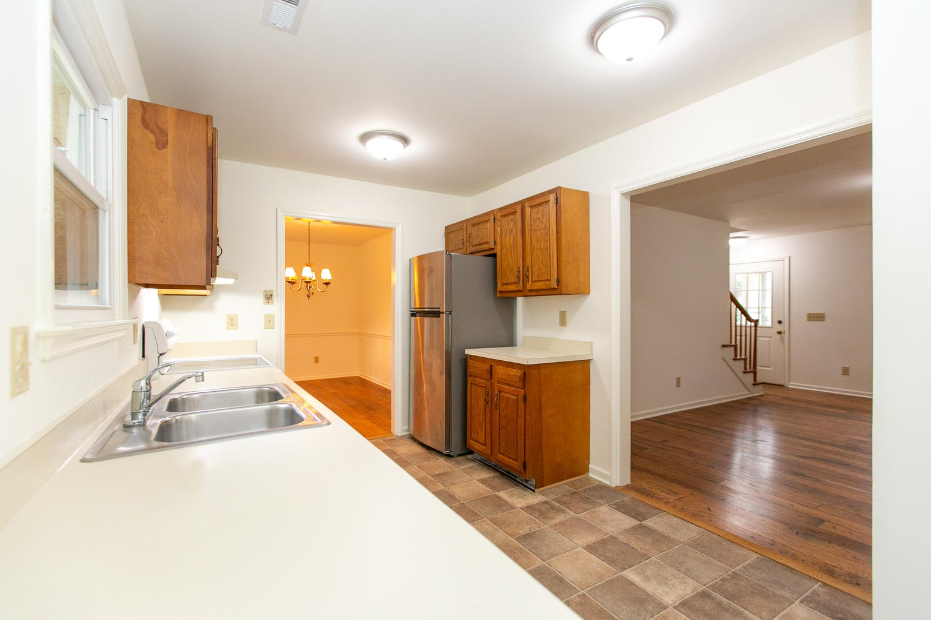
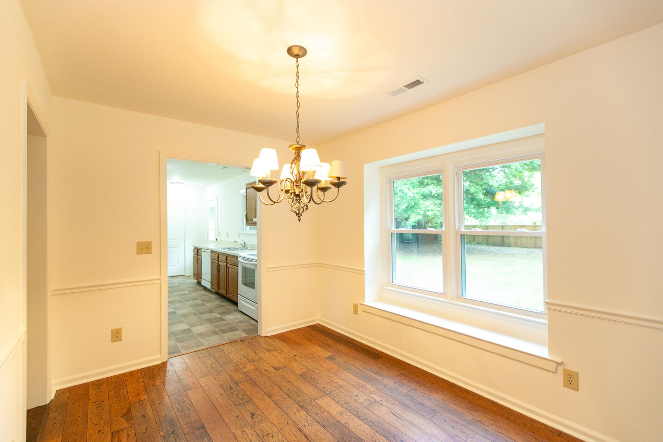
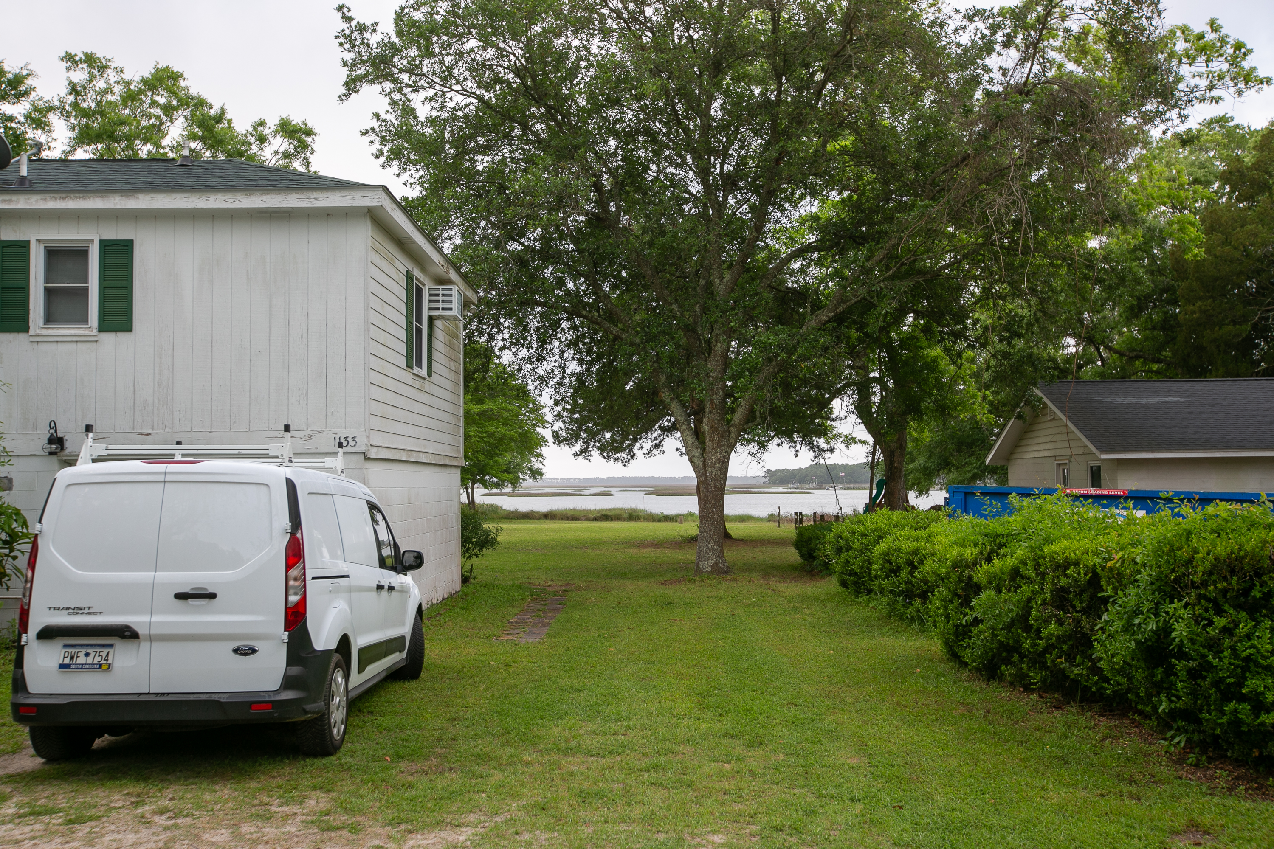
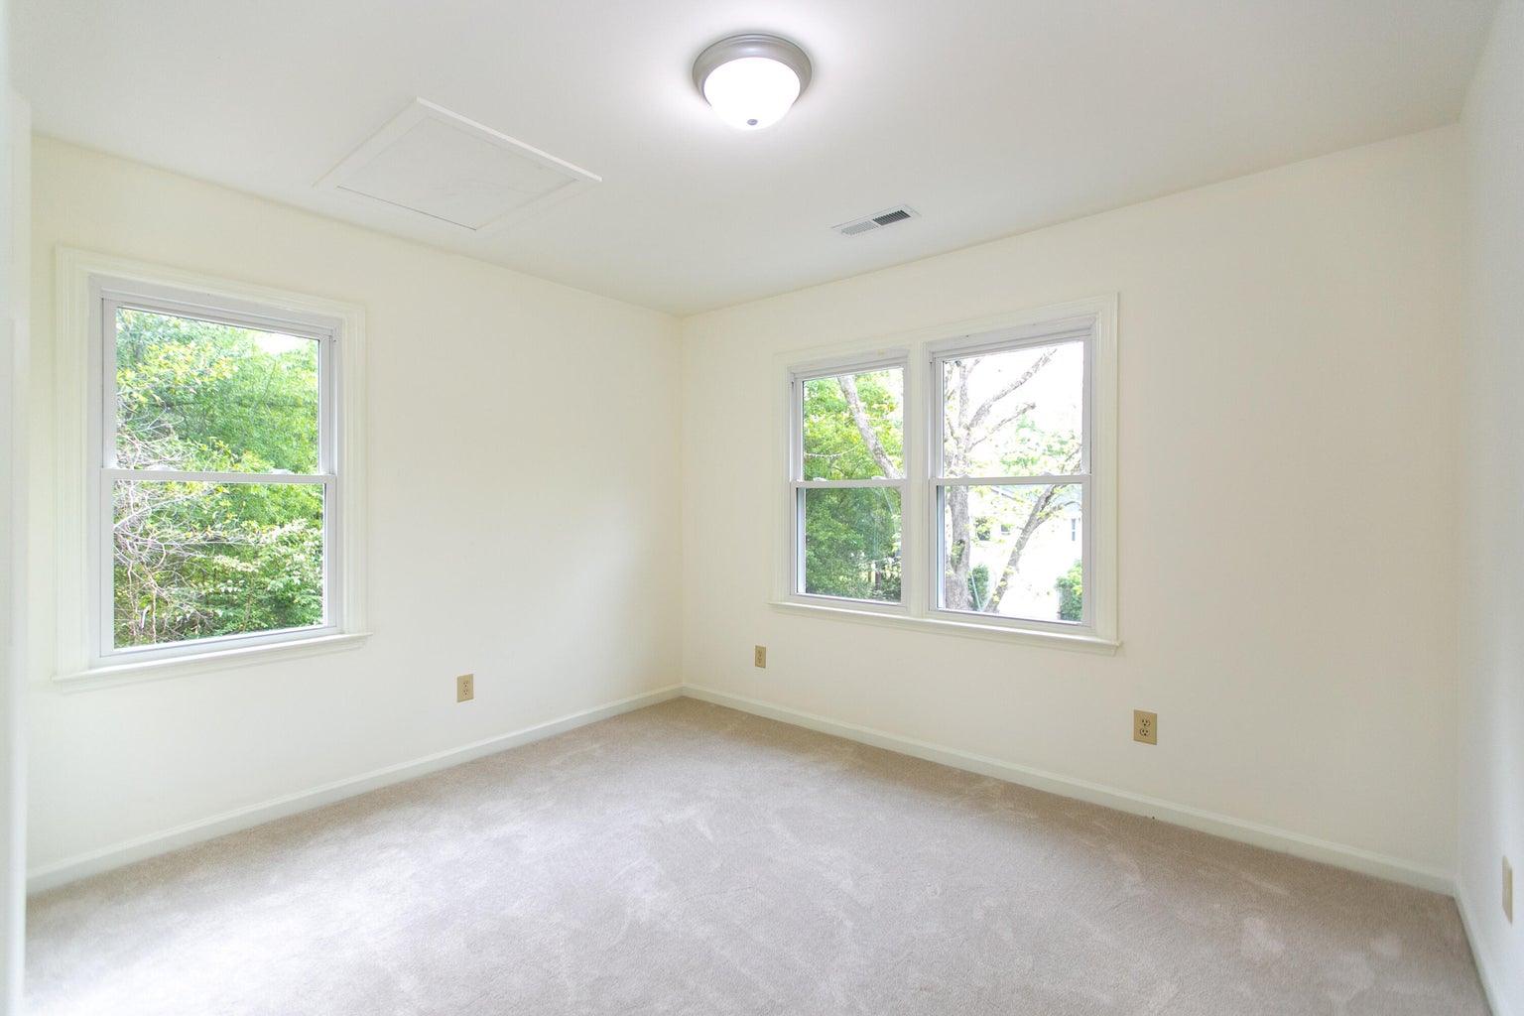
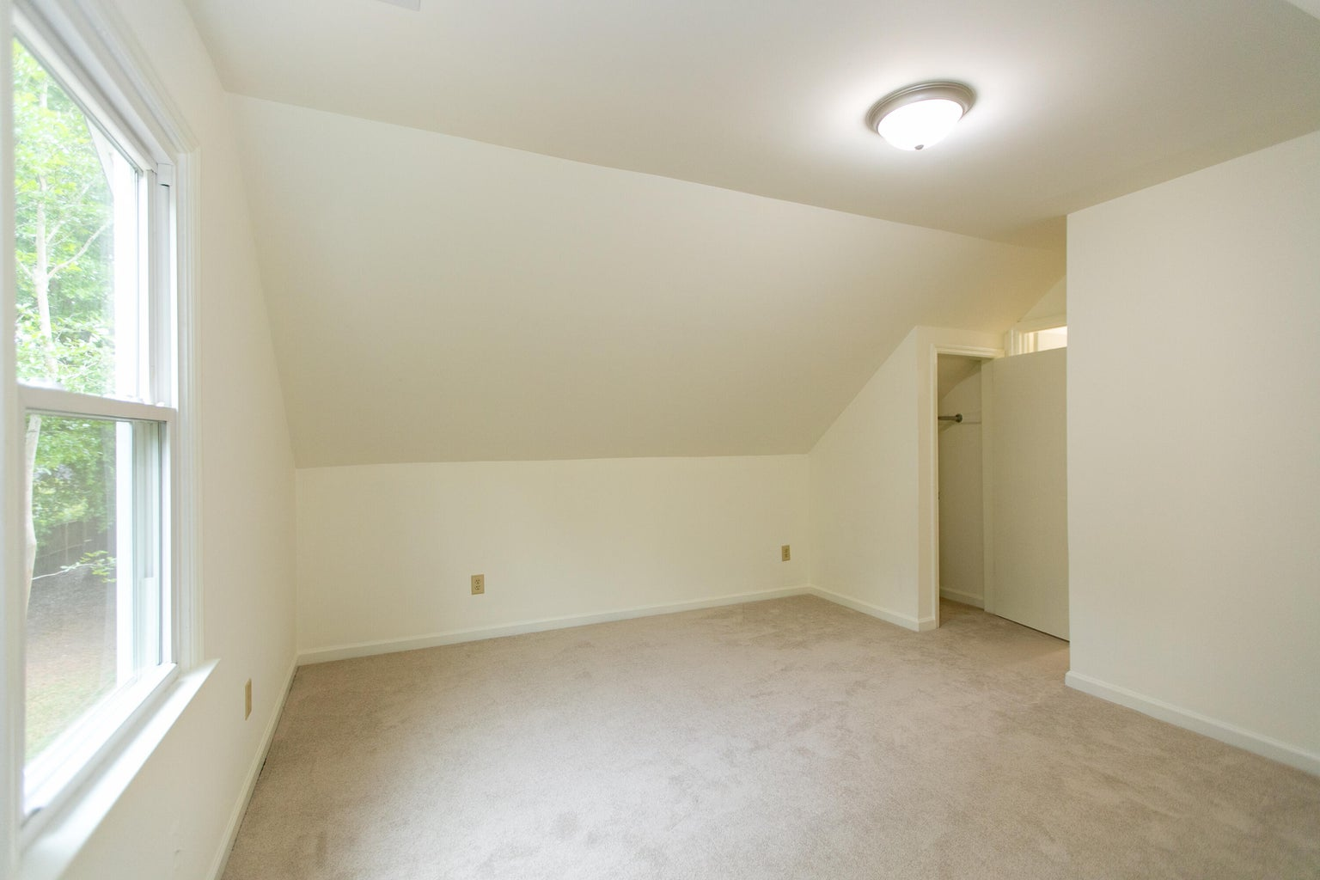
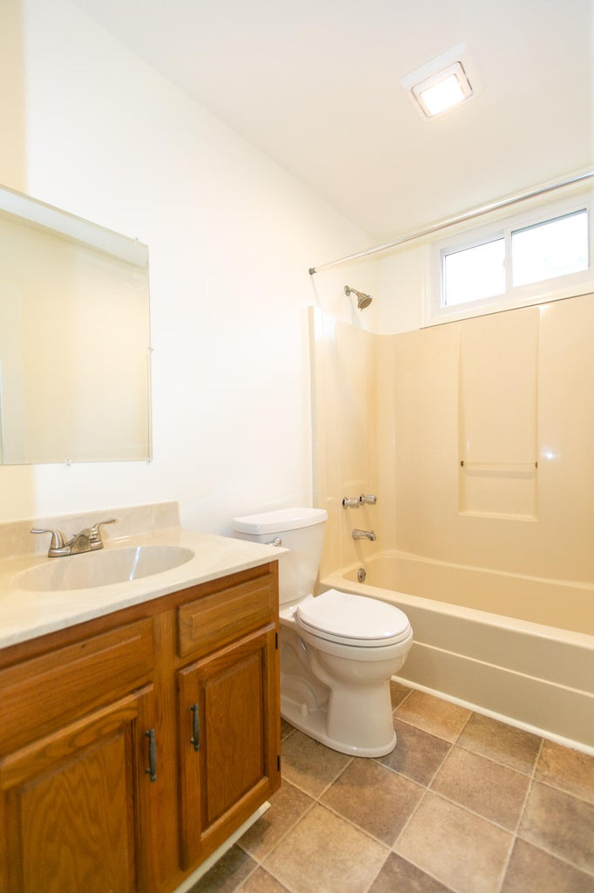
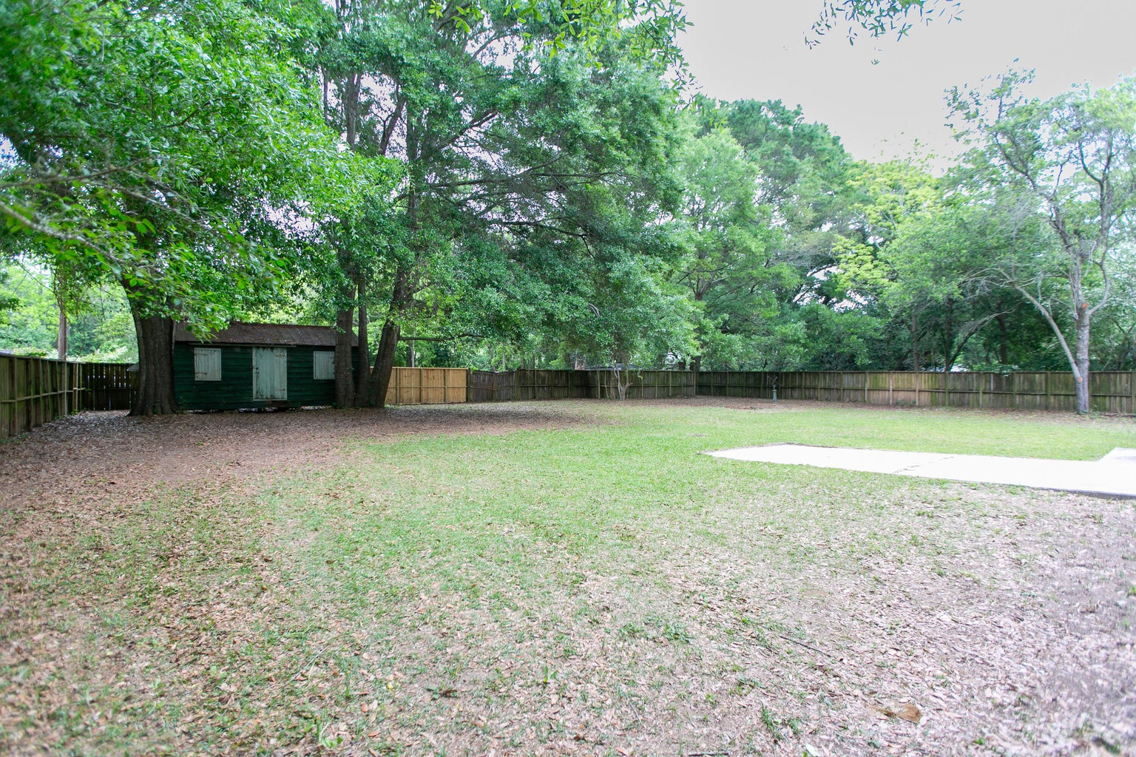
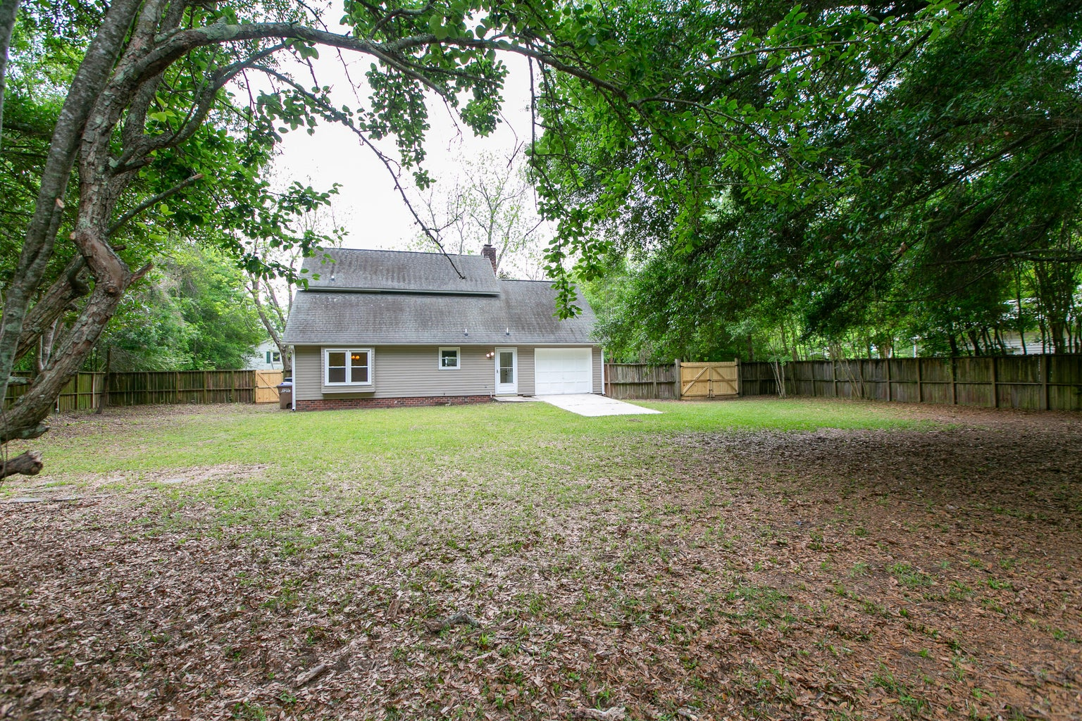

AVAILABLE FOR SALE
4 Bedrooms/ 2 Baths With Water Views
1138 Cottage Road
Lebby | James Island, SC 29412 | MLS# 24010750 | $655,600
Tranquil area with no through traffic; this four bedroom/ two bath home offers genuine peace and quiet with unobstructed views of Clark Sound and is move-in ready; or ready for your changes.
A half-acre lot, walk-in attic and attached garage offer lots of storage and room to expand. Come experience this location and see if this is the spot for you!
Marion Jackson
Broker-in-Charge/Owner
Mobile - (843) 442-4404
mj@charlestonpropertybrokers.com
Charleston Property Brokers, LLC | 2182 Edisto Avenue | Charleston, SC 29412

