Slide 1
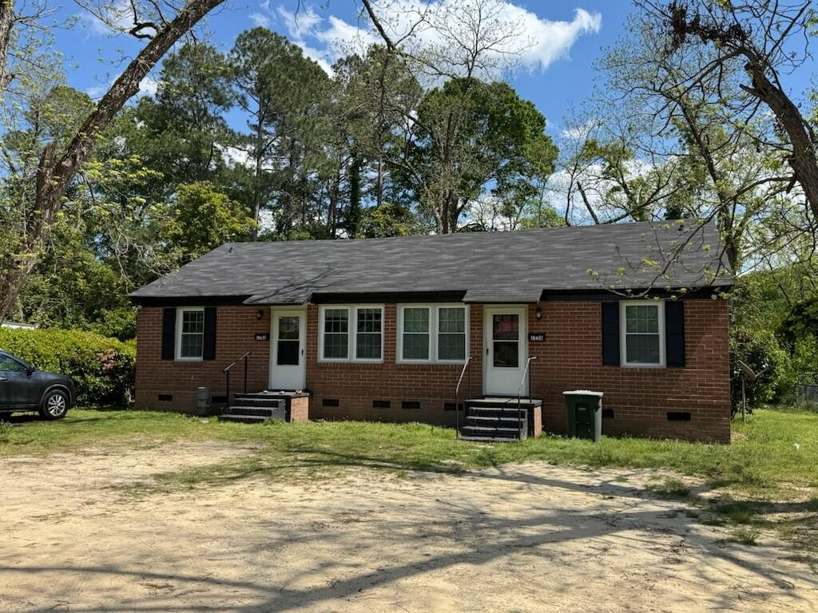
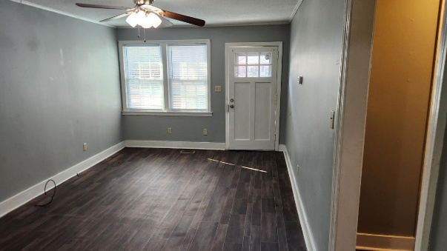
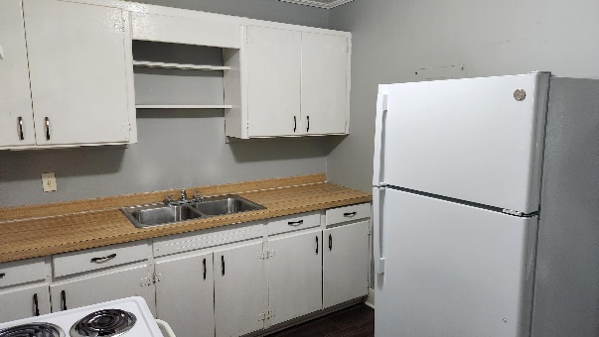
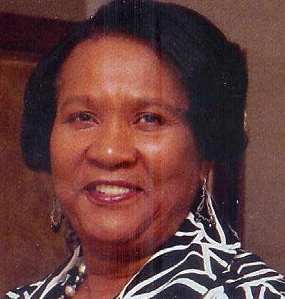
Close to SC State & Claflin University
1138 Ellis Avenue
Orangeburg, SC 29115
MLS# 25007959 | $950/Mo
2 Beds | 1 Baths | 1,372 SqFt
Vacant and available for showings! Updated two bedroom apartment located close to South Carolina State University, Claflin University, local schools, shopping and restaurants.
THE
AgentOwned
Deborah Lawrence,
REALTOR®
843-442-0018
DeborahLawrence@aol.com AgentOwned.com
REALTY CO.
R
Helping buyers and sellers with every aspect of real estate since 1992.
Real Estate • Mortgage • Insurance • Business Brokerage • Property Management

