Slide 1
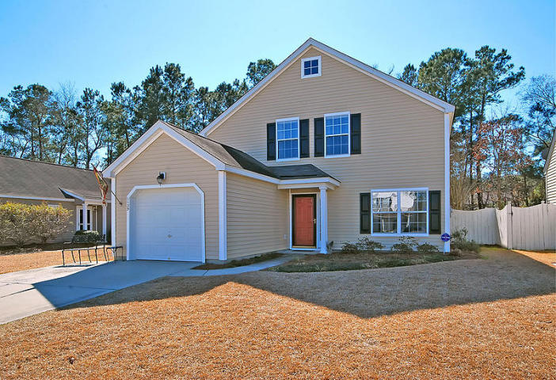
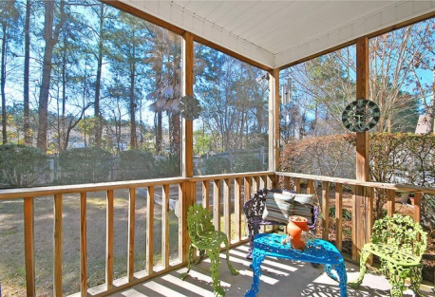
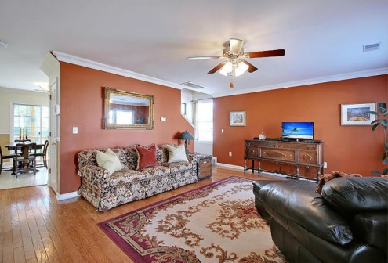
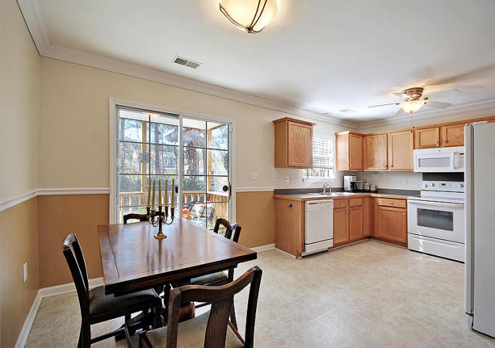
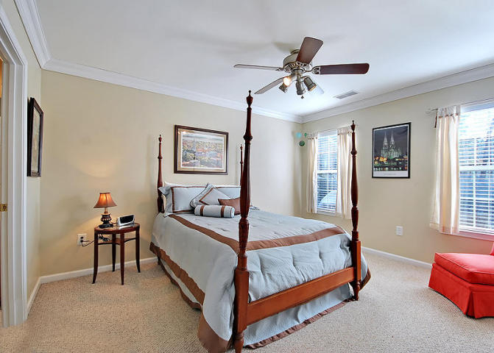
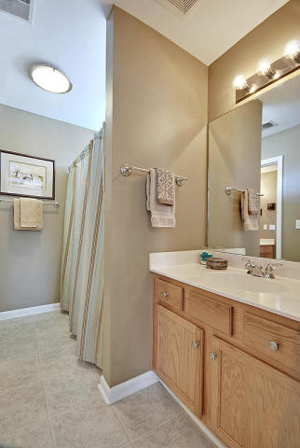
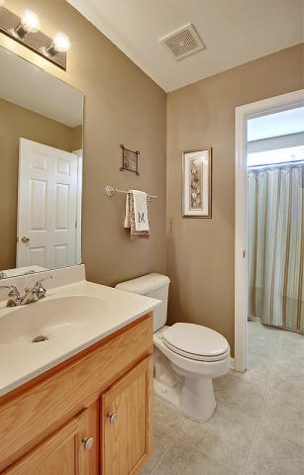
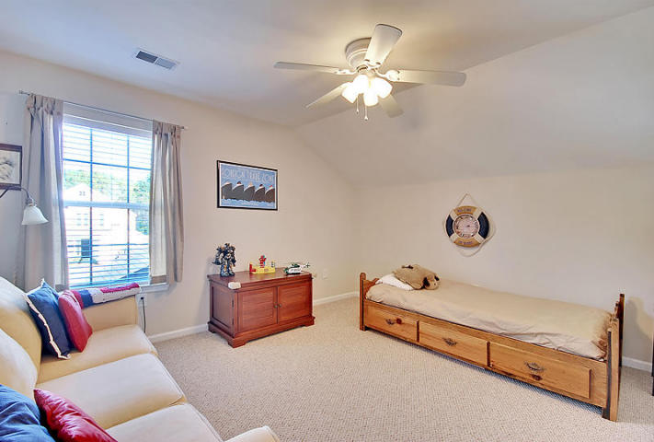
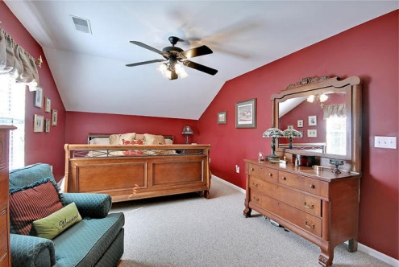
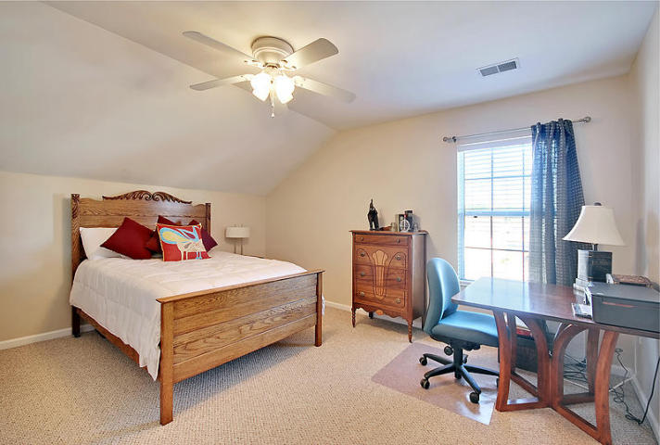
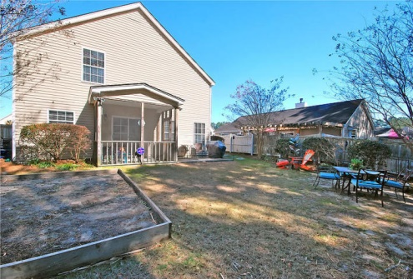

Open House Sunday 2-5:30
Price Reduced!
1139 Peninsula Cove Drive
The Peninsula ~ MLS# 15004757 ~ $239,900
This charming single-family home is conveniently located in the Peninsula subdivision. This well-maintained home offers 1,656 square feet of living space, 4 bedrooms, 2 baths, with an attached garage. Featuring a comfortable screened in porch and an enormous fenced in backyard, this is the perfect place for playtime with the children or entertaining your friends and family. The backyard has beautiful mature trees and is also on a pond. Opening the door of your new home, you enter the large family room bathed in natural light and accented by gorgeous hard wood floors and crown molding. Step through entrance into the large eat-in kitchen, featuring plenty of solid wood cabinets, sharp white appliances, a custom wine rack, elegant chair rails, and crown molding. The massive first floor master suite offers tons of sunshine, warm carpeting and crown moldings, a walk-in closet, and an attached spacious master bathroom. On the second floor, you will find three roomy, fully carpeted guest bedrooms with large closets and a full bathroom. Take advantage of the two neighborhood pools, a clubhouse, and play park in this beautiful subdivision. You will love the convenient location. You are just minutes away from Daniel Island, Mt Pleasant, Downtown, Charleston, and the beaches Sullivan's Island and Isle of Palms. In addition, this area has new schools slated for completion in 2016 (k-8) and 2017 (high school). This exceptional home has the beauty and space that won't last long, so call today for your appointment!
Stephanie Toole
843-277-4498 stephanie@mattoneillteam.com

