Slide 1
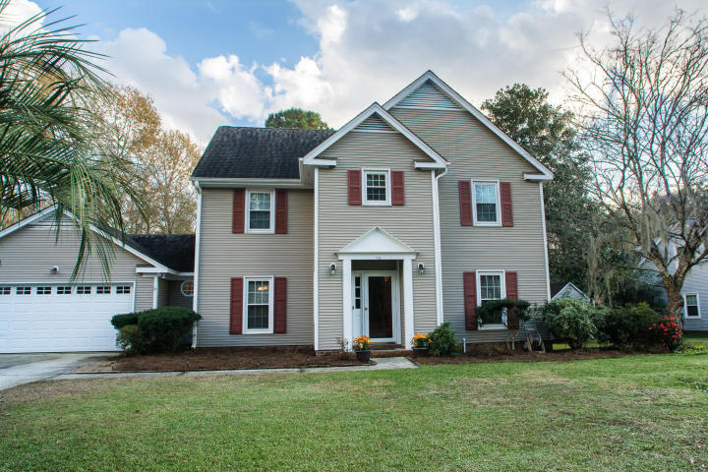
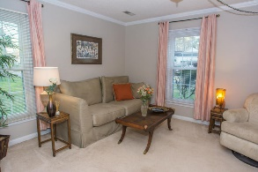
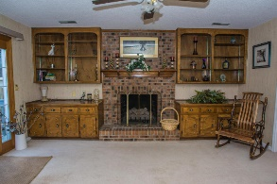
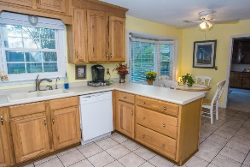
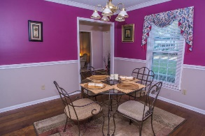
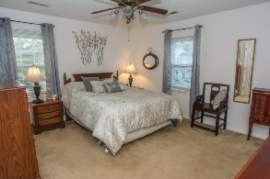
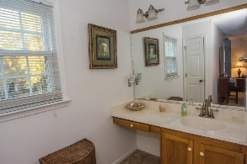
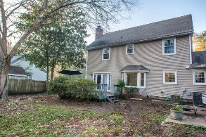
Just Listed!
113 Essex Drive
Irongate
Summerville, SC 29485
MLS# 15030741
$243,900
Amazing 5 bed/3.5 bath home with wonderful curb appeal in highly desirable Irongate. This well maintained 2 story home sits on approx 1/3 acre. Many extras throughout! Very spacious kitchen with upgraded cabinets and tile flooring. Lovely bay window overlooks the backyard! Family room has a remarkable wood burning/gas fireplace and custom built bookshelves! Formal dining room is simply elegant with hardwood floors, crown molding and chair rail. Dual masters on both floors with large walk-in closets. Downstairs master makes the perfect mother in law suite and has a new separate HVAC. 2 car garage with lots of storage. Fenced in large back yard with deck. Irrigation system! Community has much to offer such as a neighborhood pool and rec area. Dorchester District II schools. Welcome home!
David Hickman | 843.505.0456 | davidisyouragent@gmail.com | www.omnicarolinarealestate.com
Omni Carolina Real Estate | 126 Eston Dr | Goose Creek, SC 29445

