Slide 1
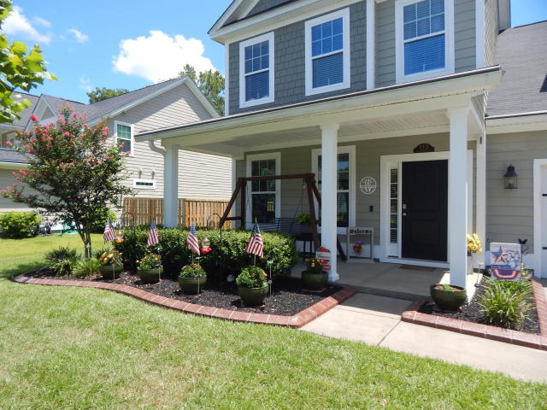
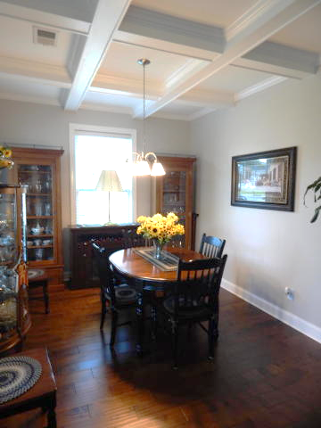
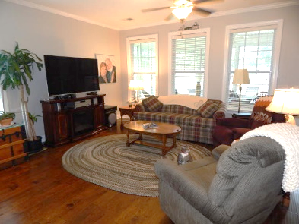
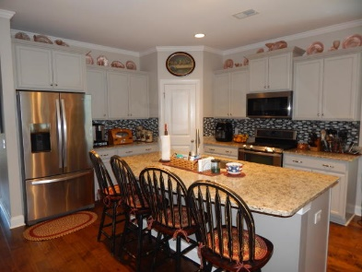
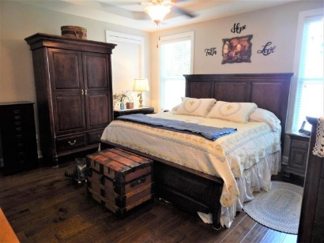
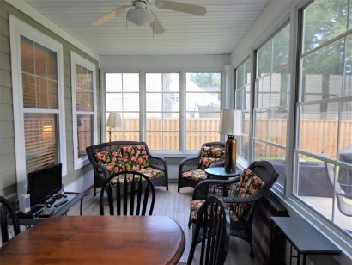
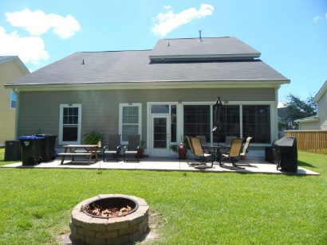
Beautiful Cement-Board Sided 5BR Home!
113 Long Needle Lane
Long Needle Estates
Summerville, SC 29485
MLS# 20019839
$349,900
Handsome 5BR home in quiet, convenient neighborhood! This stately home features cement board siding and is very energy efficient. The large front porch welcomes you in, and you notice the beautiful wood fls. DR features an exquisite coffered ceiling and many windows. From here you come into the stunning huge open kitchen with gorgeous granite, tile backsplash, all stainless appliances and a large walk-in pantry. Big, beautiful island comfortably seats at least 4. Behind island is built-in buffet area. Living Room is off of kitchen as is 1st floor Owner's Suite. Just off Liv. Rm. is sunroom, perfect for moderate temps though not heat & cooled. And there is a huge poured concrete patio in backyard, and a built-in fire pit! The gorgeous wood staircase to 2nd floor features lovely wrought iron detailing. Upstairs are the other 4 bedrooms; one is being used as an office, one for storage, the oversized bonus/5th bedroom is being used as a hobby room and the last bedroom is a guest room. This home features upgrades galore and real pride of ownership is evident throughout, and it is immaculate! A pleasure to show.
Darlene Bollettino
Miler Properties
Office: 843-821-1111
Cell: 843-209-8955
dbollo84@yahoo.com
www.milerproperties.com

