Slide 1
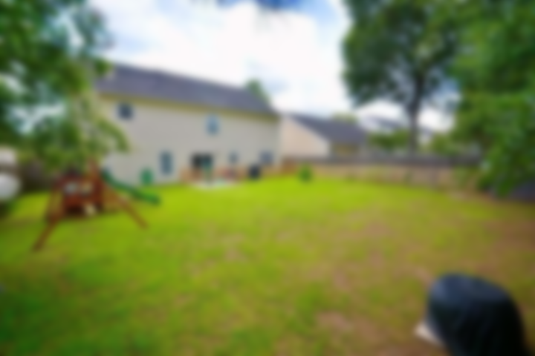
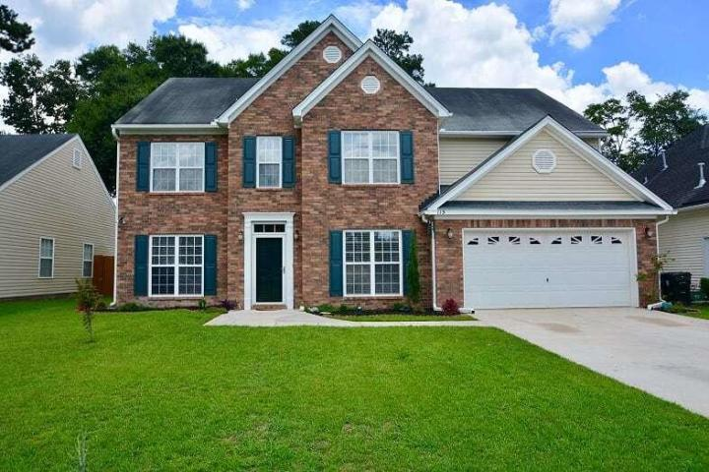
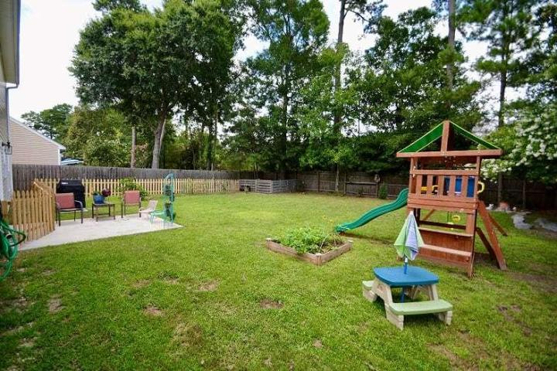
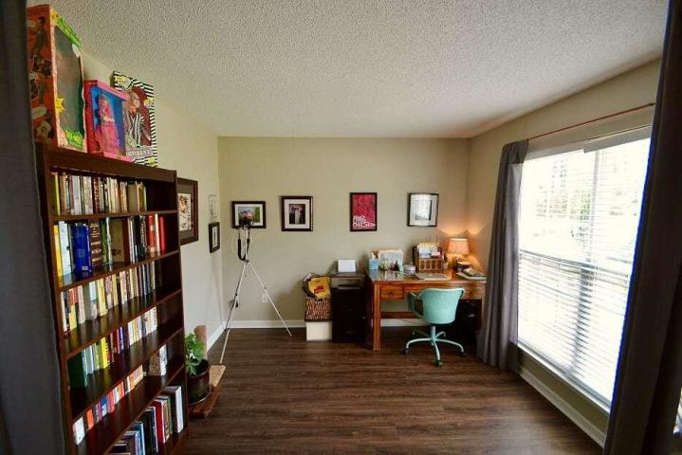
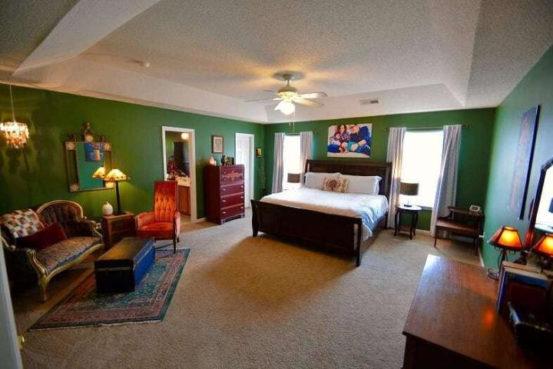
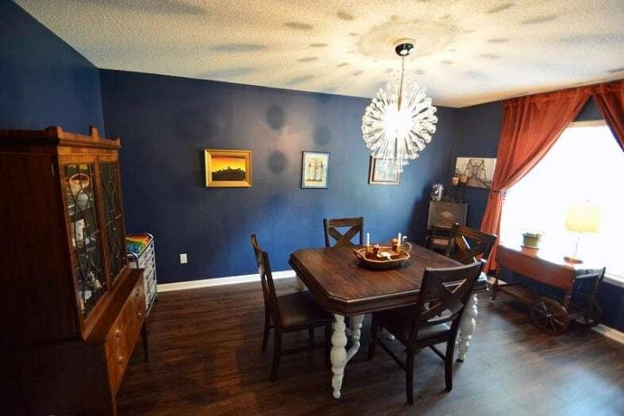
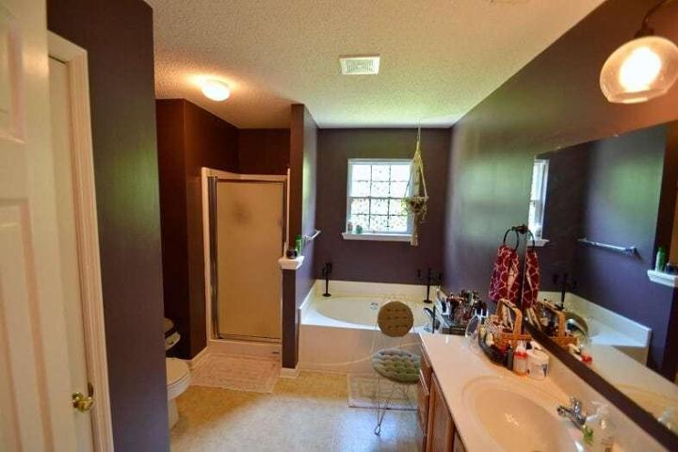
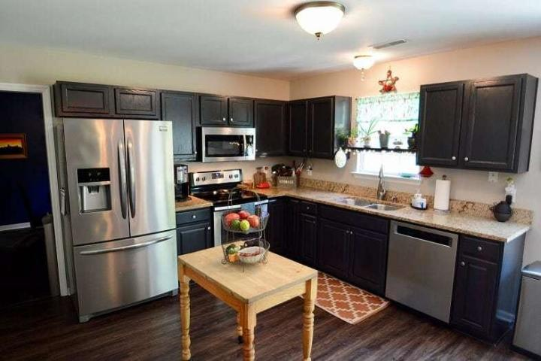
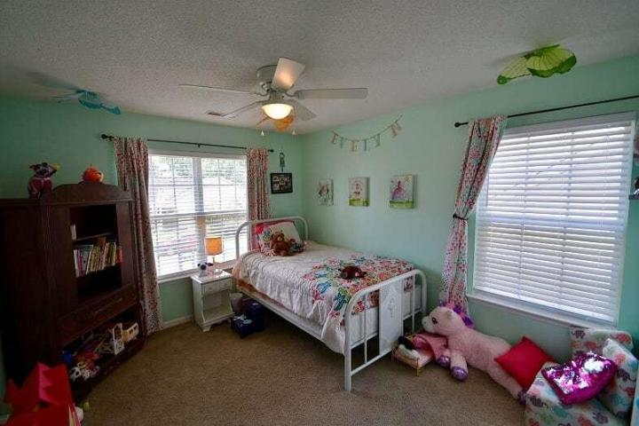
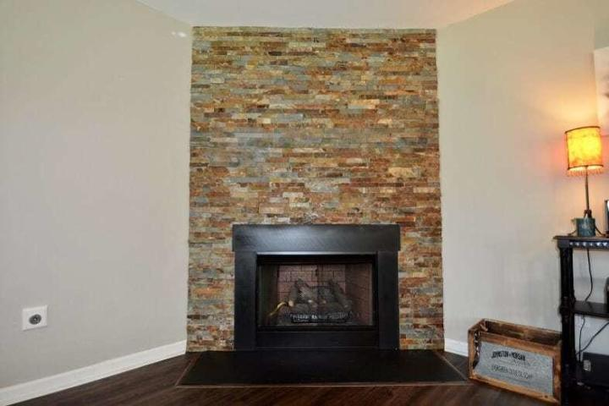
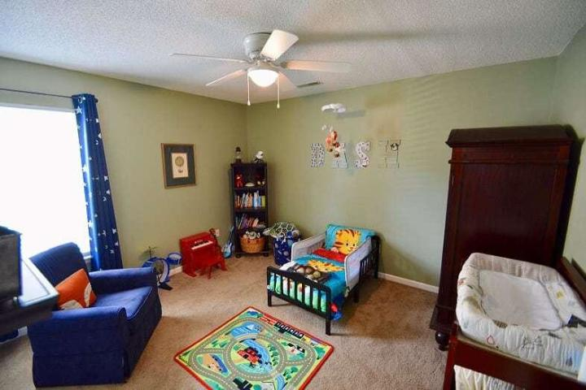
New Listing in Summer Trace
113 Melanie Lane
Summerville, SC 29485 ~ MLS# 19020748 ~ $329,000
Welcome to 113 Melanie Lane! This beautiful well kept home has many room options for everyone. This home has new LVP flooring throughout the downstairs, with an open concept for entertaining. Downstairs features 2 separate study/office rooms or create your own bar/sitting room. The kitchen boasts granite countertops and a big island with seating. Enjoy the living room w/ stone accented wall around the fireplace. A formal dining room, oversized pantry and half bath are also located downstairs. Head upstairs to find 4 bedrooms, 2 baths and a huge open flex room. The master bedroom w/ separate sitting room, could be used as an additional master closet or newborn nursery. The backyard gives plenty of space and privacy backing up to trees. Come see this home zoned for highly rated DD2 schools.
Melissa Binkowski
(843) 345-9747
melissa.binkowski.rn@gmail.com
Brand Name Real Estate
4 Carriage Lane Suite #106
Charleston, SC 29407
Michael Albenesius
(843) 343-5870
m.albenesius@gmail.com

