Slide 1
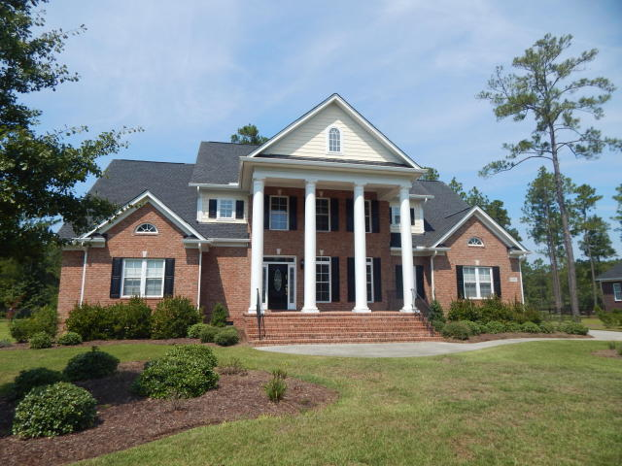
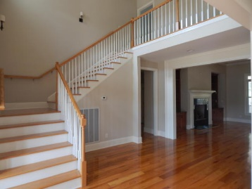
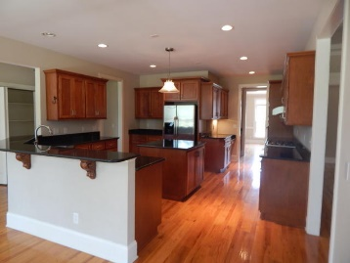
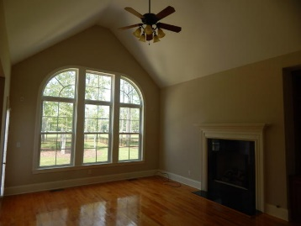
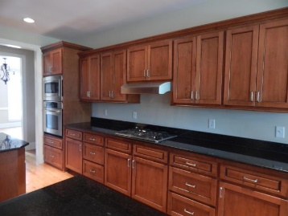
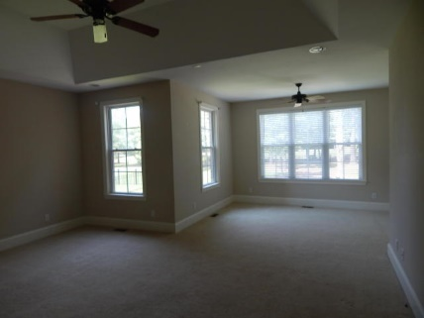
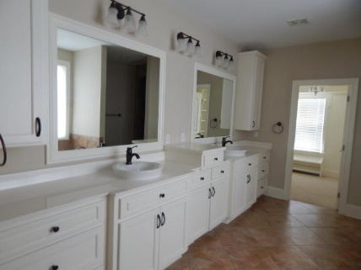
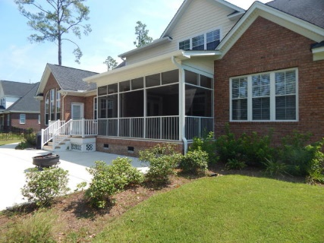
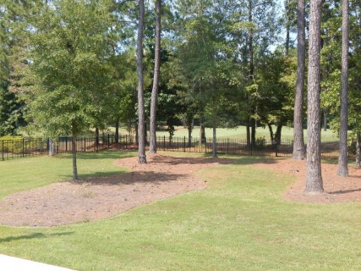
FANTASTIC DEAL FOR A Stunning Golf Course Home!
113 Pine Valley Drive
Pine Forest Country Club
Summerville, SC 29483
MLS# 16024578
$569,900
5 Bedroom | 4 Baths
AWESOME NEW PRICE!!!
Magnificent Southern traditional home has all the bells & whistles! This custom built brick beauty offers everything the discriminating buyer is looking for: two fireplaces, coffered ceiling in grand living room, sweeping golf course views, wonderful gourmet kitchen with all appliances, 3-car garage, master suite on main level with luxurious master bath & huge closet, oversized screened porch, large media room, four large secondary bedrooms--2 being en suites, loads of closet storage, huge 2/3-acre lot with irrigation system in place and wrought-iron fenced backyard with company-sized patio to enjoy those golf course views! Experience this elegant home to truly appreciate all of the customized details. Public Golf Course, with Memberships to club/pool available.
Darlene Bollettino
Miler Properties
Office: 843-821-1111
Cell: 843-209-8955
dbollo84@yahoo.com
www.milerproperties.com

