Slide 1
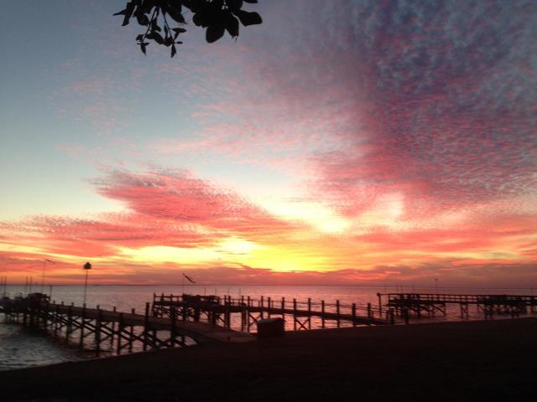
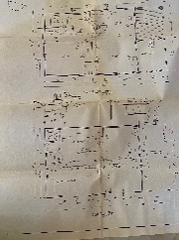
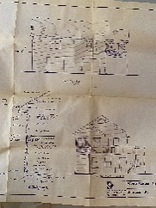
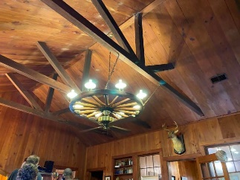
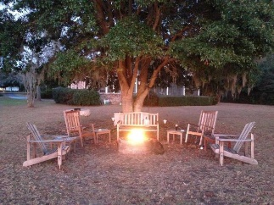
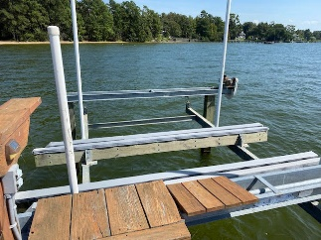
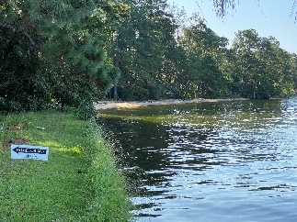
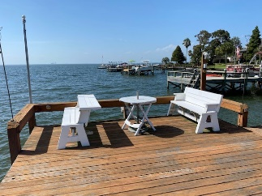
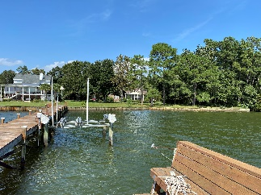
113 Porcher Drive
Pooshee | Bonneau, SC 29431
MLS# 20024717 | $799,000
Where time stands still...
Spectacular view of Lake Moultrie to enjoy from the old world charm of this property.
The lodge was built in 1946 with materials from Numertia Plantation in Eutawville.
The heart pine floor boards and the cypress walls and ceiling were cut especially for this house from wood at Numertia.
This one of a kind interior captures the Arts and Crafts period/era beautifully. The style provides a graciousness rarely found.
In addition a guest cottage was built in 2001. The Robin’s son is an architect. You will find his rendering of this addition to the property.
Carolina Life Real Estate & Auctions LLC
314 E Main St
Monks corner, SC 29461
Edy Mimms
843-224-9507
mimms@sanddollarsc.com
Judy Ash
843-708-1781
judy@judyash.com

