Slide 1
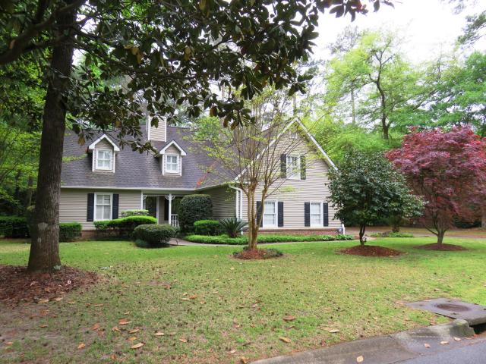
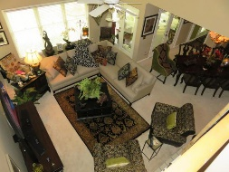
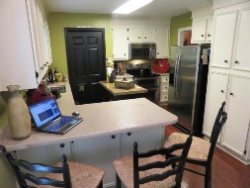
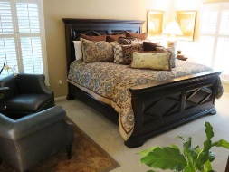
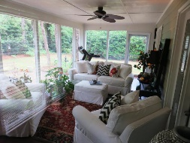
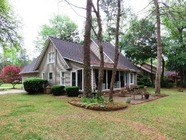

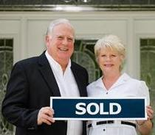
Just Reduced In Gadsden Manor
113 Quinby Street
Summerville, SC 29483
MLS# 16010307
$364,900
4 Bedrooms
2 1/2 Baths
2,761 sf
This charming country style home is a real showplace located on .42 acre wooded lot on cul-de-sac in an established neighborhood in the historic district of a Summerville. This one of kind custom design with dormers and side entry garage provide great curb appeal. The well maintained yard and immaculate condition of this home demonstrates pride of ownership. The master suite is on the first level. The large great room with fireplace and vaulted ceiling with adjoining dining room and large sunroom provides great flow for entertaining, relaxing with family, or enjoying a good book. The spacious kitchen with stainless appliances also has a built in desk and breakfast area. The second level bonus room is being used as 4th bedroom. Great location and price for a growing family or retiree. The exterior siding of home is vinyl as well as soffits and fascia for easy maintenance. Cooper piping had pin hole leaks and was completely replaced with PVC/CPVC about 6-8 years ago. The architectural shingles were installed around 2000.
Tommy & Lynne Lovett
Tommy - (843) 442-1276
Lynne - (843) 697-0491
tlovett@carolinaone.com
lynne.lovett@carolinaone.com
www.tommylovettrealestate.com
Carolina One Real Estate
628 Long Point Rd.
Mt Pleasant, SC 29464-3032

