Slide 1
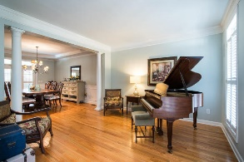
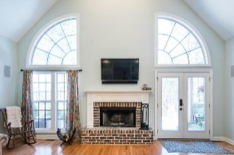
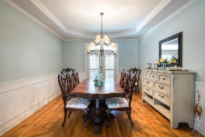
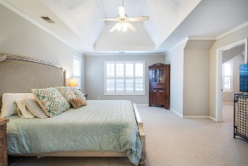
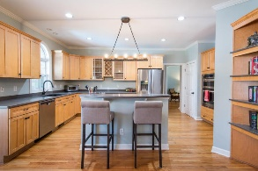
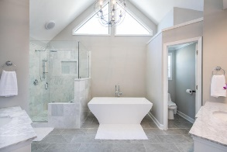
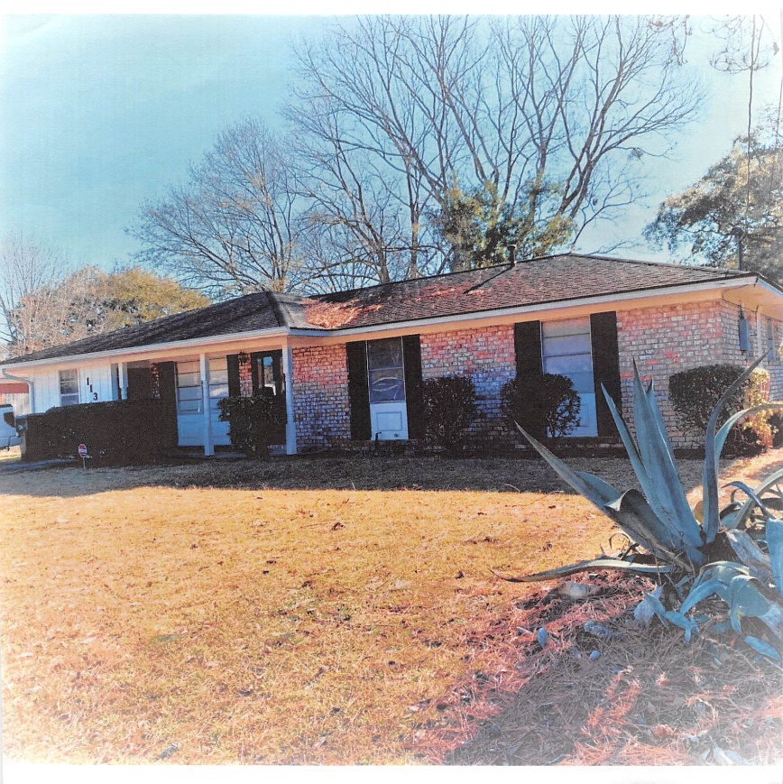
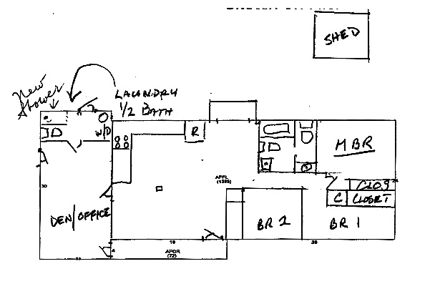

113 Stewart Street
Camelot Village
Goose Creek, SC 29445
3 OR 4 BEDROOM, 2 FULL + ONE 1/2 BATHROOMS
1386 SQUARE FEET
ASKING $173,900 ~ AGENTS PROTECTED
Tommy Lovett
Tommy - (843) 442-1276
tlovett@carolinaone.com
www.tommylovettrealestate.com
NOT DRAWN TO SCALE - DRAWN CONCEPTUALLY
THE EAST ROOM CAN BE A DEN/OFFICE/4TH BEDROOM ETC. A NEW WATER SERVICE LINE WAS INSTALLED FROM THE METER TO THE HOME. KITCHEN APPLIANCES AND ALL FLOORING (CERAMIC WOOD LOOK, CARPET & OTHER CERAMIC), COUNTER TOPS, TOILETS, SINKS, STAND ALONE SHOWER & GAS HOT WATER HEATER ARE ALL NEW. AN ASSUMABLE HOME WARRANTY IS IN PLACE & SELLER WILL PAY FOR A ONE YEAR EXTENSION OF THE SAME HOME WARRANTY, SELLER WILL ALSO PAY FOR A ONE TIME YARD CLEAN UP, ONE TIME INTERNAL HOUSE CLEAN & A BASIC SIMPLISAFE SECURITY SYSTEM THE DAY BEFORE CLOSING. THIS HOME LOT SIZE IS APPROXIMATELY 1/3 ACRE.
OFFERED BY OWNER WITH APPOINTMENT ONLY
Sheri Glover
843-834-8617
newjobs18@outlook.com
Carolina One Real Estate
628 Long Point Rd.
Mt Pleasant, SC 29464-3032

