Slide 1
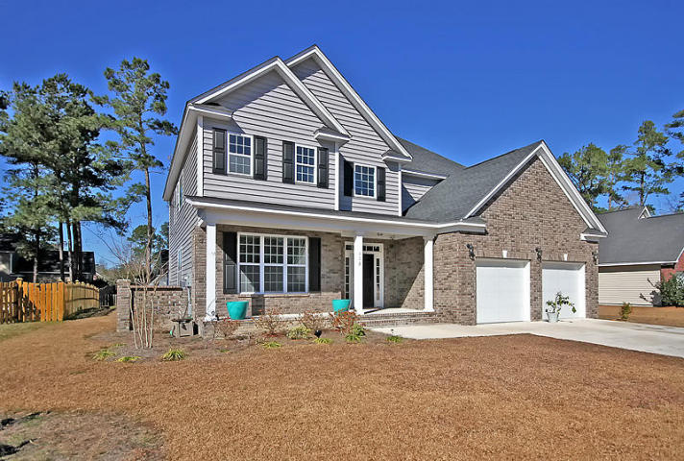
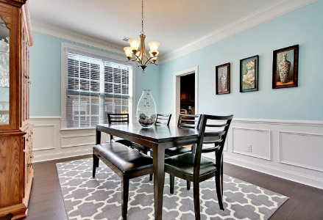
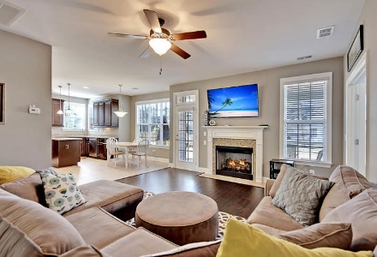
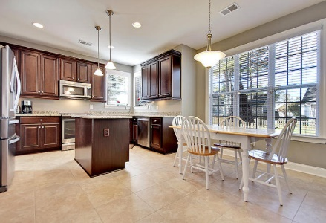
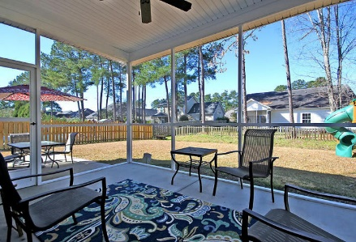
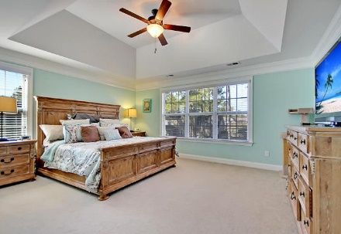
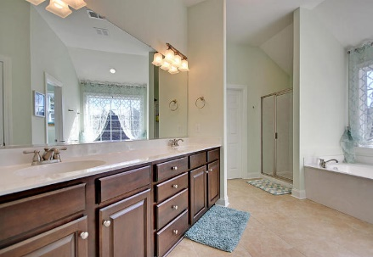
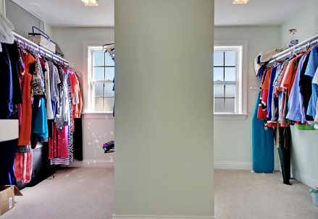
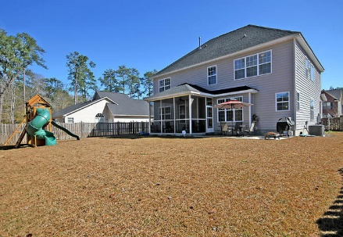


Custom Home ~ Nearly New
113 Torrey Pines Dr
Pine Forest Country Club
Summerville, SC 29483
MLS# 16002184
$339,000
5 Bedrooms | 2½ Baths | 2,782 sf
This 2,782 Sq. Ft. nearly new home is situated on a cul-de-sac in an established section of the neighborhood. Why wait for a home to be built when you can move in now!! This home was custom built and FULL of upgrades. As you enter the home you will find a beautiful brick front and large porch, perfect for a rocker or two. Inside the front door you will be blown away buy the hand-scraped 7'' hardwoods and elegant wood staircase with wrought iron, basketed pickets. To your left is a large office with lots of natural light. Continuing through you will find the formal dining room and open living room. The kitchen is a chef's dream - gas range, all appliances upgraded, lots of cabinets and counter space, under-cabinet lighting, soft-close cabinets & drawers… TOO MANY UPGRADES TO NAME!!
Kitchen opens to the open living room with gas fireplace and marble surround, which is a great spot for relaxing. Bonus room, setup as a kids playroom, could be 5th bedroom - French doors lead from the living room to the bonus room. Half bath downstairs as well. Upstairs you will find 4 additional bedrooms, another full bath with dual vanities and a separate shower/toilet area. Laundry room is upstairs as well. The master suite makes this home!! HUGE master bedroom with extra tall tray ceilings, huge windows provide wonderful light during the day. Master bath and closet are amazing! Separate over sized tub and marble shower, dual extra height vanities give plenty of space for your morning prep. Amazing master closet with his and hers custom wood shelving gives you even more space than you can fill. You will not find another home with this many upgrades!! Come see it today.
Larry Mazalatis
843-693-0529
lmaz@sc.rr.com
Kevin Goemaat
(843) 693-1468
krgoemaat@gmail.com
www.mazteam.com
AGENTOWNED PREMIERE GROUP | 1800 TROLLEY RD | SUMMERVILLE, SC 29485

