Slide 1
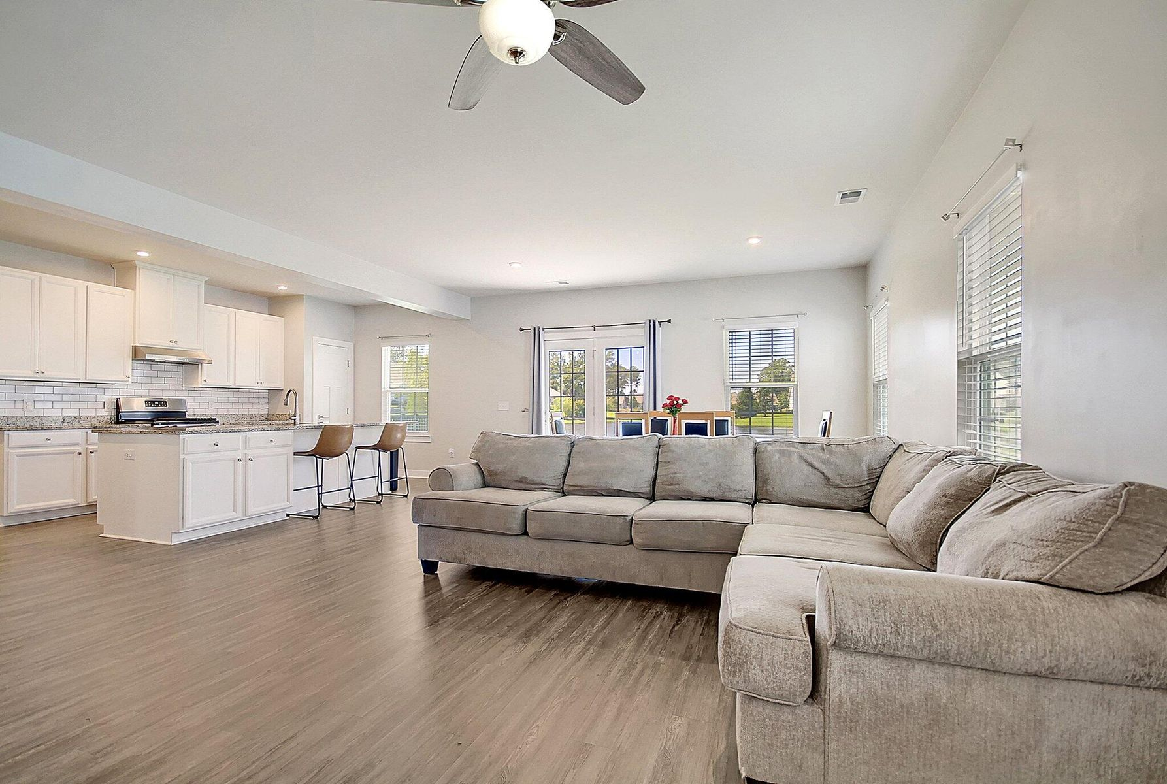
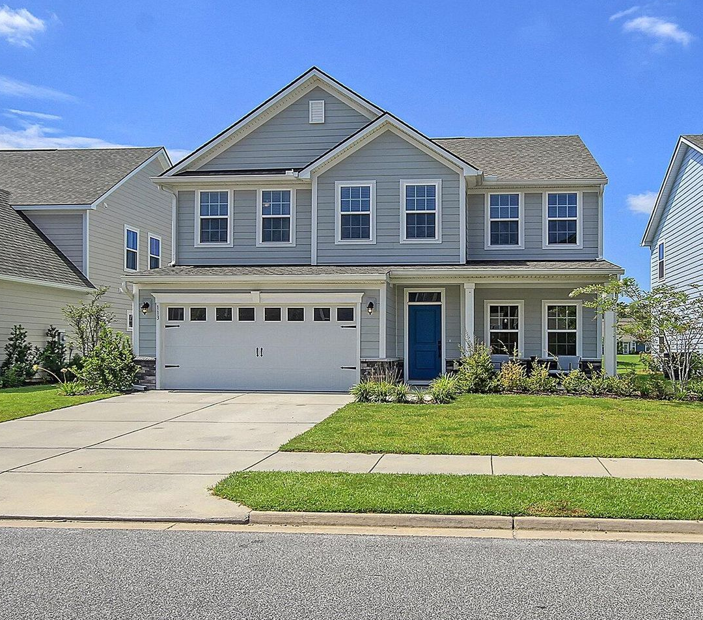
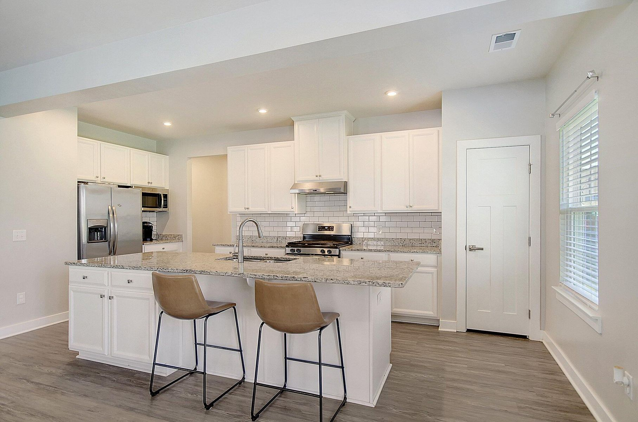
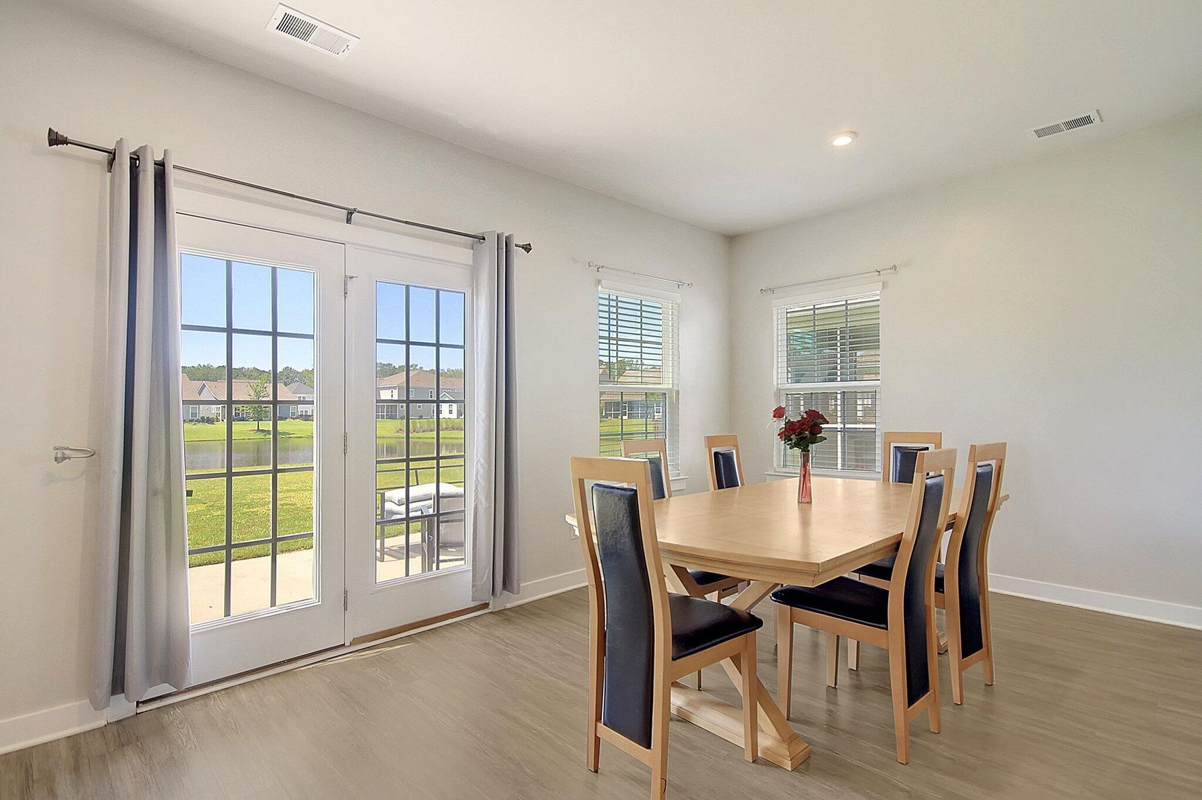
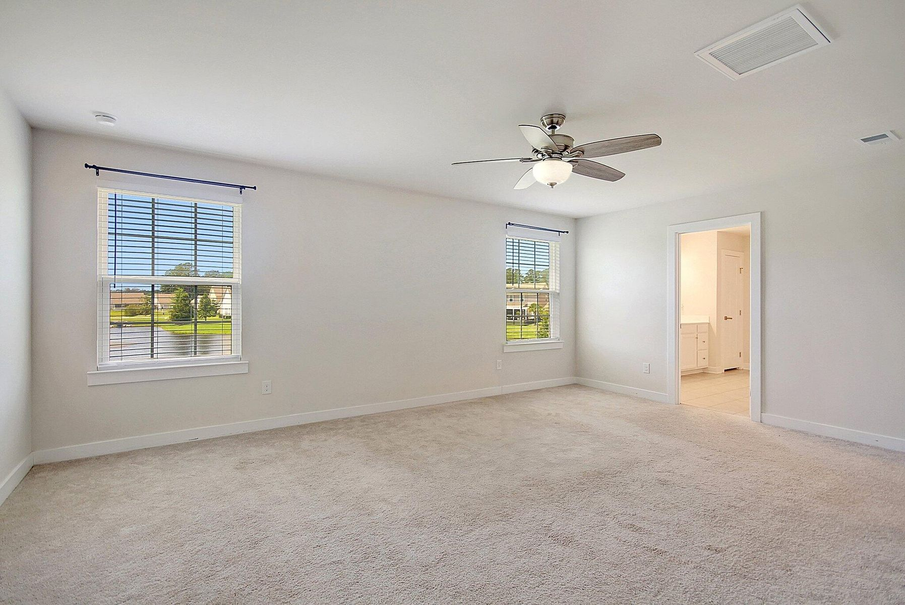
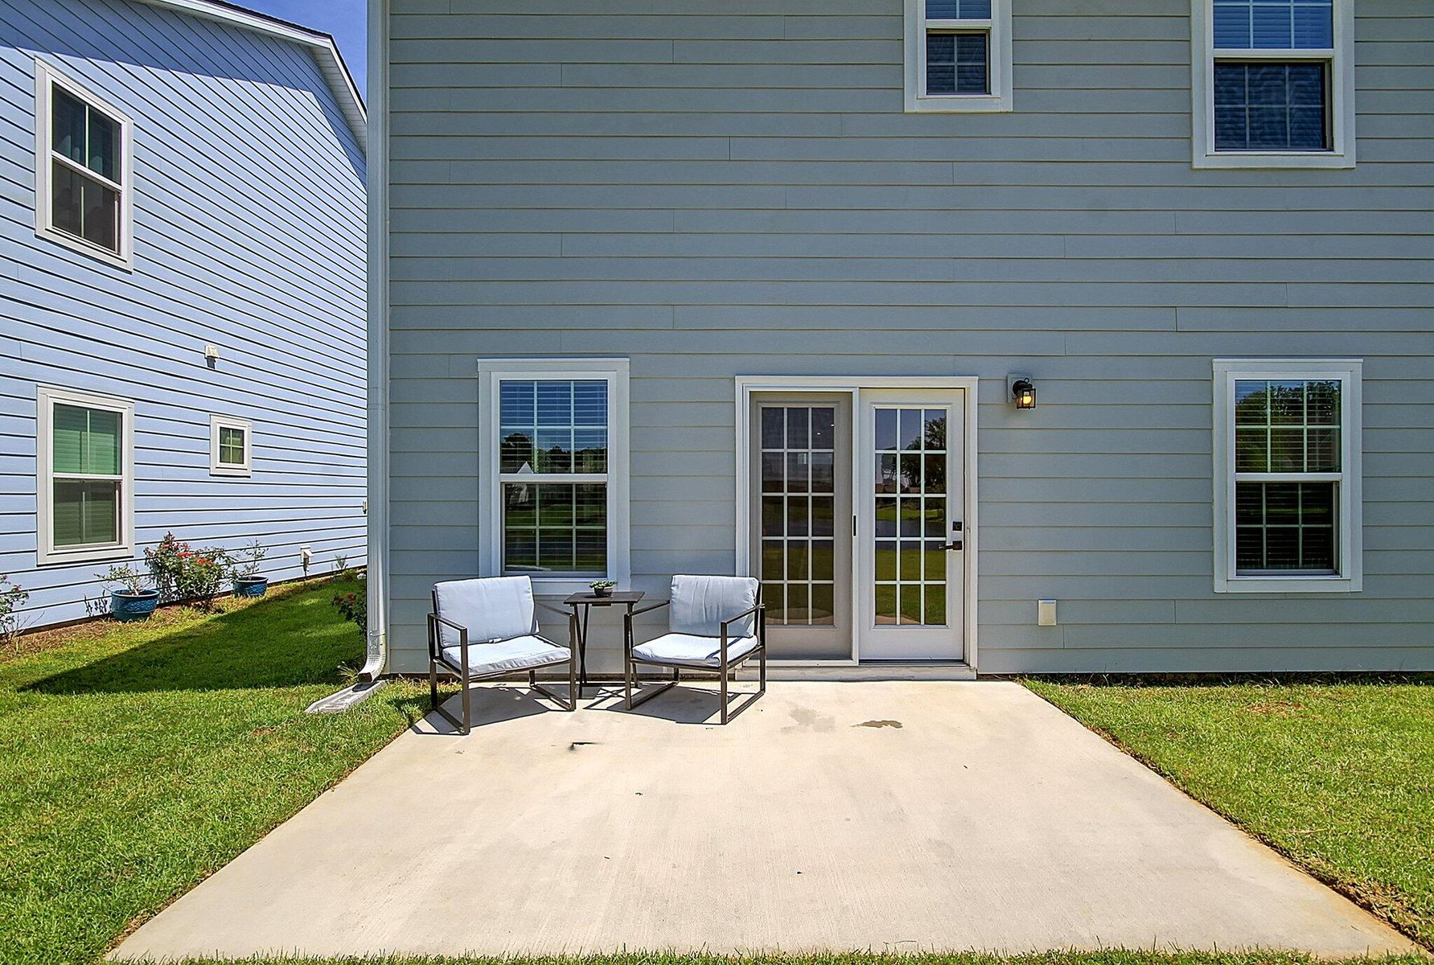
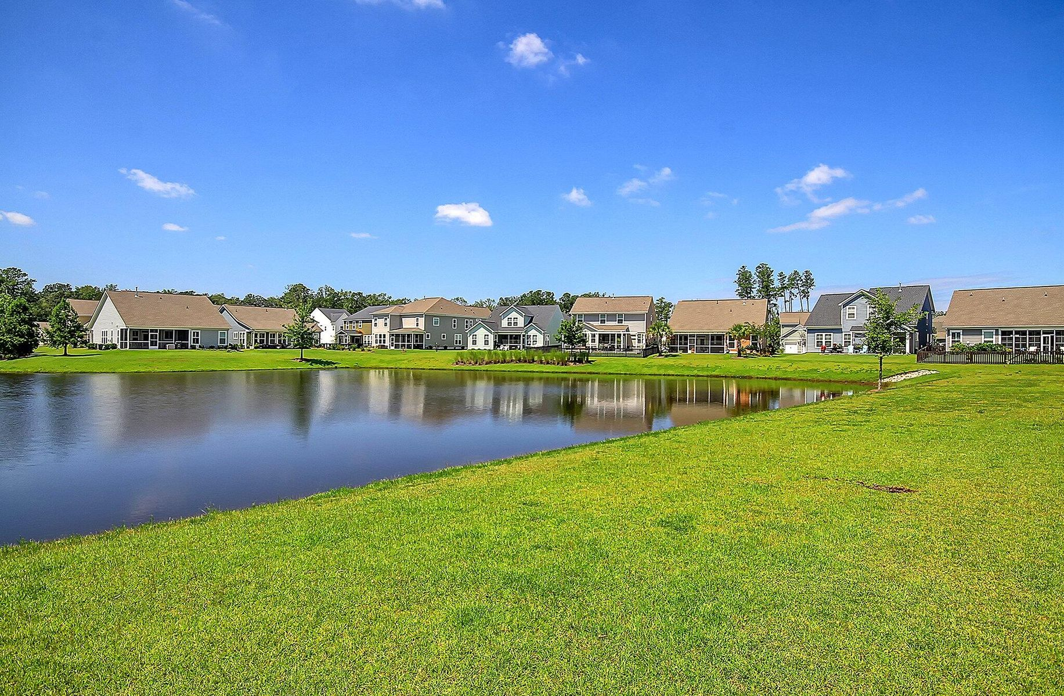


$5000 Selling Agent Bonus!
113 Corvus Street
The Ponds | Summerville, SC 29483
MLS# 23020199 | $488,000
Welcome to your dream home. Immerse yourself in this beautiful 5 bedroom 3 bathroom home located in the highly desirable community of The Ponds in Summerville. This open floorplan seamlessly combines modern design with spacious living, creating an inviting atmosphere for both relaxation and entertainment. The kitchen is a culinary enthusiast's delight, featuring granite counter tops, an elegant tile backsplash, a spacious island and stainless appliances. A main-floor guest bedroom with an ensuite bathroom provides convenience and comfort for visitors or family.
The second floor of this home is a true sanctuary. The master suite, overlooking the serene pond, boast of its own private bathroom - a tranquil escape after a long day. Two large spacious closets provide ample storage for all your needs. Three more generously sized bedrooms ensure there's room for everyone. The second floor laundry room is thoughtfully placed for easy access and efficiency. Enjoy your morning coffee or unwind after a day's work on the back patio overlooking the pond view. The attached 2-car garage not only provides shelter for your vehicles but also offers extra storage space.
Corwyn Melette
843-364-3095
corwyn@corwynmelette.com
www.exitlowcountry.com
Exit Realty Lowcountry Group | 3294 Ashley Phosphate Rd, 1-E | North Charleston SC 29418

