Slide 1
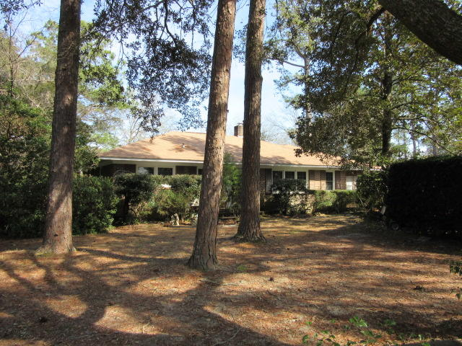
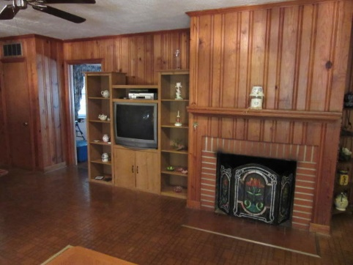
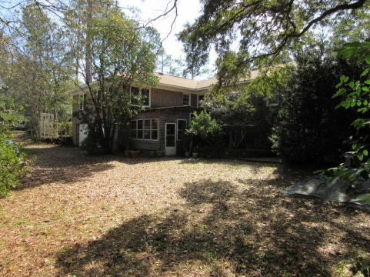
Summerville
Historic District
$40,000
Price Reduction!
Walk to Azalea Park
113 E 6th South Street
Summerville, SC 29483
MLS# 19006668 ~ $349,900
Live here and you feel like your in the country...but only a few blocks from downtown Summerville. The lot is gorgeous, lots of trees, mature shrubs, and even a change of 10 feet in elevation on a lot that's more than 1/2 acre in size. Since the property is on a corner lot there is access from 2 different streets (S Magnolia and E 6th South St). The homes driveway runs through the property from 6th St to S Magnolia. The home can be entered from the front, side, and rear.
When you enter you feel like you are in a rustic cabin. There are knotty pine wood walls (if you paint white you will have a wonderful texture and brighten up the rooms) and hardwood floor throughout. There is a huge eat in kitchen that was added to the home after it was originally built. When you look out the window you see almost nothing but trees and shrubs. To the rear of the home is a 2 car garage, workshop, and porch with a hot tub.
The usable square footage can be easily increased by adding a "mini-split" HVAC to the side enclosed porch. The roof and HVAC are almost new and the home is in excellent condition.
Rick Willis
843-327-3017 Rick@RickWillis.com The Group, LLC

