Slide 1
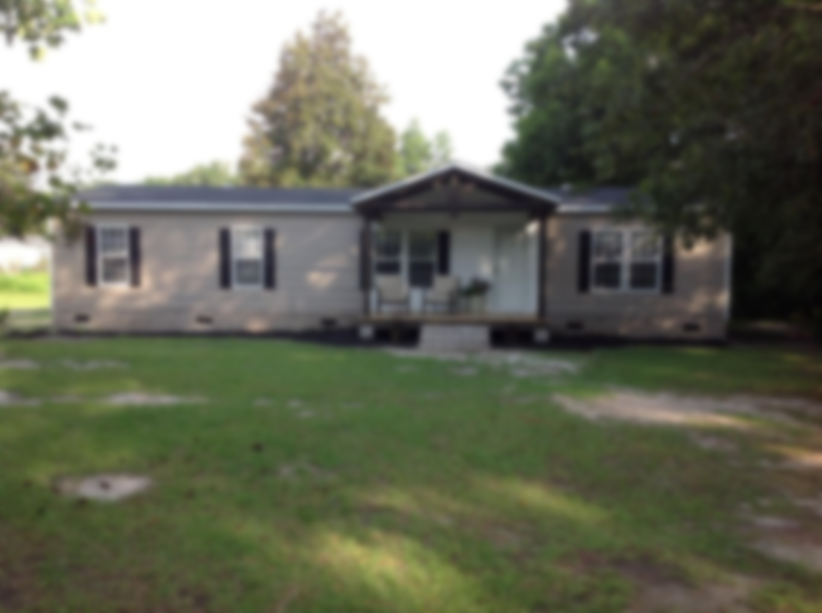
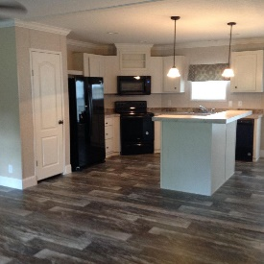

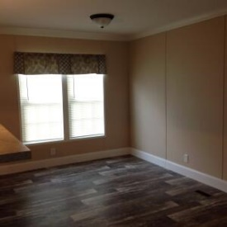
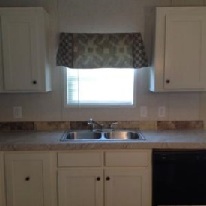
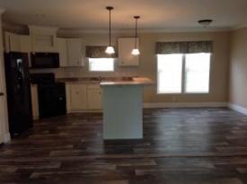
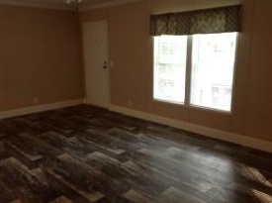
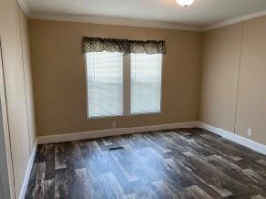
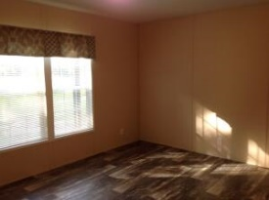
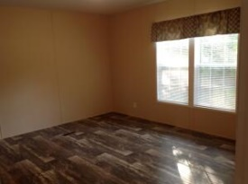

THIS IS A MUST SEE PROPERTY
113 First Street
Eutawville, SC 29048 | MLS# 21018870 | $189,900
3 Beds | 2 Baths | 1,456 Square Feet
THIS NEW MOBILE HOME (WITH NO CARPET FLOORING) HAS 3 BEDROOMS AND 2 BATHS ON A LARGE LOT (OVER HALF OF AN ACRE) WITH FRONT PORCH AS WELL AS DECK ON THE BACK. OPEN FLOOR PLAN (LIVING/DINING /KITCHEN) WITH KITCHEN ISLAND FOR GATHERINGS OR ENTERTAINING. ALSO HAVE FLEX SPACE THAT MIGHT BE PLAYROOM, OFFICE OR 4TH BEDROOM. MASTER SUITE IS ALSO SEPARATE FROM THE OTHER BEDROOMS. THIS HOME HAS NEVER BEEN LIVED IN. IT IS MOVE IN READY JUST BRING YOUR BELONGINGS. ALSO CLOSE TO SHOPPING AND COMMUNITY PARK. CLOSE TO SEVERAL PUBLIC BOAT LANDINGS. MAKE YOUR APPOINTMENT TODAY.
Carla C Davis
Mobile - (843) 437-4873
gaweber@tds.net
AgentOwned Premiere Group
141 A N. Main Street
Summerville, SC 29483

