Slide 1
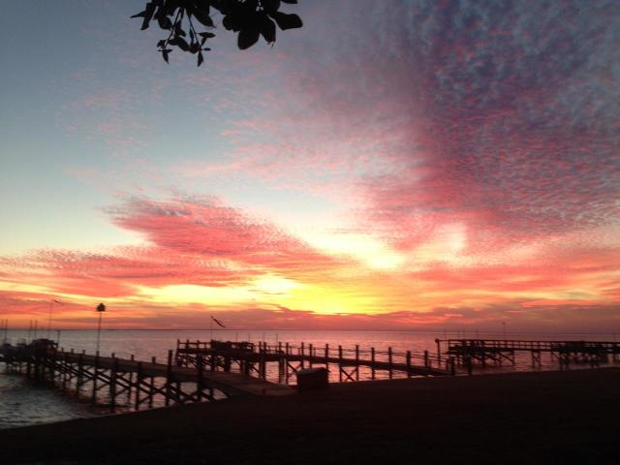
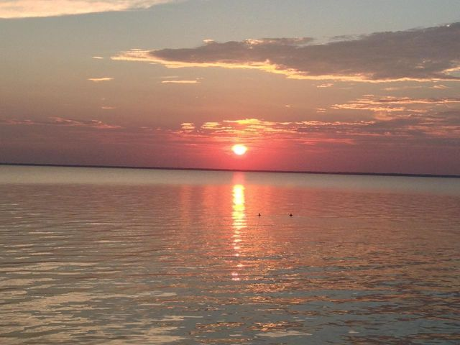
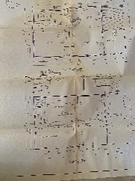
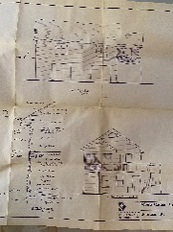
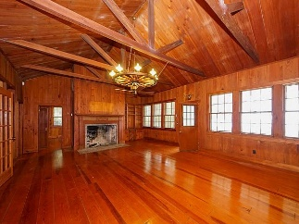
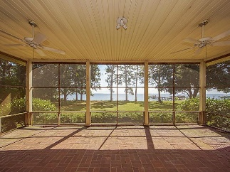
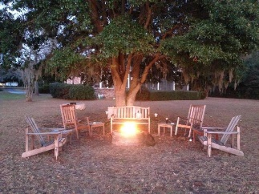
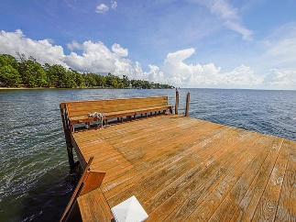
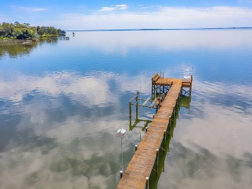
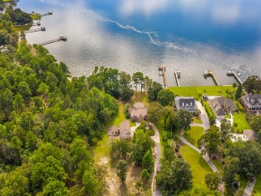
113 Porcher Drive Pooshee | Bonneau, SC 29431 MLS# 20024717 | $797,000
Where time stands still...
One of a kind and rarely available lakefront property with 90 feet waterfront access. This fantastic property has been owned by the same family for 4 generations and provided years of joy and sweet memories. Now is your time to relax and enjoy. Antique heart pine floor throughout and local Cyprus ceilings in living area. Enjoy the view from the expansive screened porch overlooking the lake. Needs TLC but a very rare opportunity. Additional detached apartment with one bedroom, bath. and kitchen. Dock and boat lift are already in place. There is a separate detached guest house. More information and history available for serious inquires.
Be sure to check out the Slideshow and Matterport Tour!
Carolina Life Real Estate & Auctions LLC
314 E Main St
Monks corner, SC 29461
Edy Mimms 843-224-9507
mimms@sanddollarsc.com
Judy Ash 843-708-1781 judy@judyash.com

