Slide 1
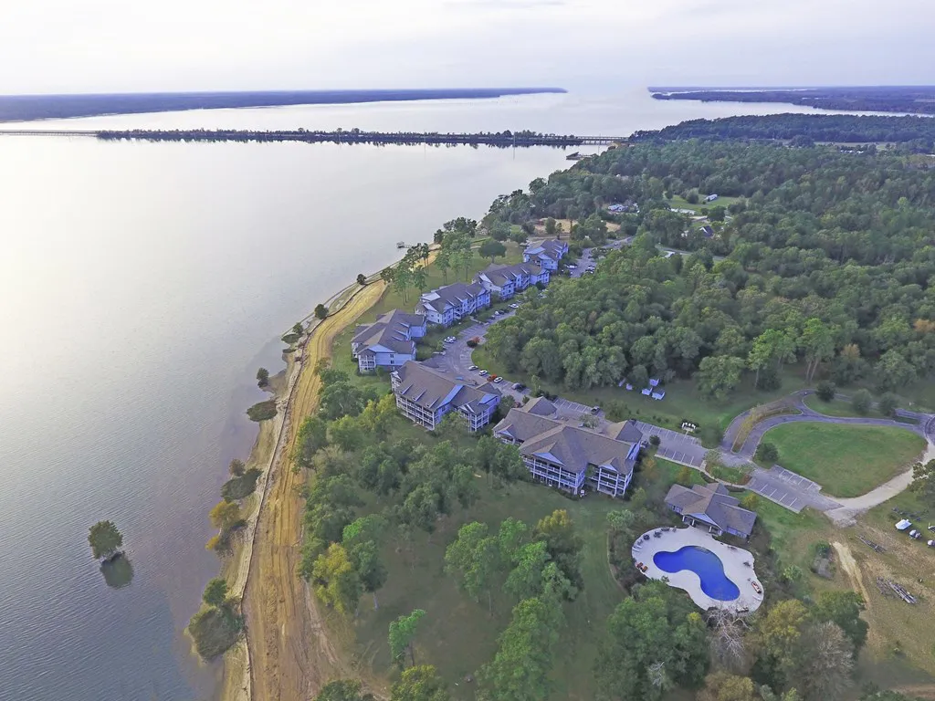
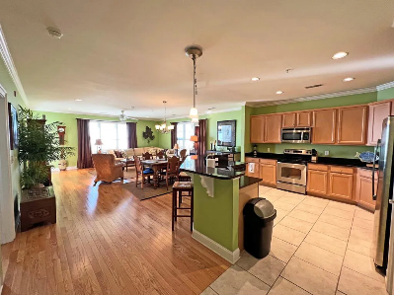
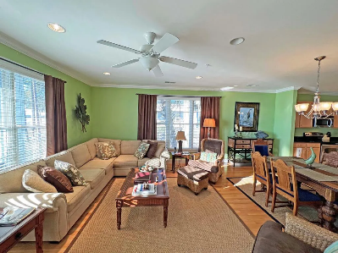
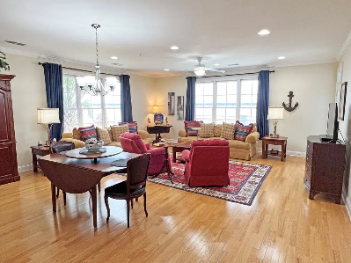
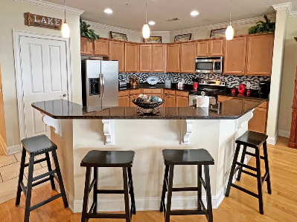
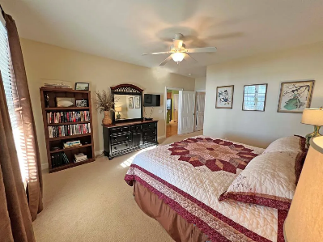
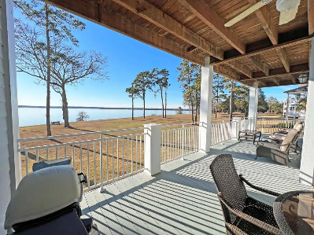
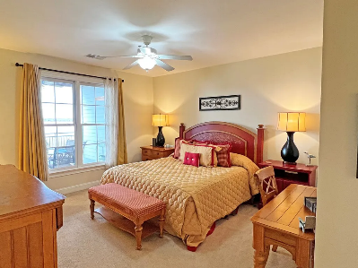
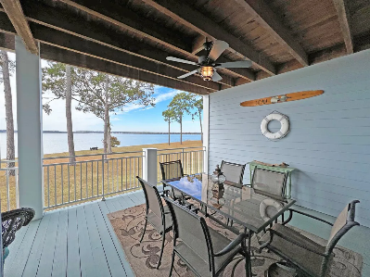

North Shore at Lake Marion Open Houses
Sunday 22nd at 2pm to 5pm
1140 Bridgeview Ln #C202
Summerton, SC 29148 | MLS# 155479 | $438,000
3 Beds | 3 Baths | 1,922 sqft
1142 Bridgeview Ln #203
Summerton, SC 29148 | MLS# 155810 | $449,000
3 Beds | 3 Baths | 1,922 sqft
Lake Homes Realty, LLC
Elloree, SC 29047
www.SCLakeLife.com
Kristie Anderson
(803) 387-9459
kristie@sclakelife.com

