Slide 1
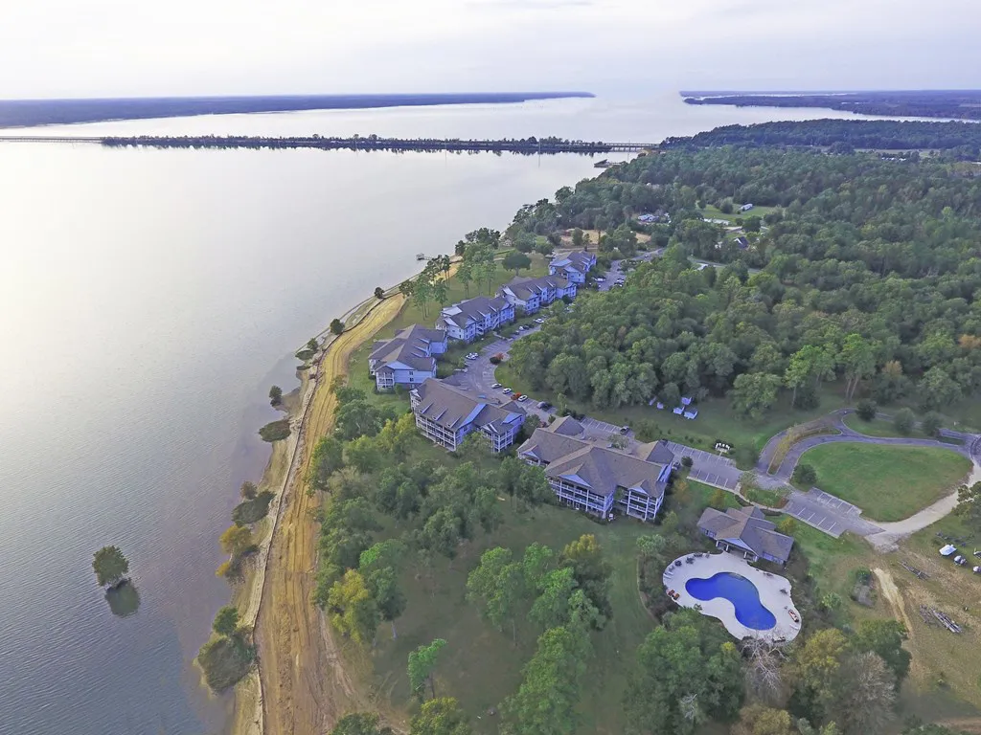
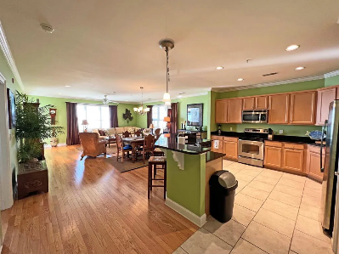
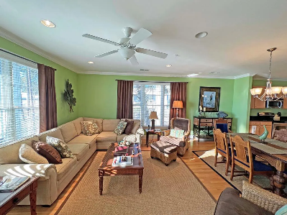
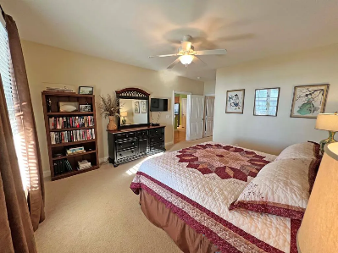
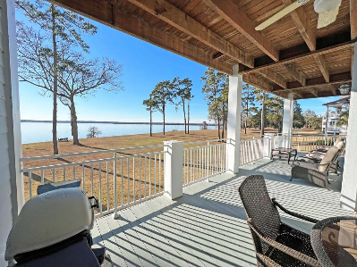

Waterfront Condo on Lake Marion
1140 Bridgeview Ln #C202
Summerton, SC 29148 | MLS# 155479 | $438,000
3 Beds | 3 Baths | 1,922 sqft
Waterfront on Lake Marion Luxury 3 bedroom Condo. This condo over looks the main body of the Lake. Watch the Sunset every night over the Lake. Condo comes mostly furnished along with appliances. It has a large living, dinning and kitchen combo to maximize the lake view from every spot in the condo. Enjoy a dip in the pool or a game of card in the clubhouse. A large green space to have with your best friend (2 legged or 4). The property has full time maintenance and property manager. This is easy access from and to I95 being only 2 mins from 102 exit. Only 1 hour to Charleston and Columbia. Florence is just under 1.5 hours on I95. Don't miss this condo! See it today! HOA Includes: Building, clubhouse, pool, seawall, & greenspace.
Lake Homes Realty, LLC
Elloree, SC 29047
www.SCLakeLife.com
Kristie Anderson
(803) 387-9459
kristie@sclakelife.com

