Slide 1
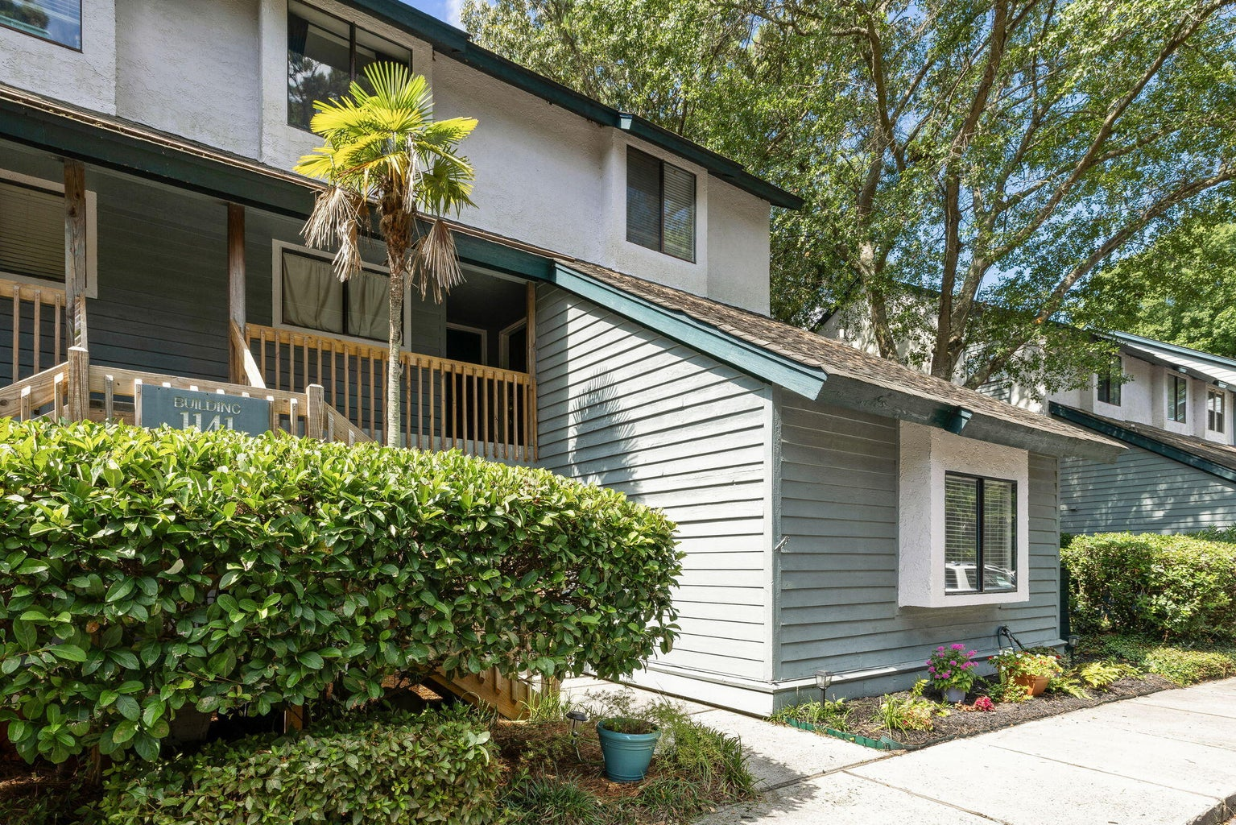
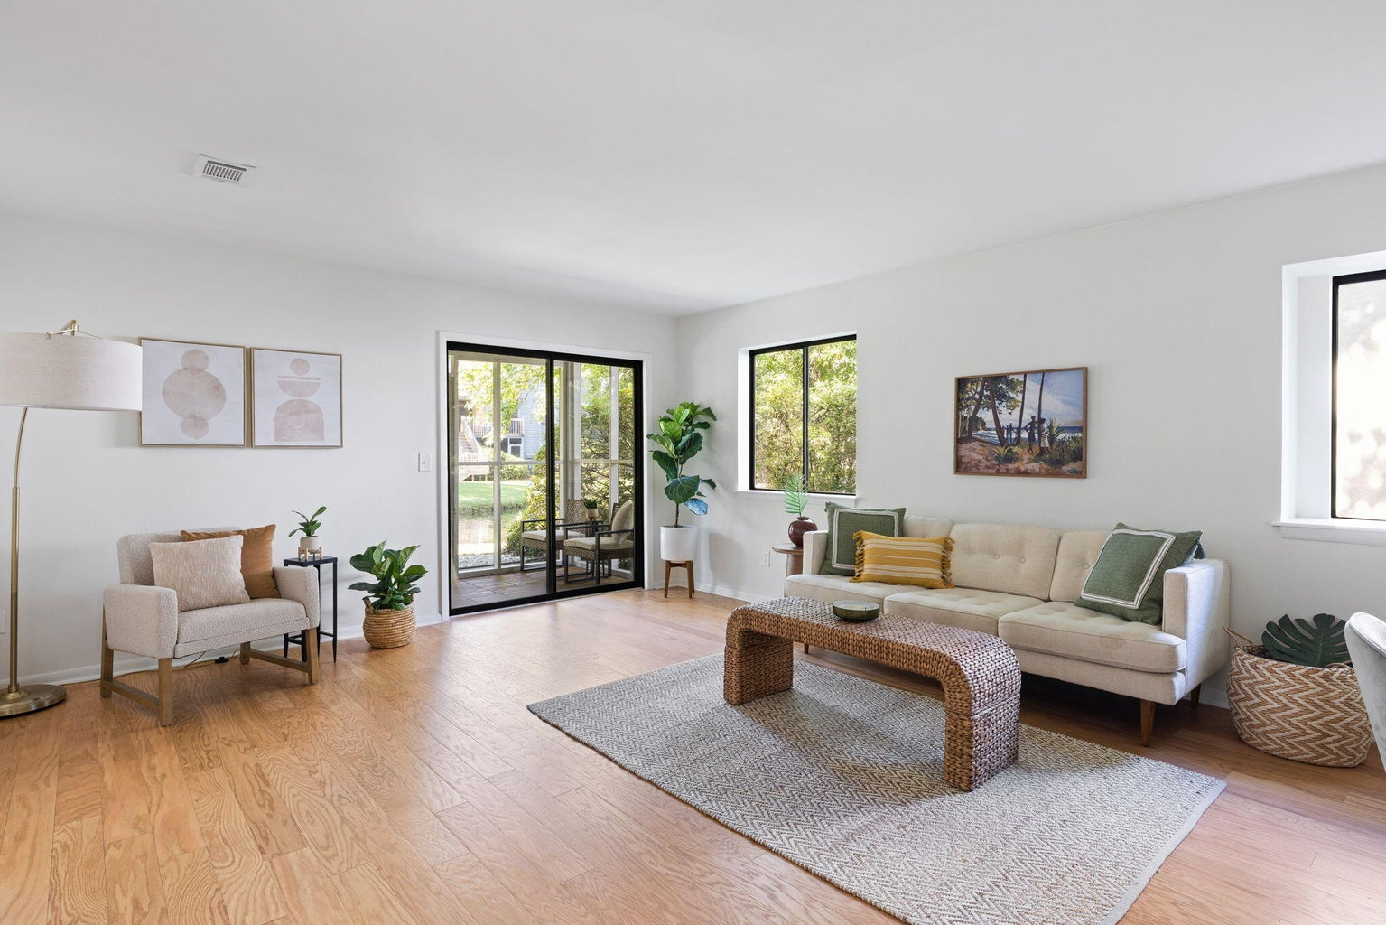
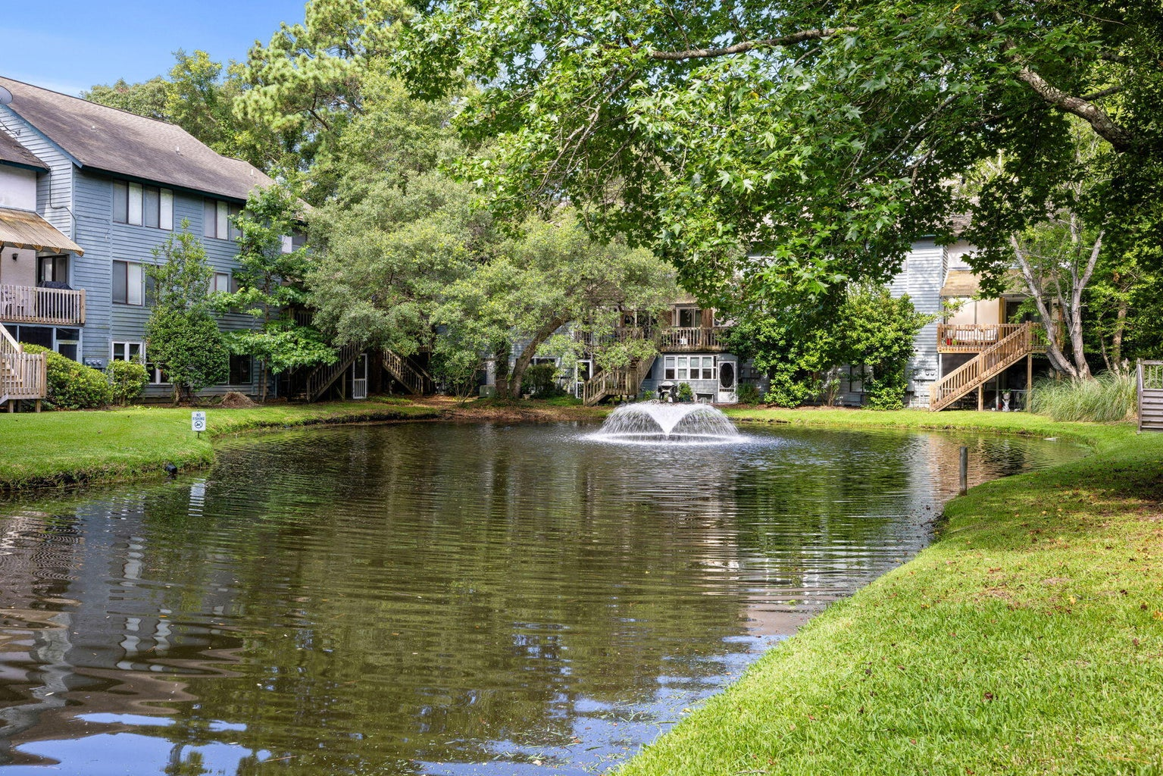
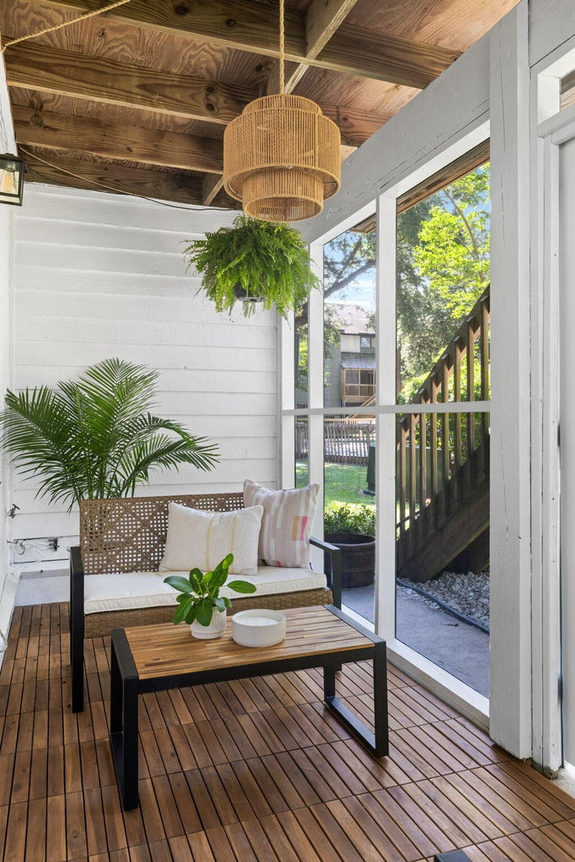
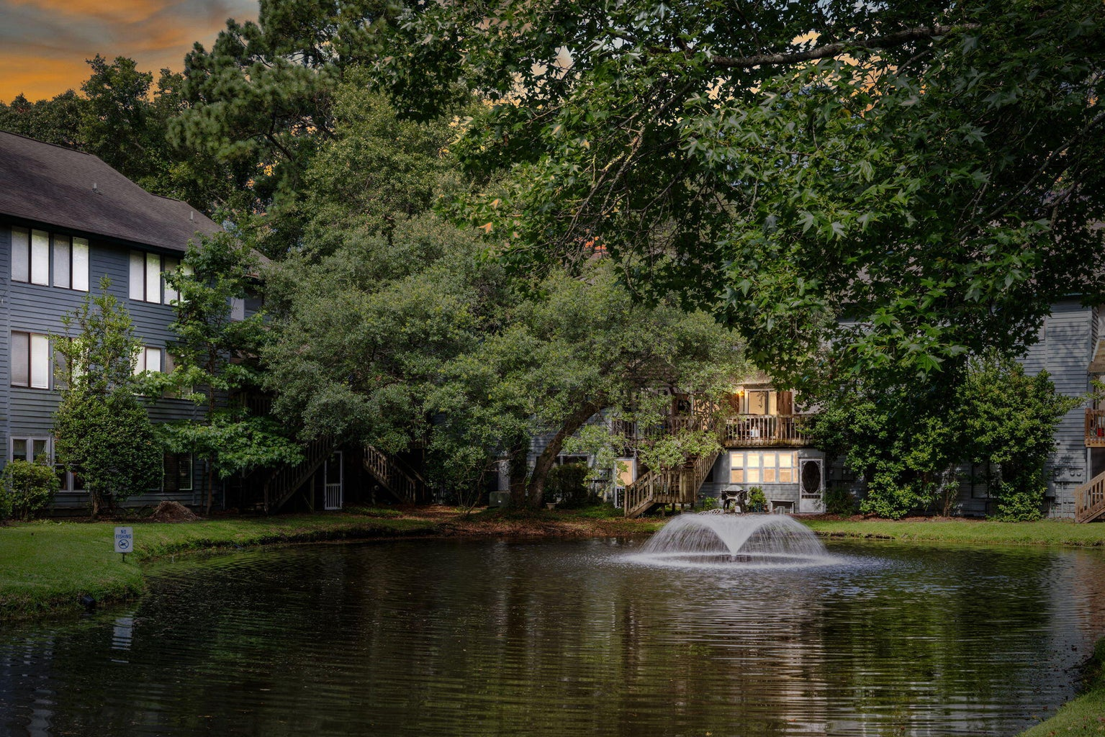
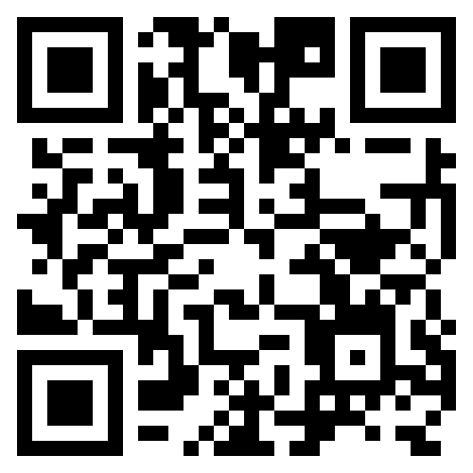


New Reduced Price $490,000
1141 Shadow Lake Circle J
Snee Farm
Mount Pleasant, SC 29464
MLS# 24016909 | $490,000
Video Tour
Seller to pay for a 2/1 Buydown
Buyer will SAVE BIG with this opportunity!
PURCHASE PRICE: $490,000
Year 1 payment $2074.58 | Savings $500.58 each month
Year 2 payment $2318.83 | Savings $256.33 each month
Year 3 payment and beyond is $2575.16 each month
if not refinanced…
This is a beautiful 3 bedroom 3 full bath condo offering ONE LEVEL LIVING in one of Mt. Pleasant’s most coveted neighborhoods- Snee Farm Lakes! This 1500+ sf END UNIT condo lives large and has beautiful updates throughout. In addition to engineered oak floors throughout and brand new carpet in the two guest bedrooms, all three baths have been fully remodeled to include beautiful tiled showers and updated vanities and lighting. Your clients will love the screened porch overlooking the pond and fountain. This is a turn key property and at this price in this location it is sure to sell fast!!!
Schedule tours through Showing Time and call Ellen O’Neil with Questions: 843-300-8530
VIDEO TOUR
Ellen O'Neil
Broker/Owner, ABR, e-PRO, CNE
Charleston Realtor of Distinction
(843) 300-8530
www.EllenONeilProperties.com

